Slide 1
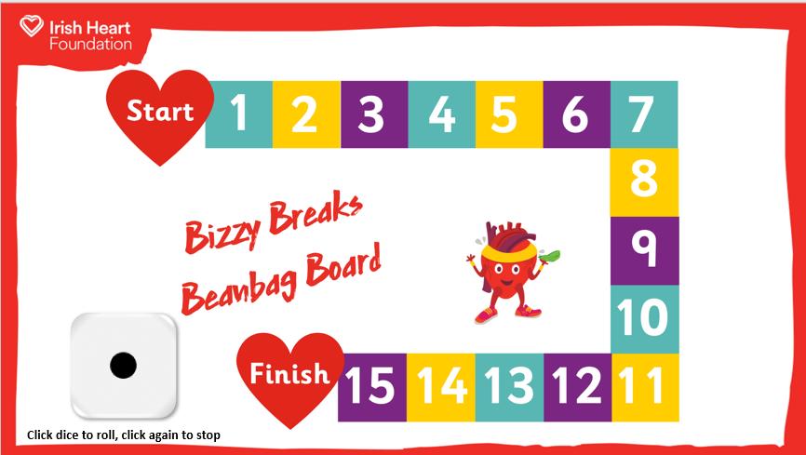
How to play
1) Each pupil will need to have one beanbag to play.
2) Start the slideshow.
You can choose to roll a dice, or to make your way through each square one by one.
If using a dice: Click the dice on the board to roll, click it again to stop. (You could also use a real dice.)
3) Count across the number of squares from the number on the dice.
4) Use the mouse to click on the square you land on. A card will pop up with a movement for pupils to do with their beanbags.
5) When the class have done the beanbag movement, click on the X on the card to return to the board.
6) Roll again and/or move to next square.
7) When you reach the Finish, click on the heart.

Slide 2
Click dice to roll, click again to stop

Slide 3
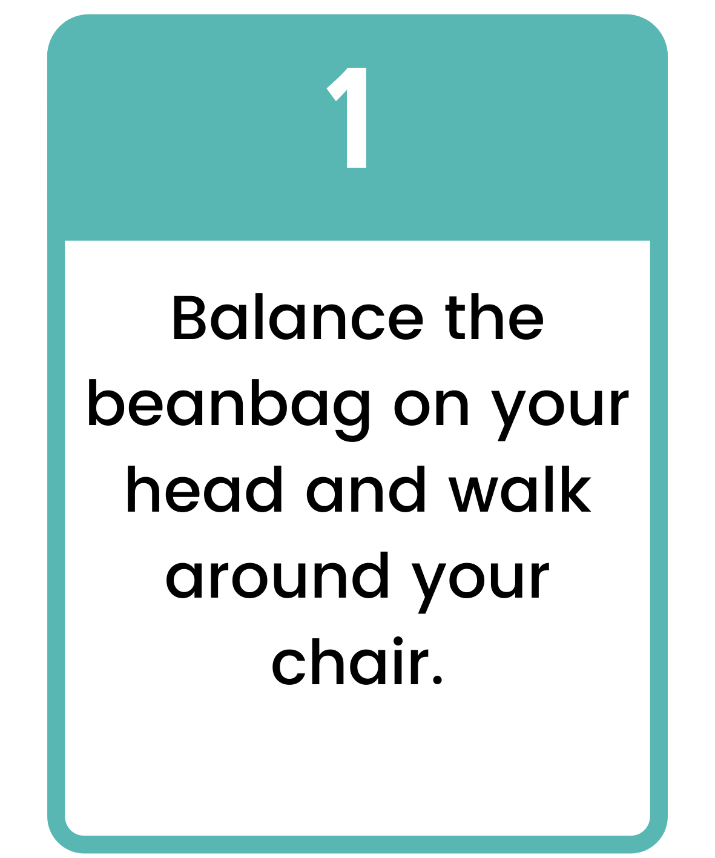
Click to return
to board

Slide 4
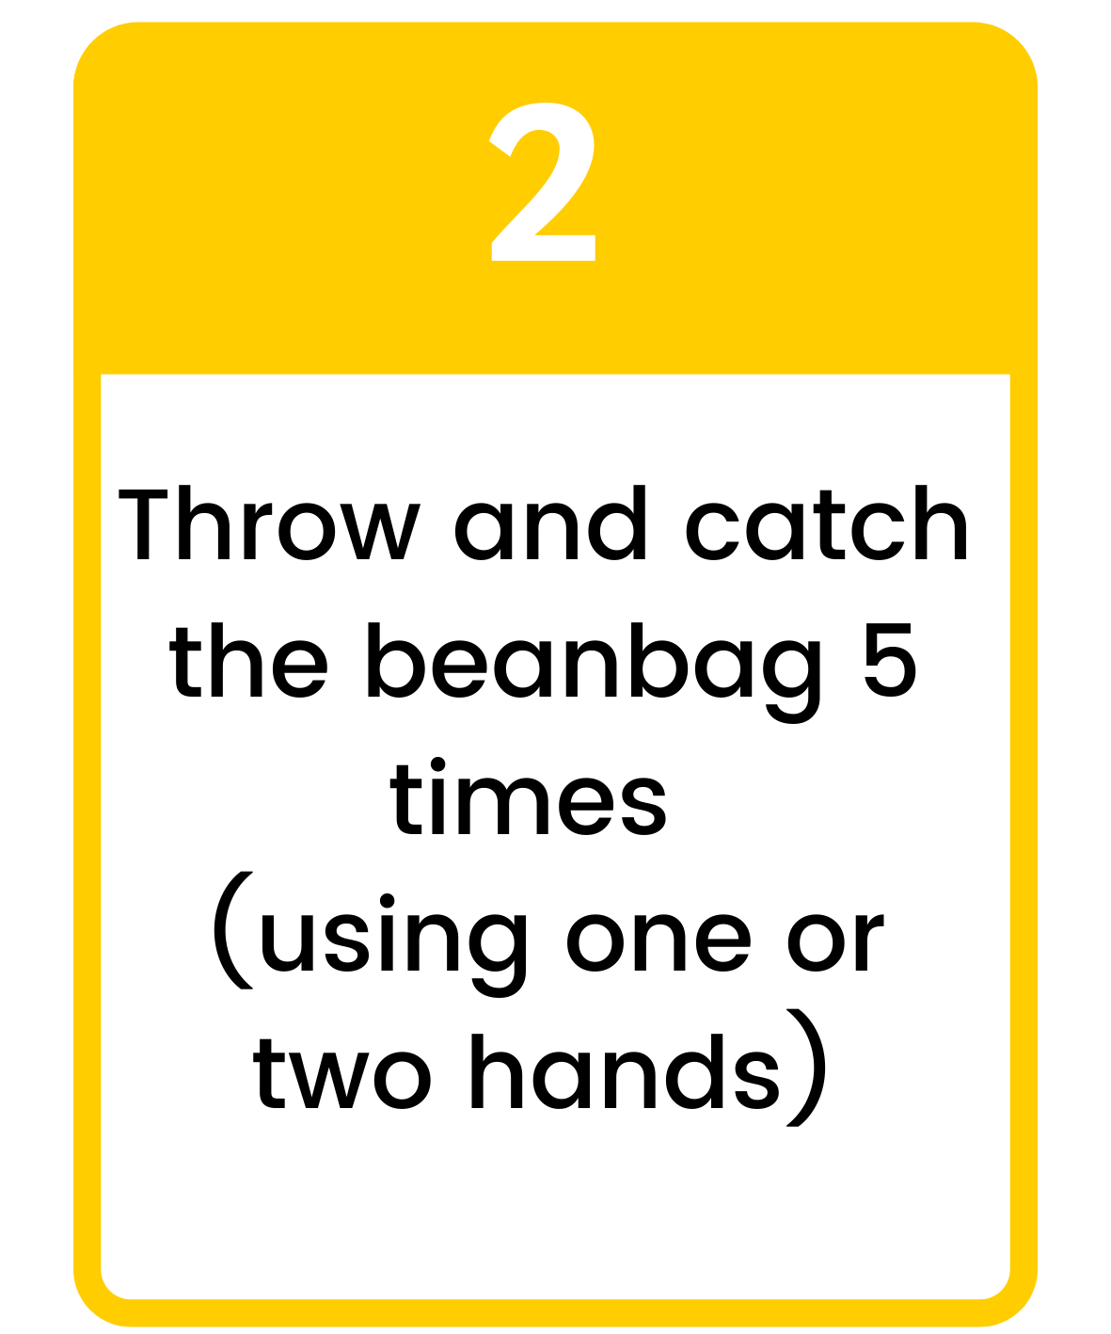
Click to return
to board

Slide 5
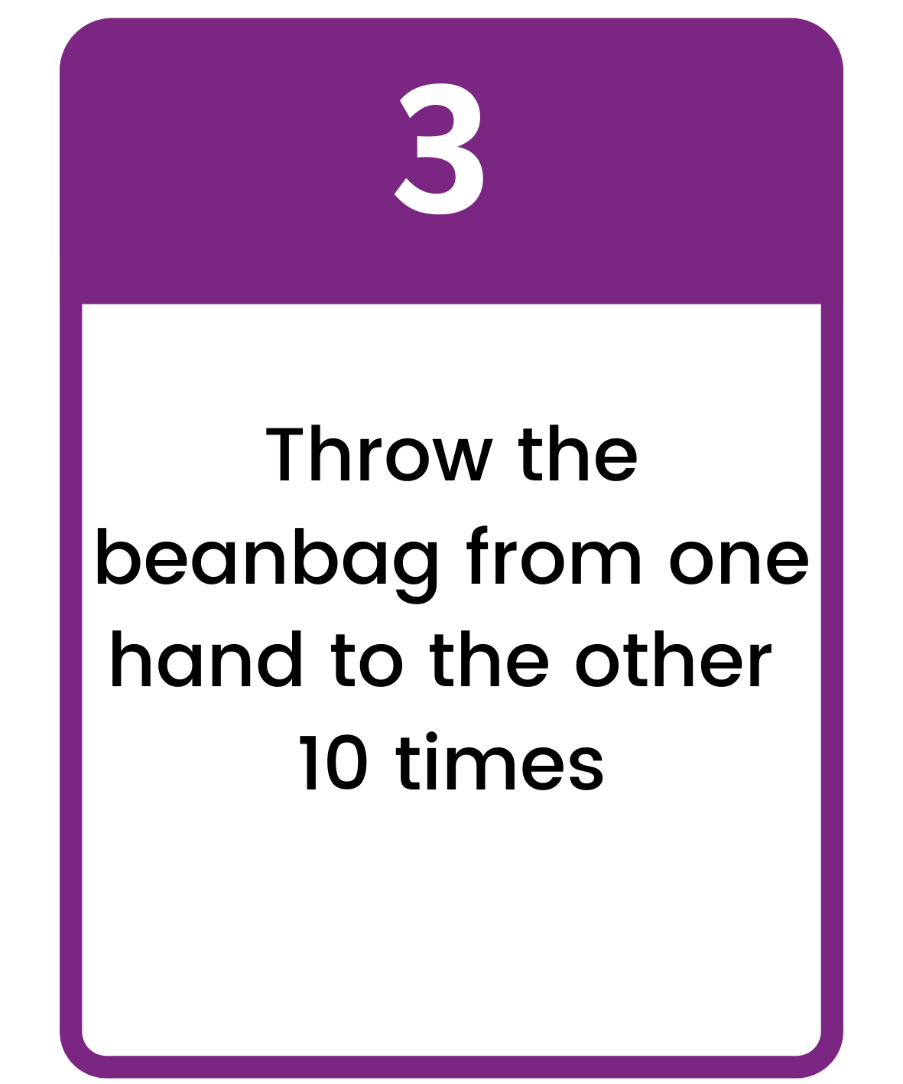
Click to return
to board

Slide 6
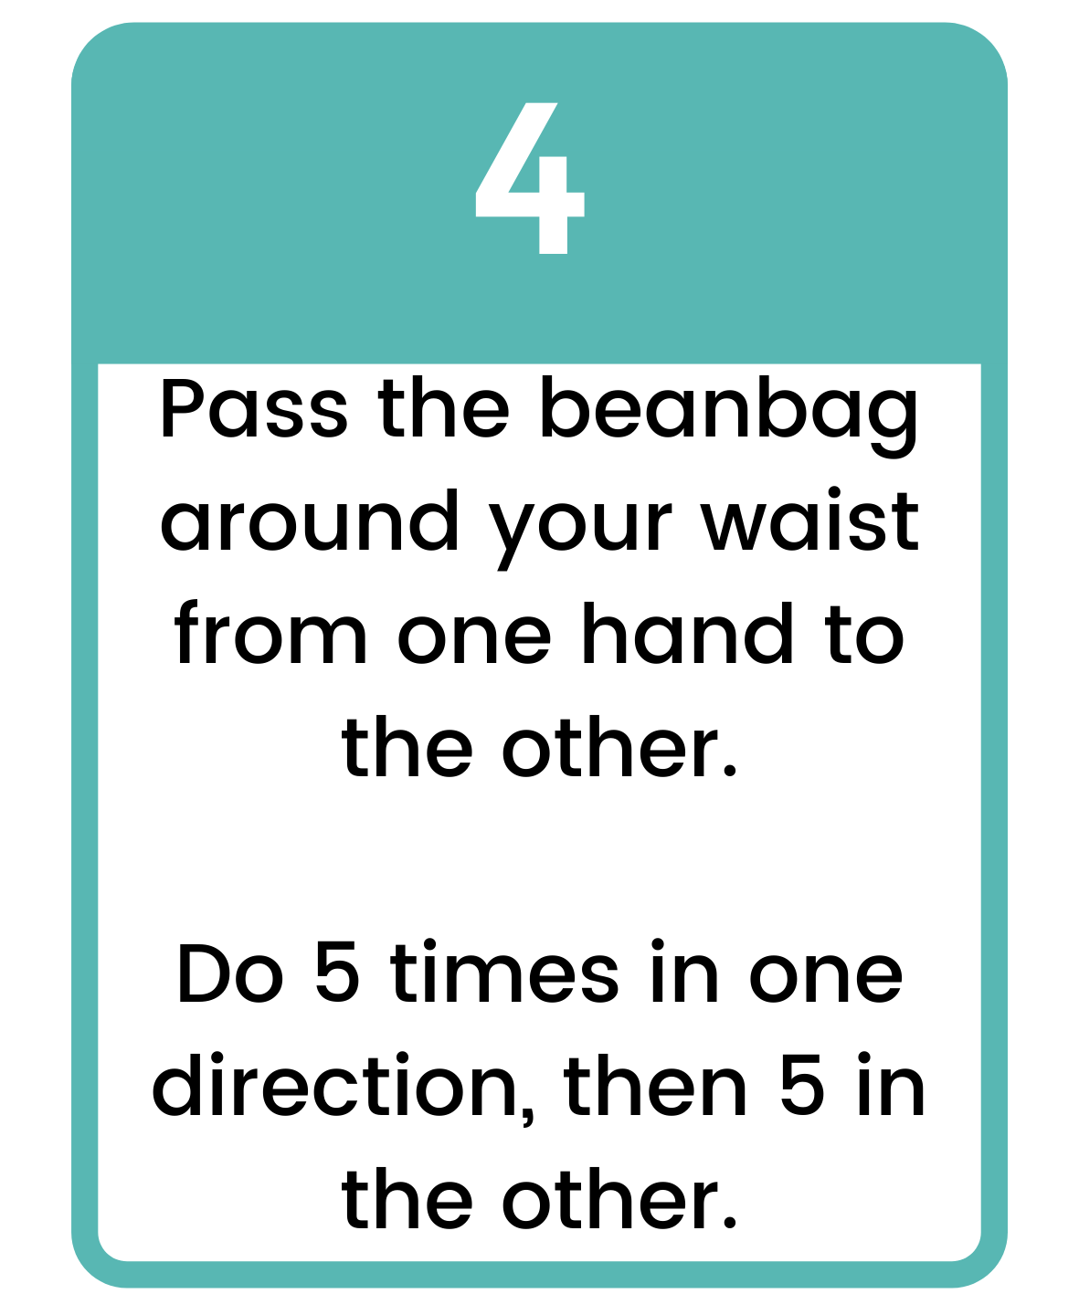
Click to return
to board

Slide 7
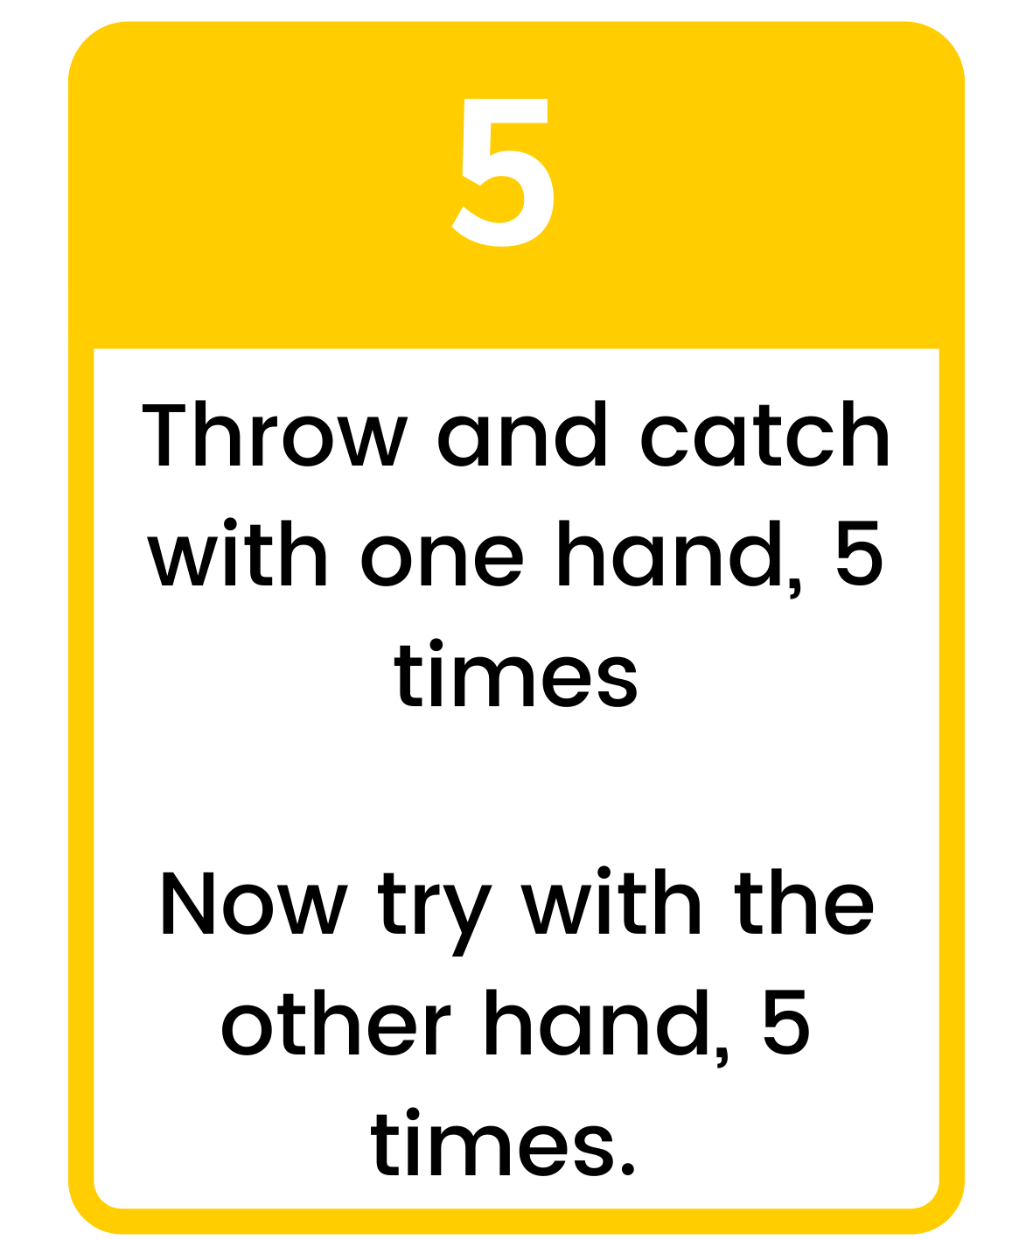
Click to return
to board

Slide 8
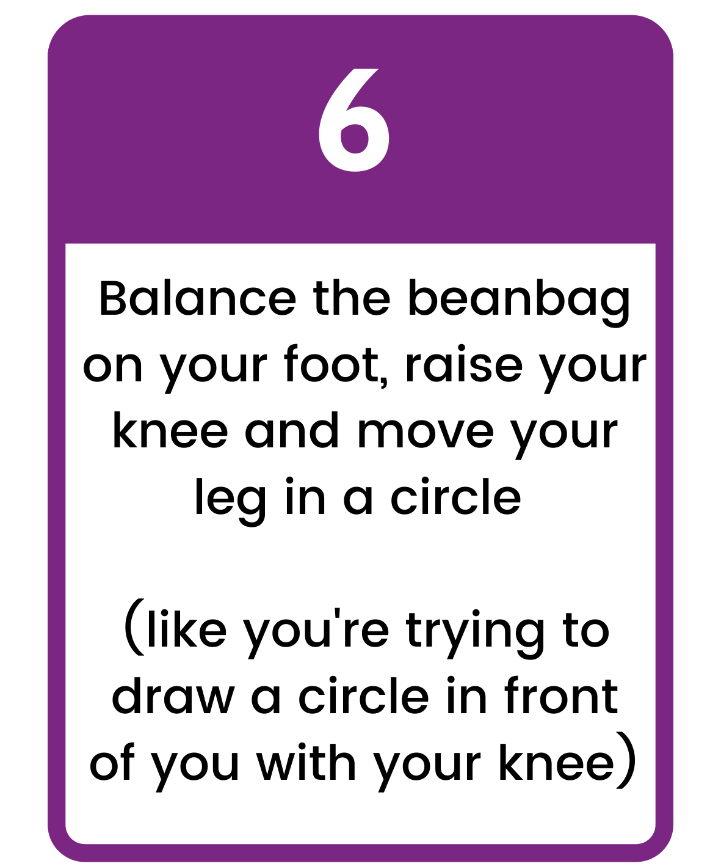
Click to return
to board

Slide 9
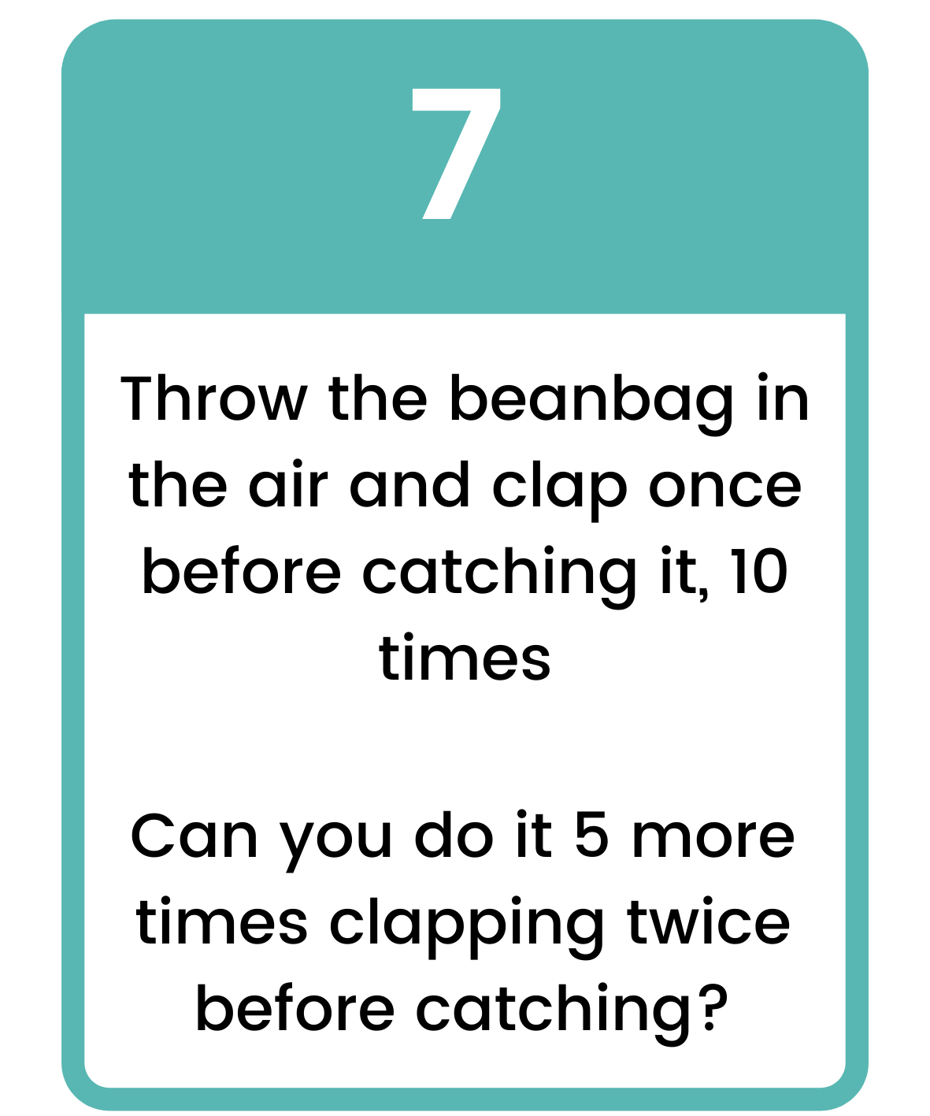
Click to return
to board

Slide 10
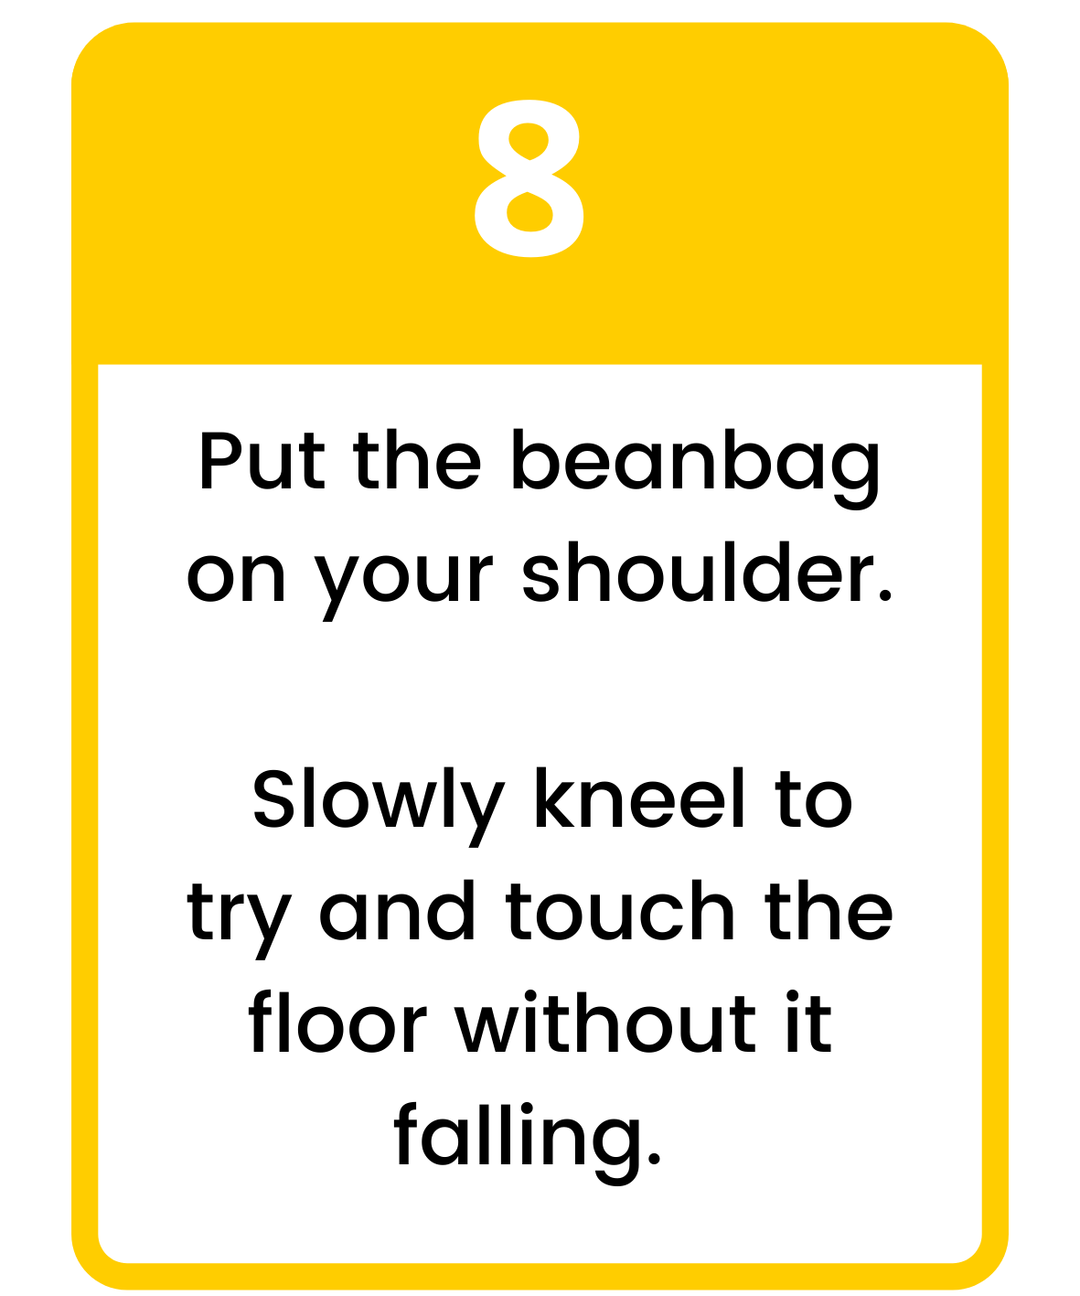
Click to return
to board

Slide 11
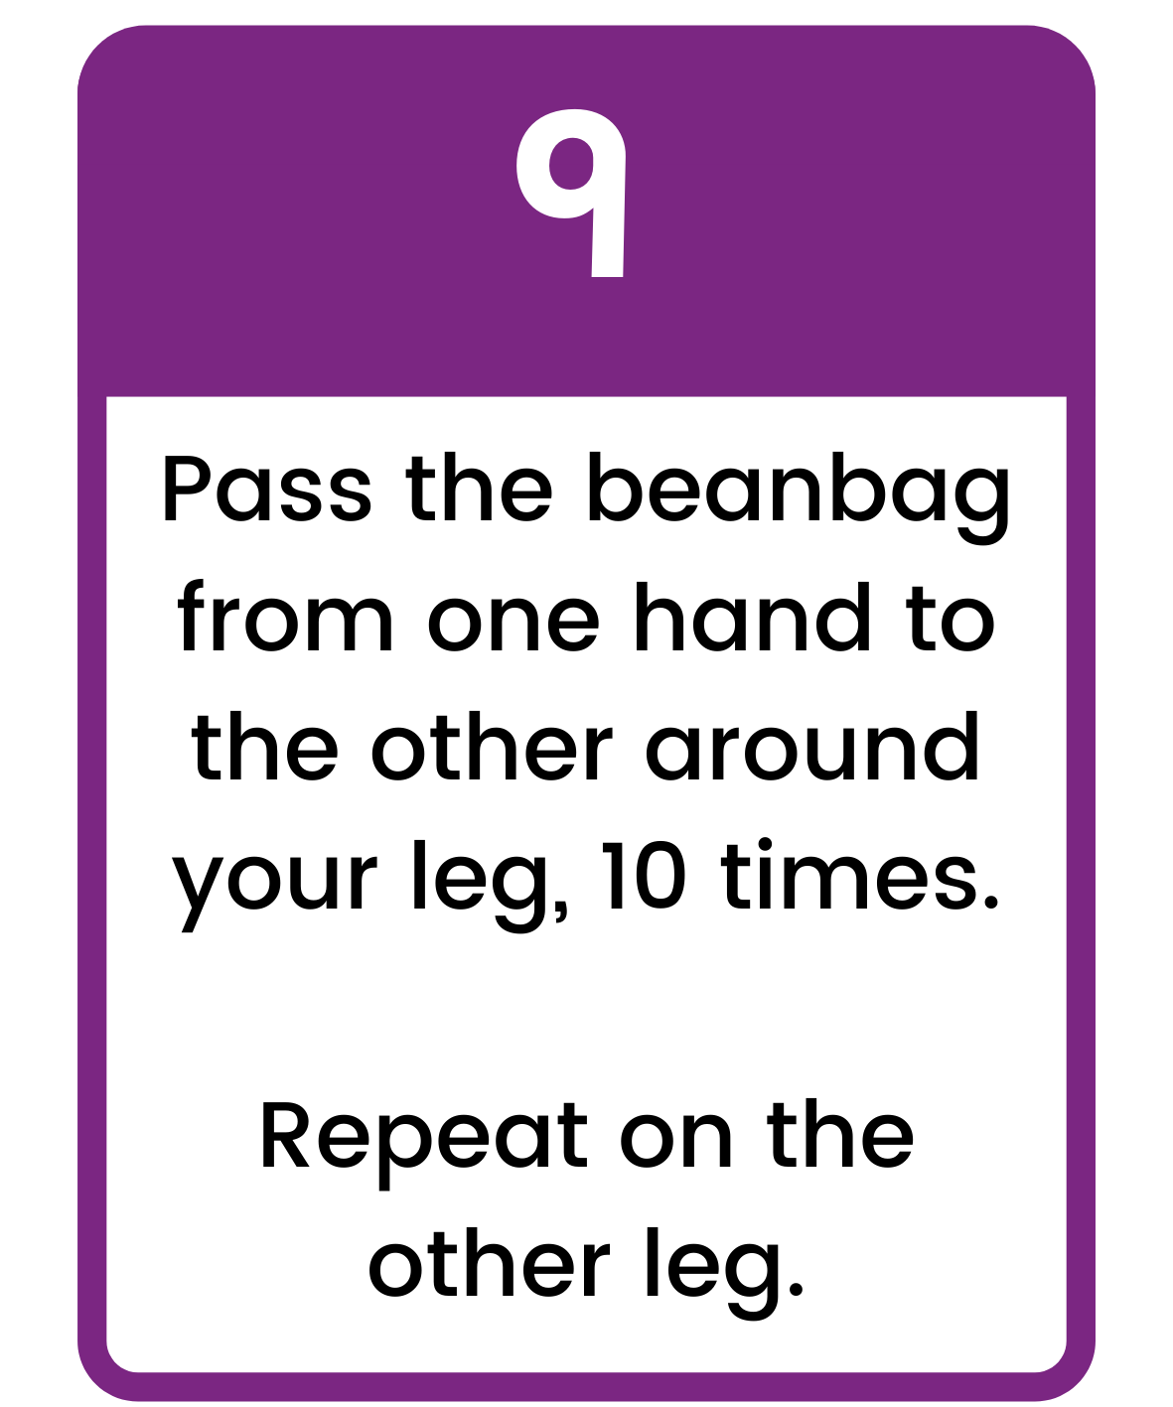
Click to return
to board

Slide 12
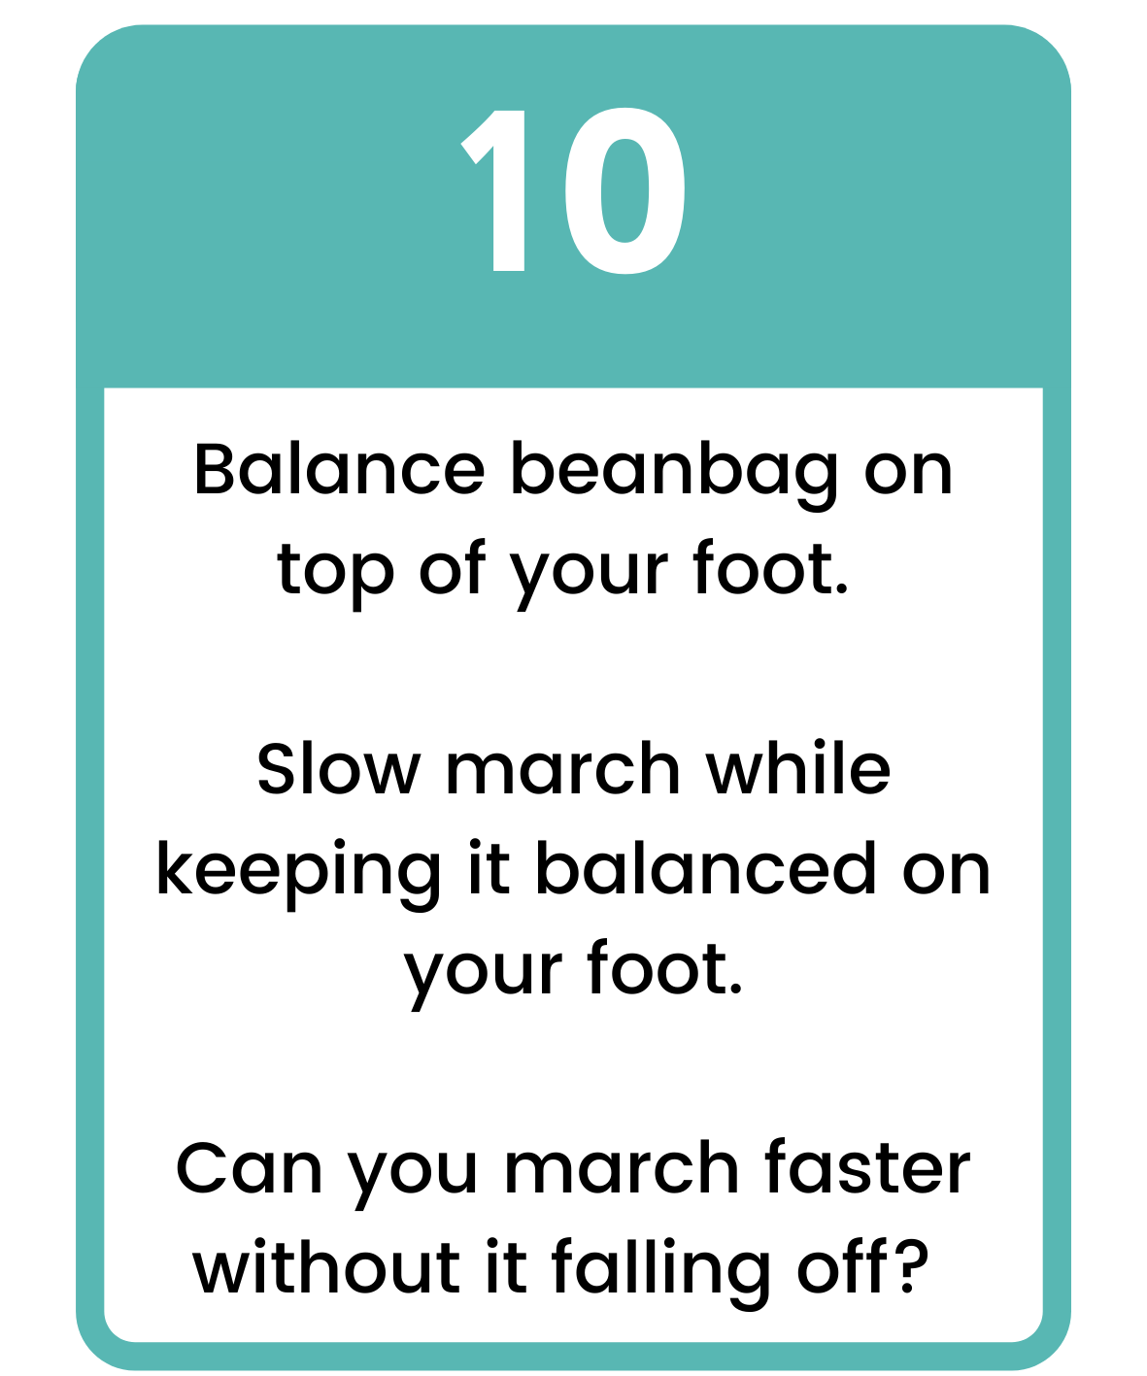
Click to return
to board

Slide 13
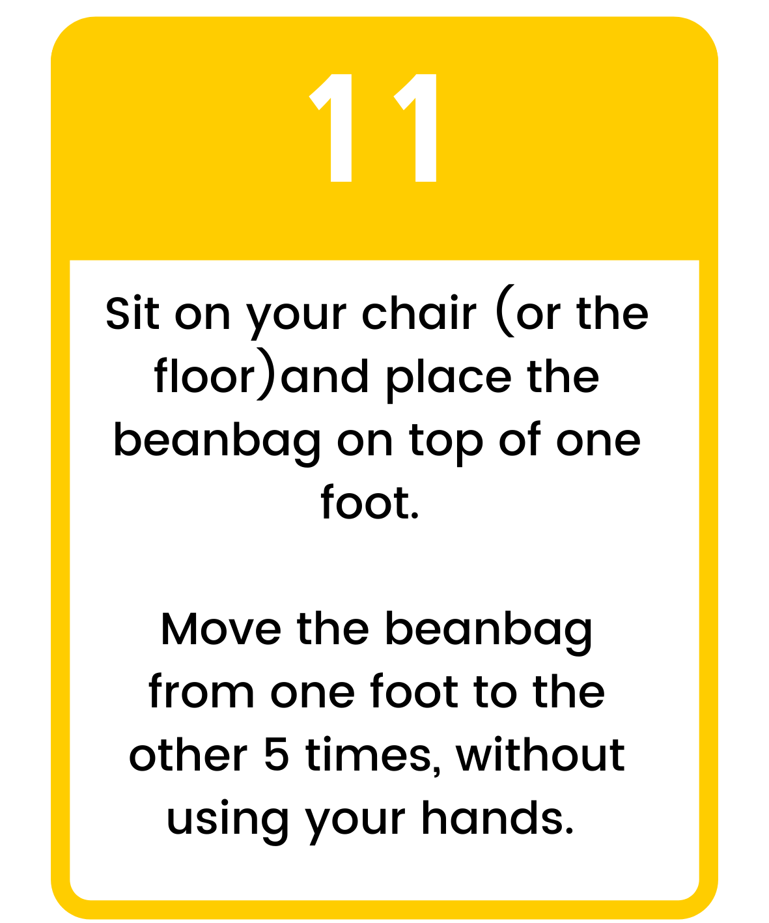
Click to return
to board

Slide 14
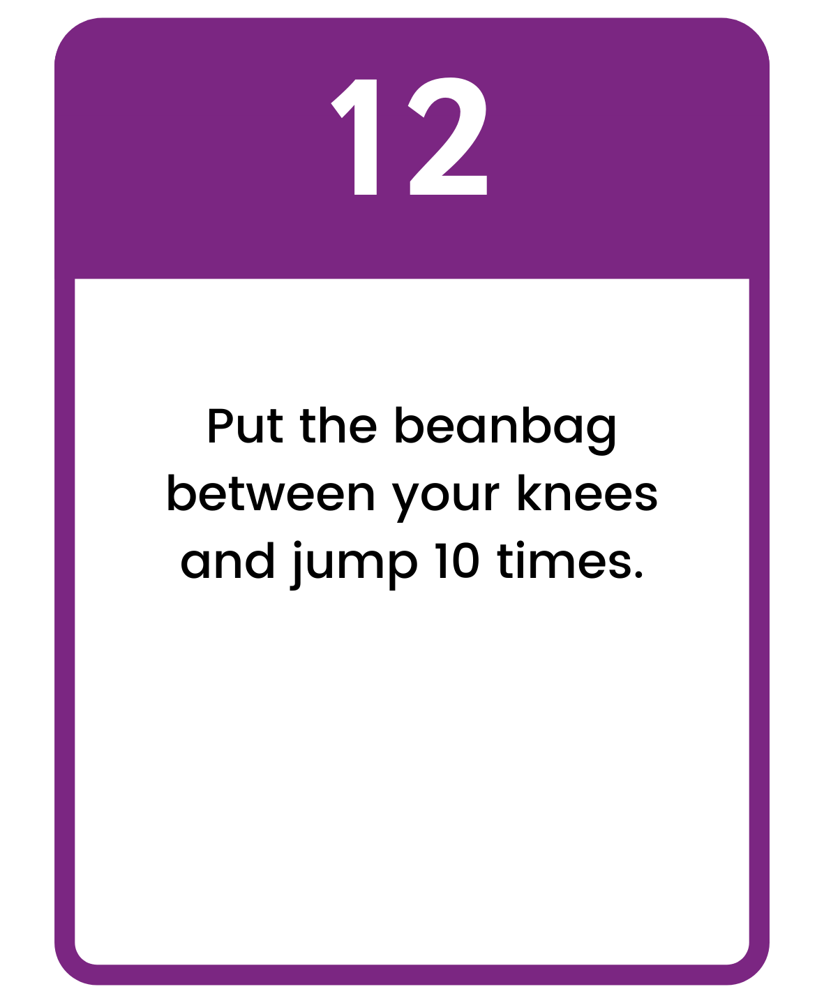
Click to return
to board

Slide 15
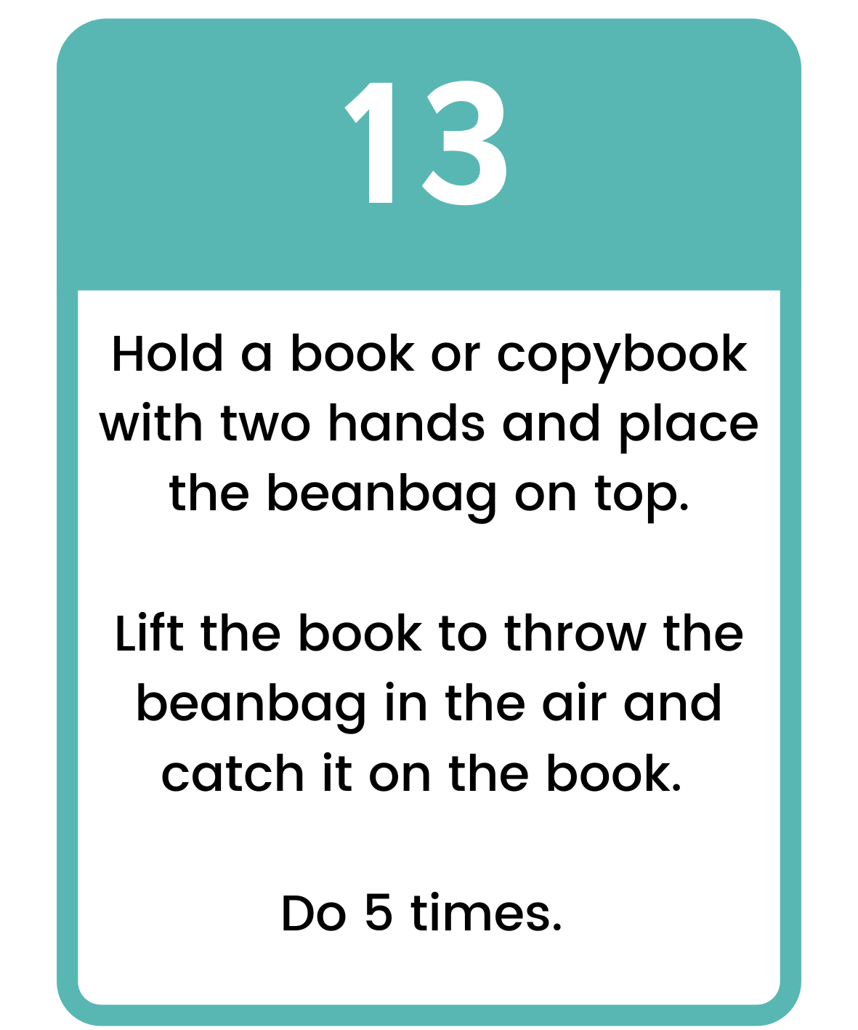
Click to return
to board

Slide 16
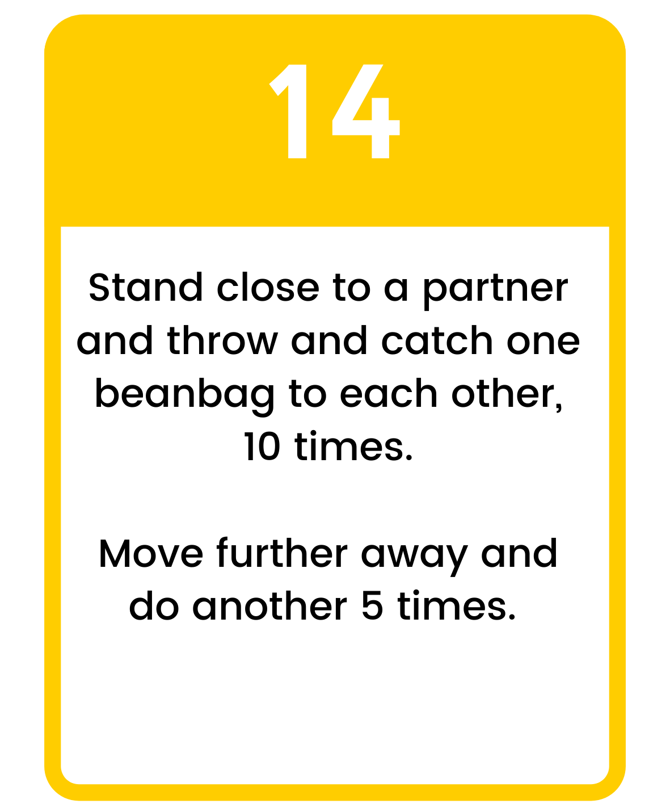
Click to return
to board

Slide 17
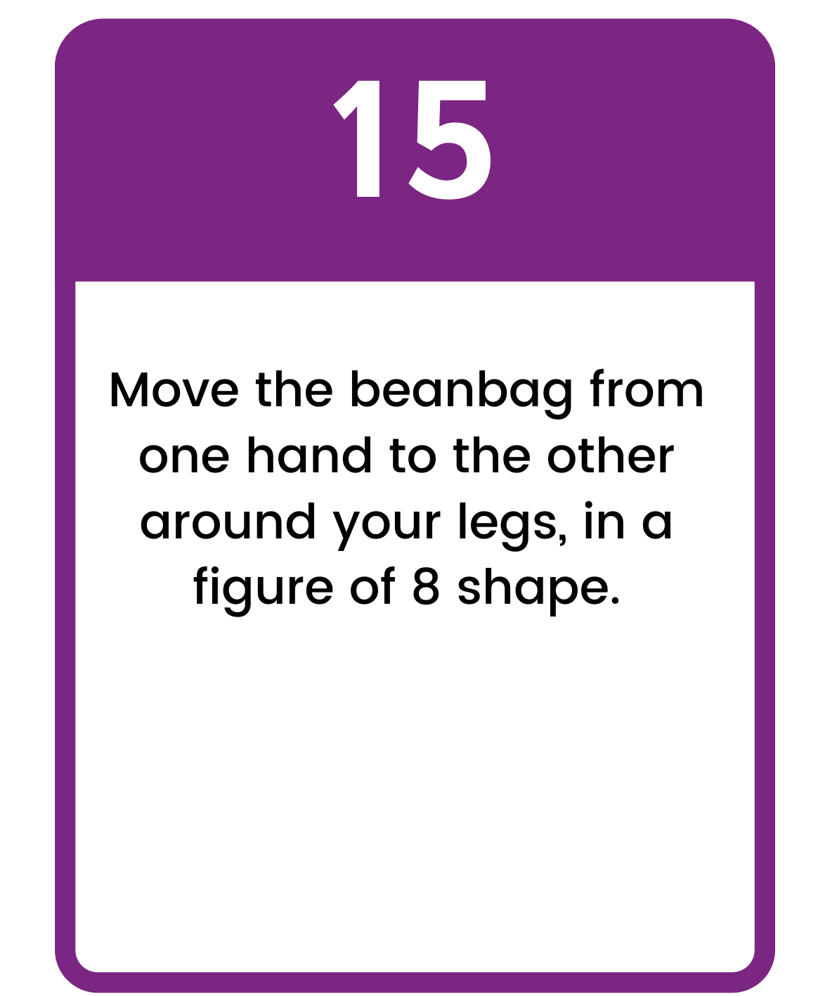
Click to return
to board

Slide 18
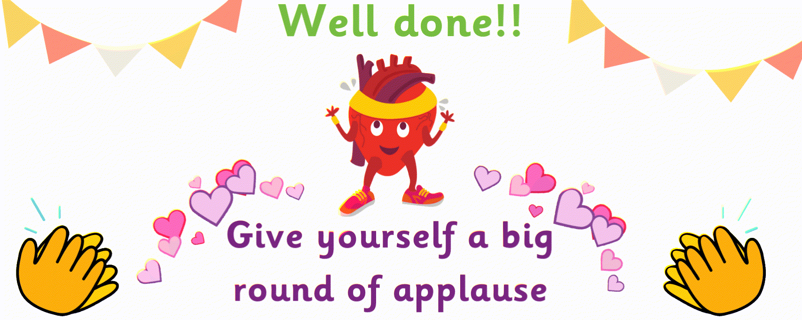
Click to play again

