Slide 1
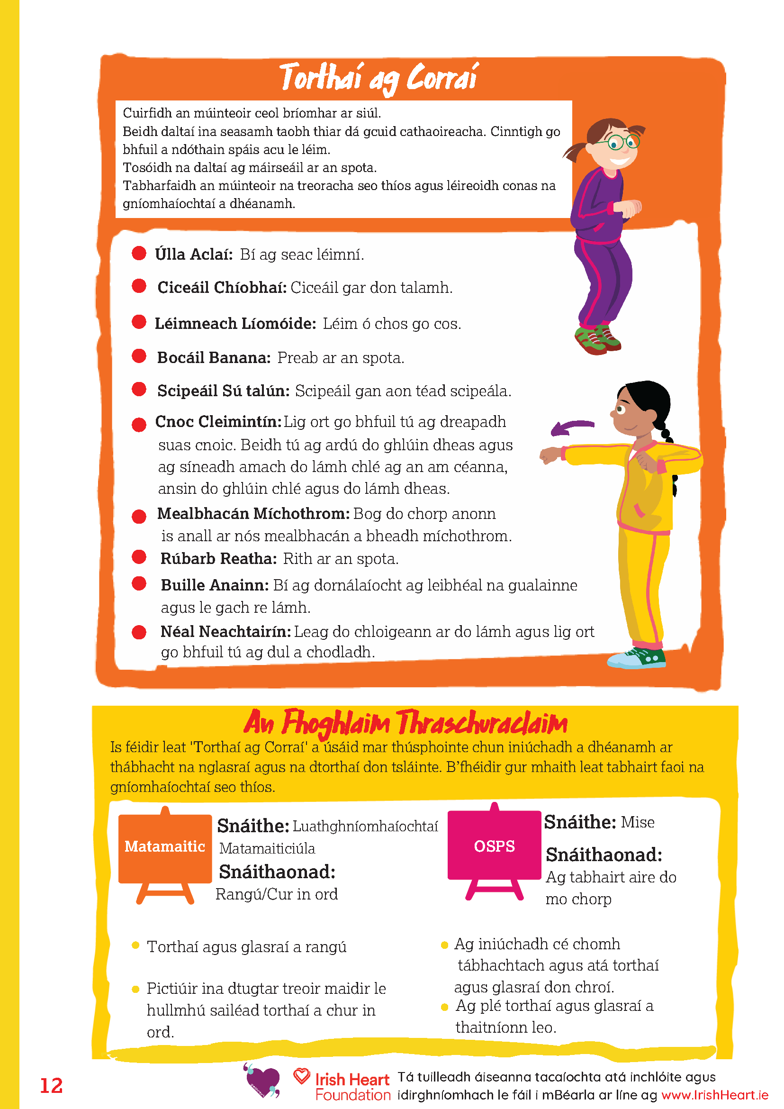
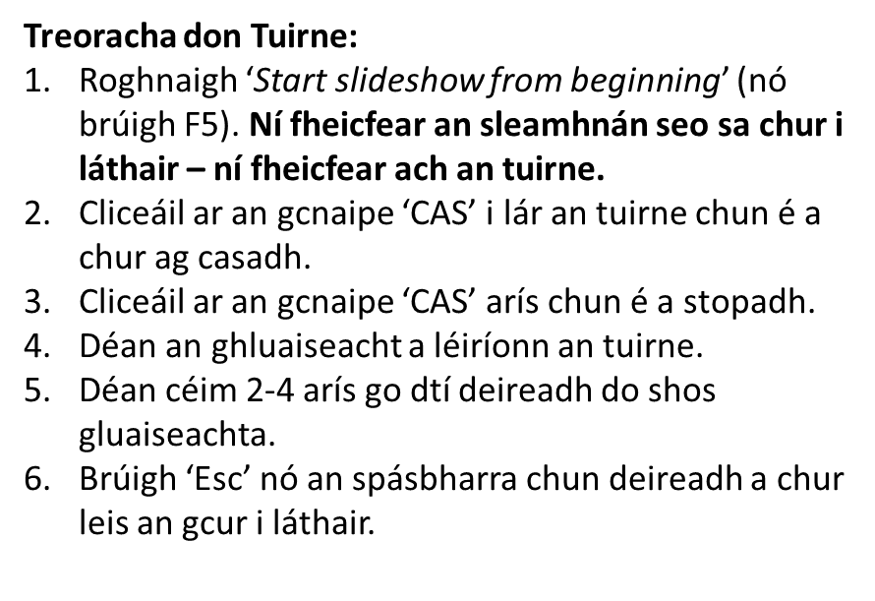
https://irishheart.ie/schools/primary-schools/bizzy-breaks/bizzy-as-gaeilge-sosanna-spleodracha/

Slide 2
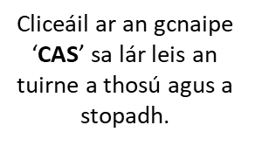
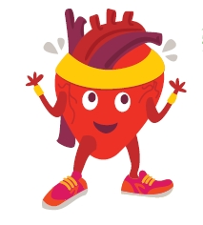
CAS

