Slide 1
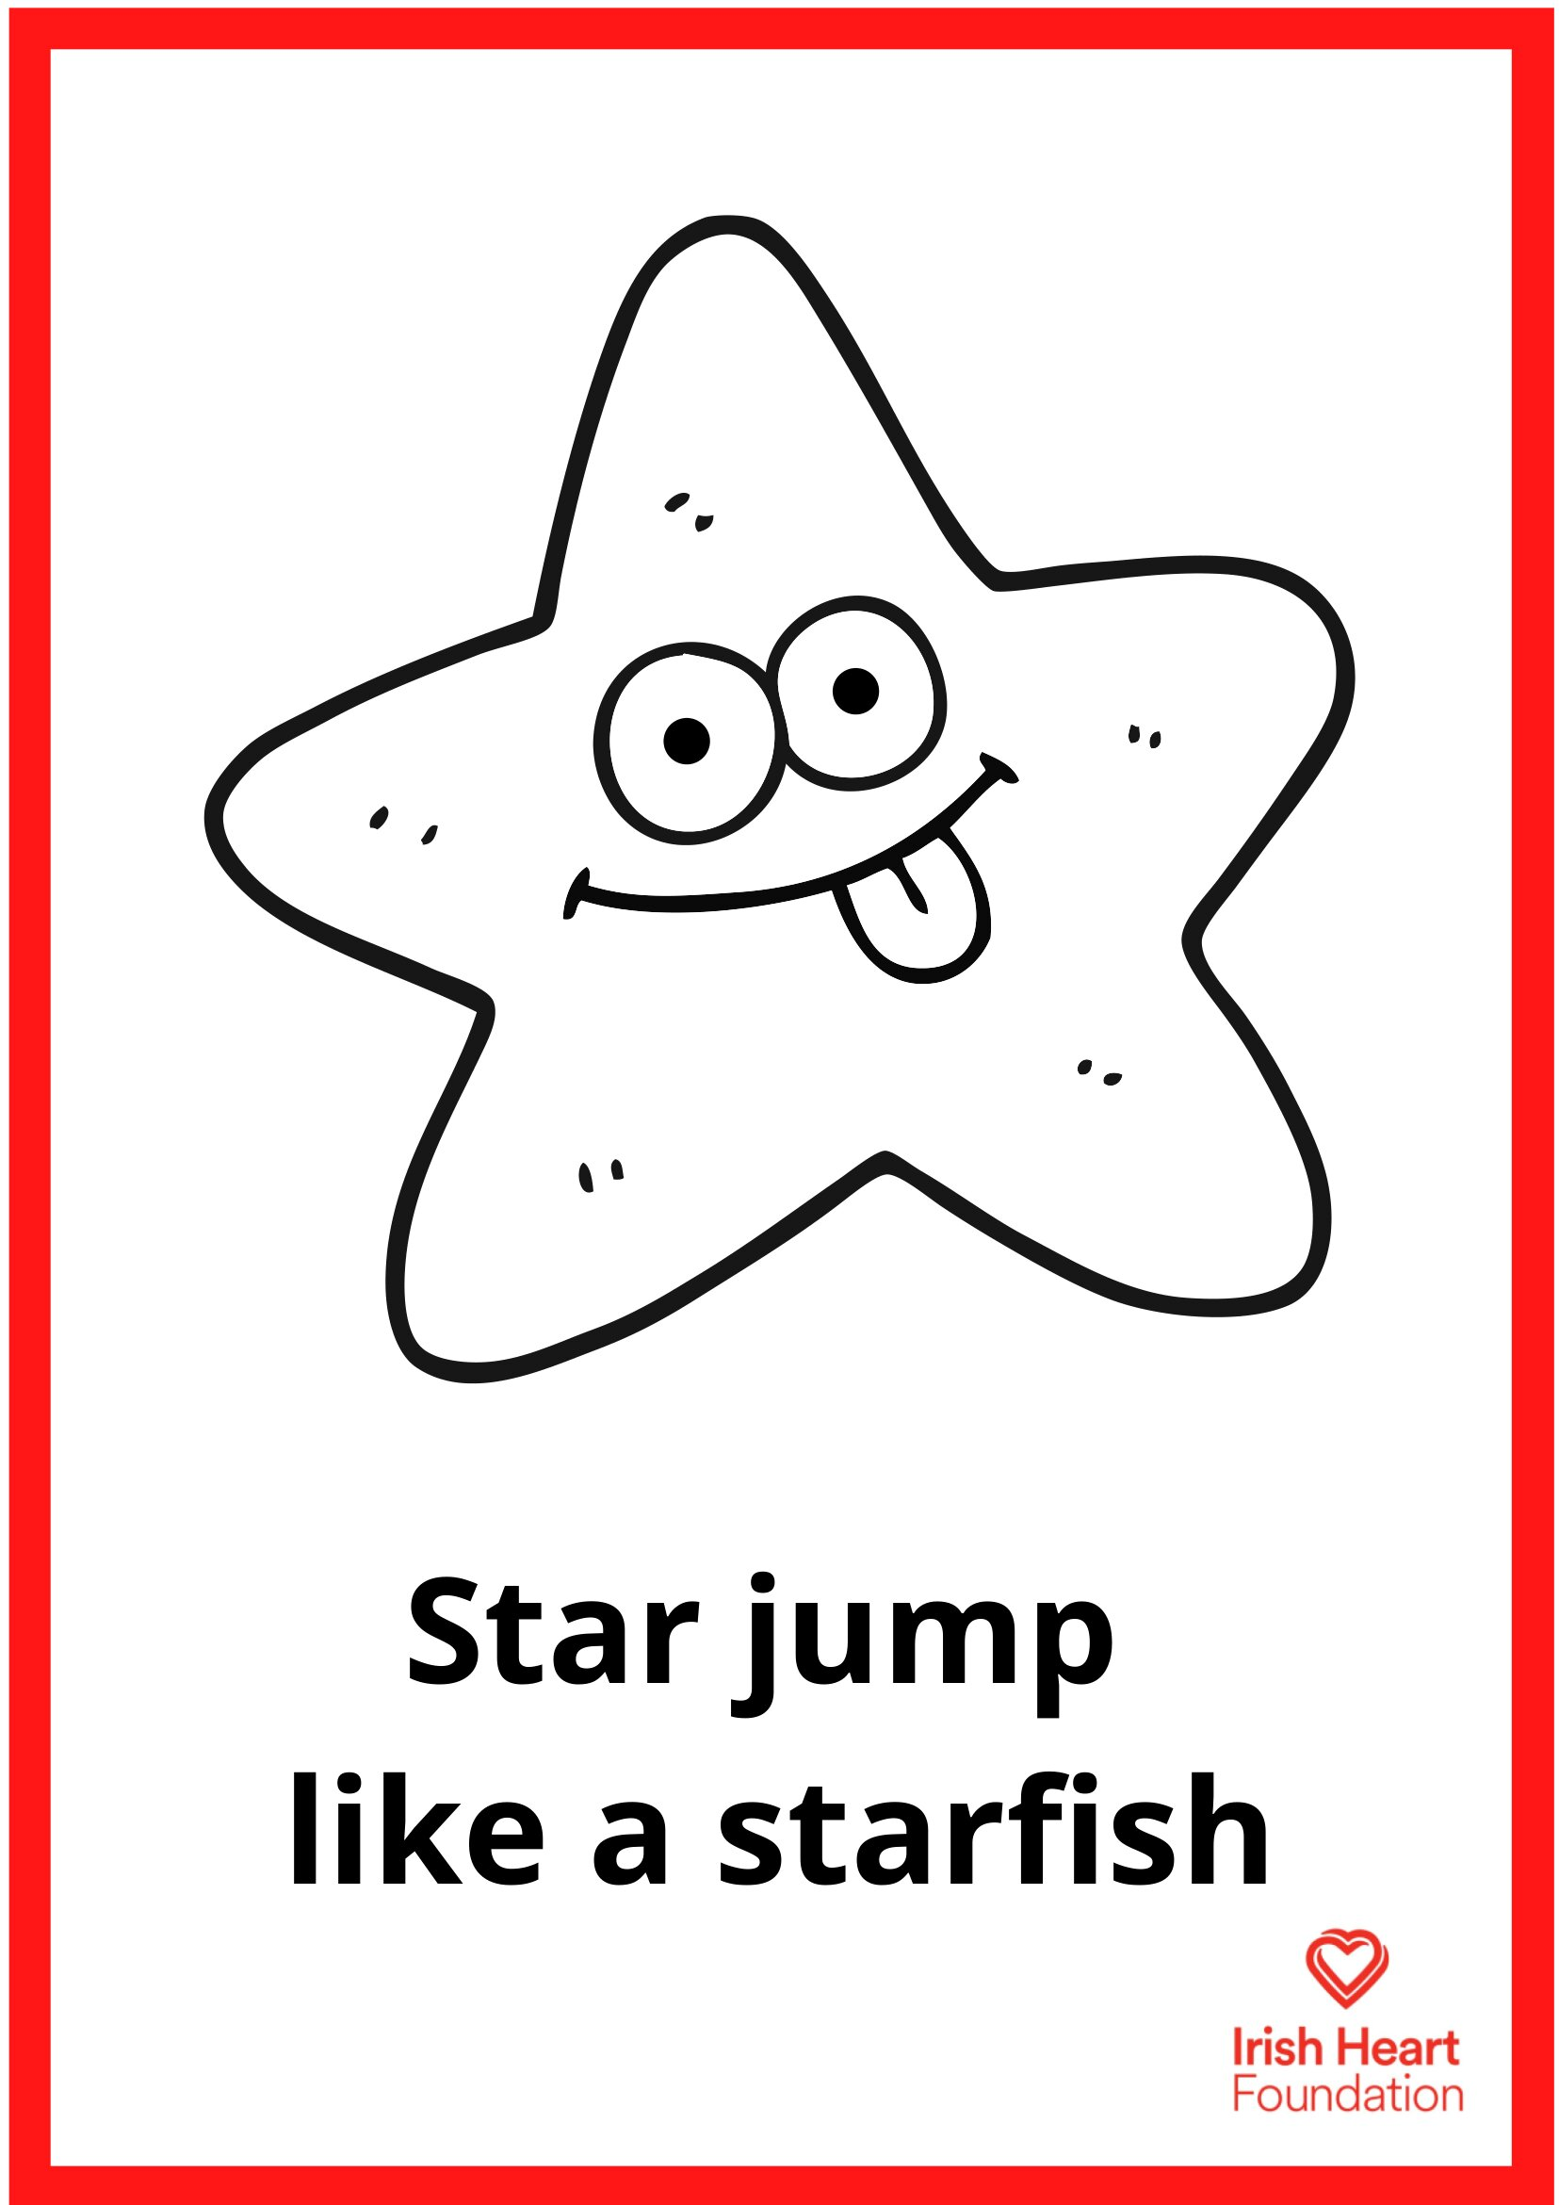
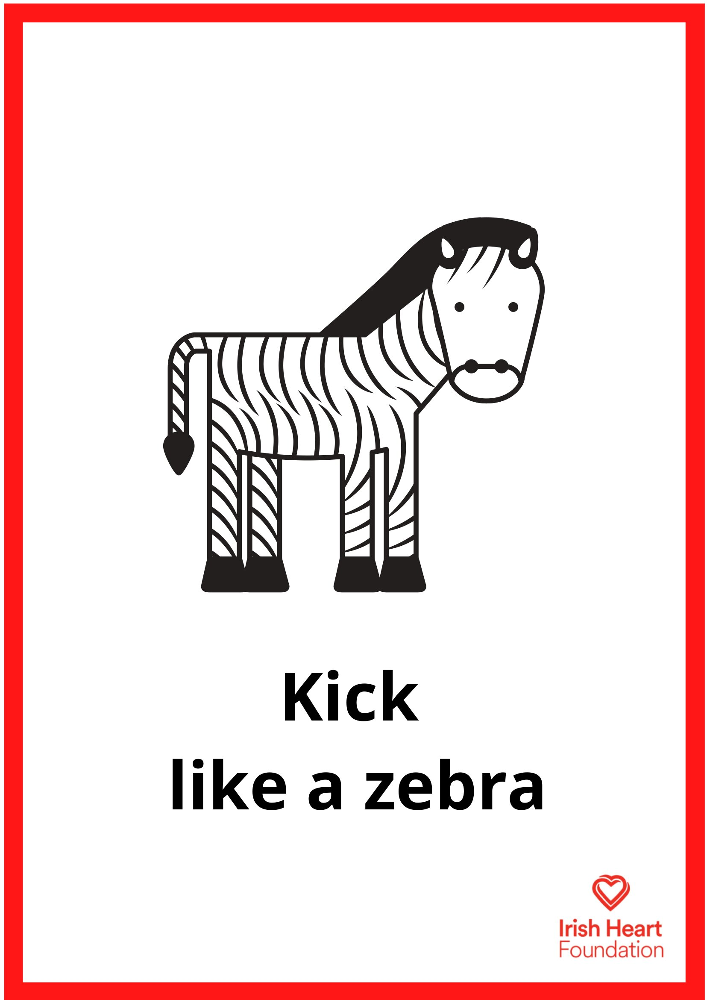
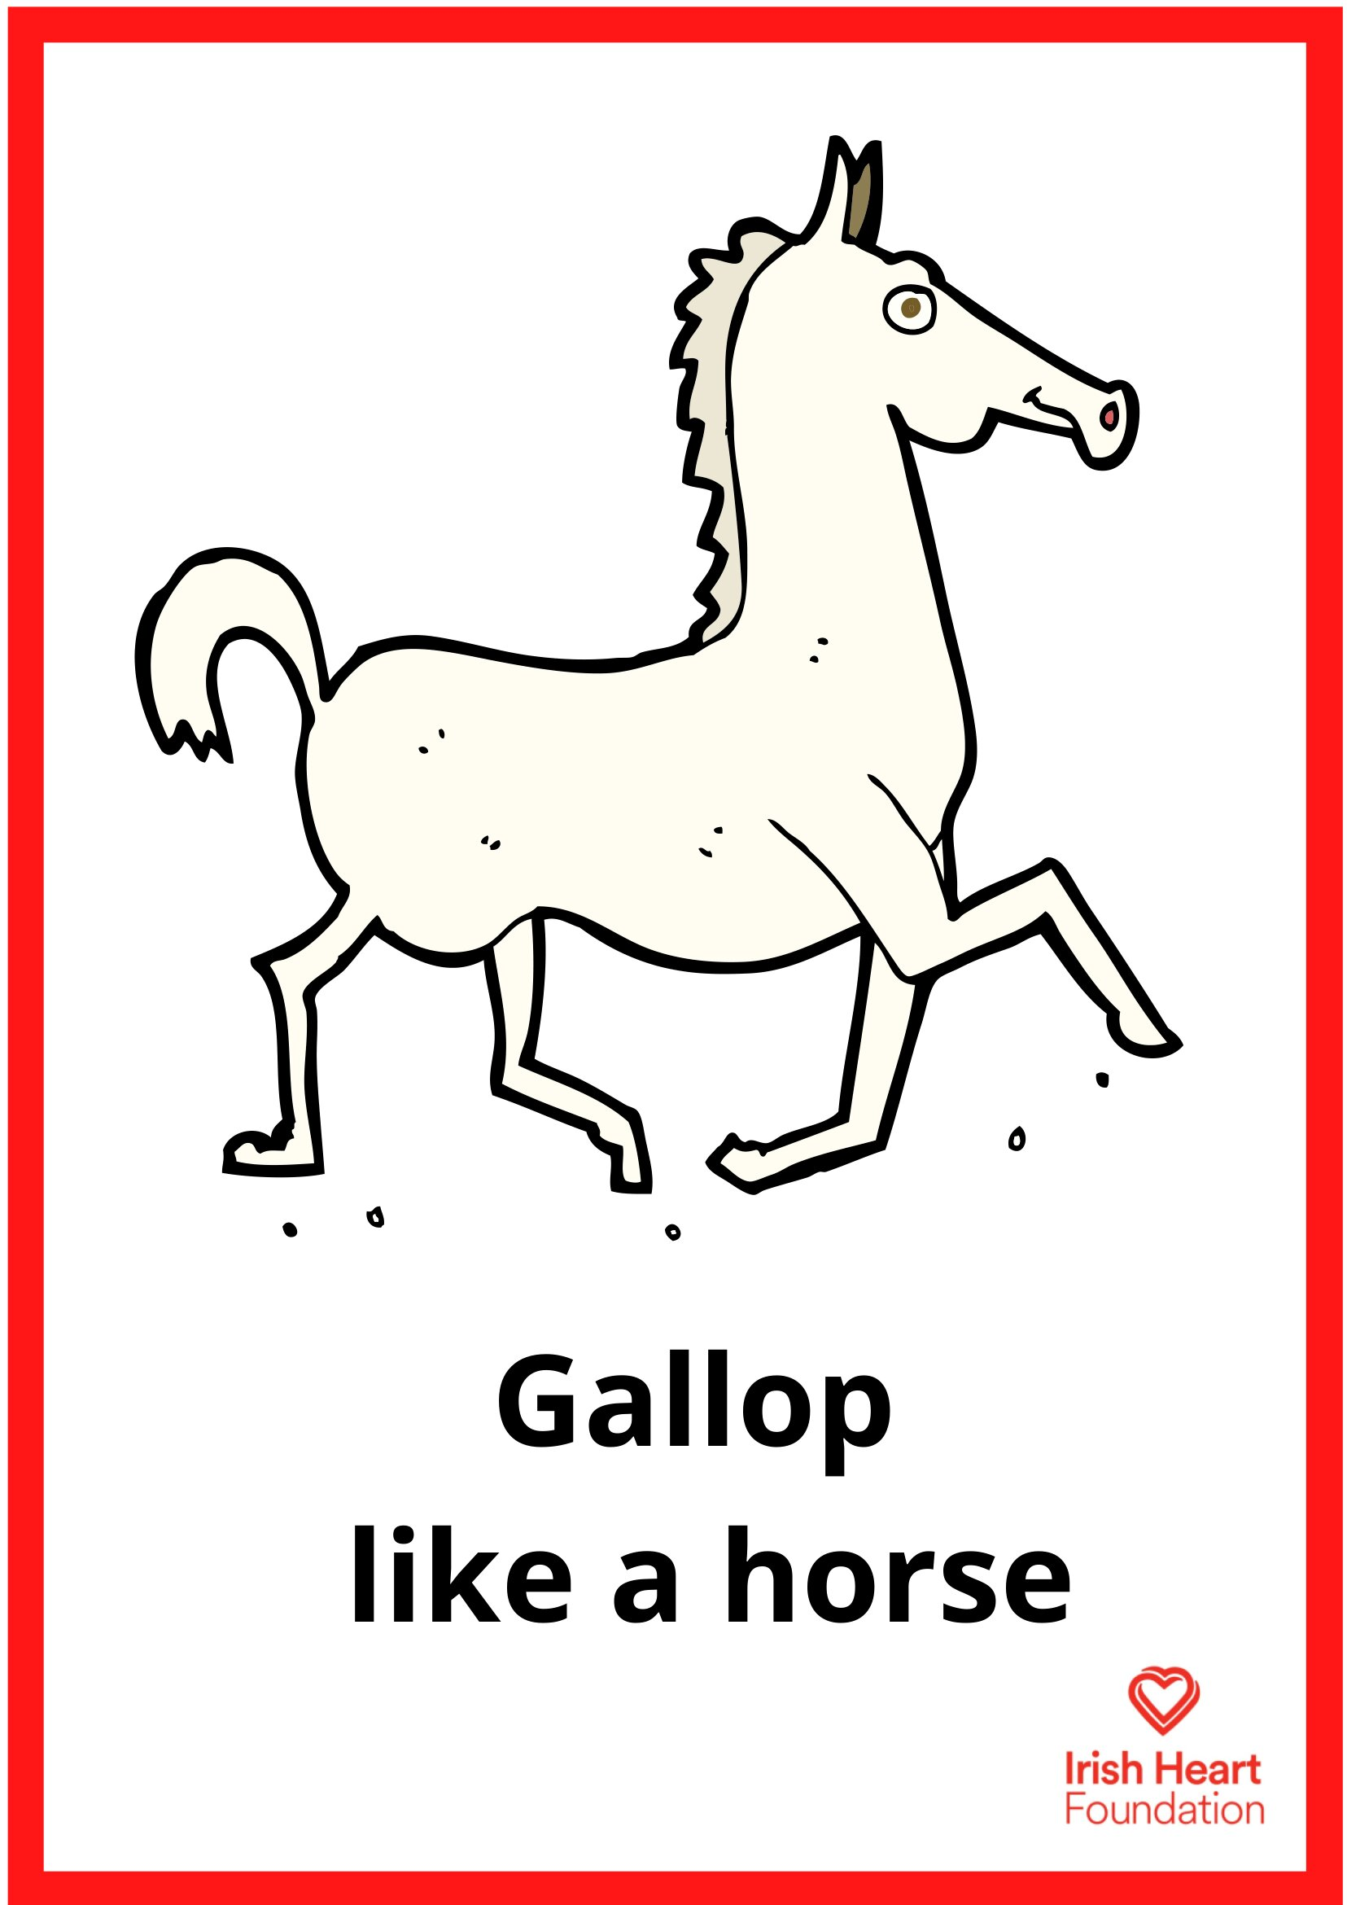
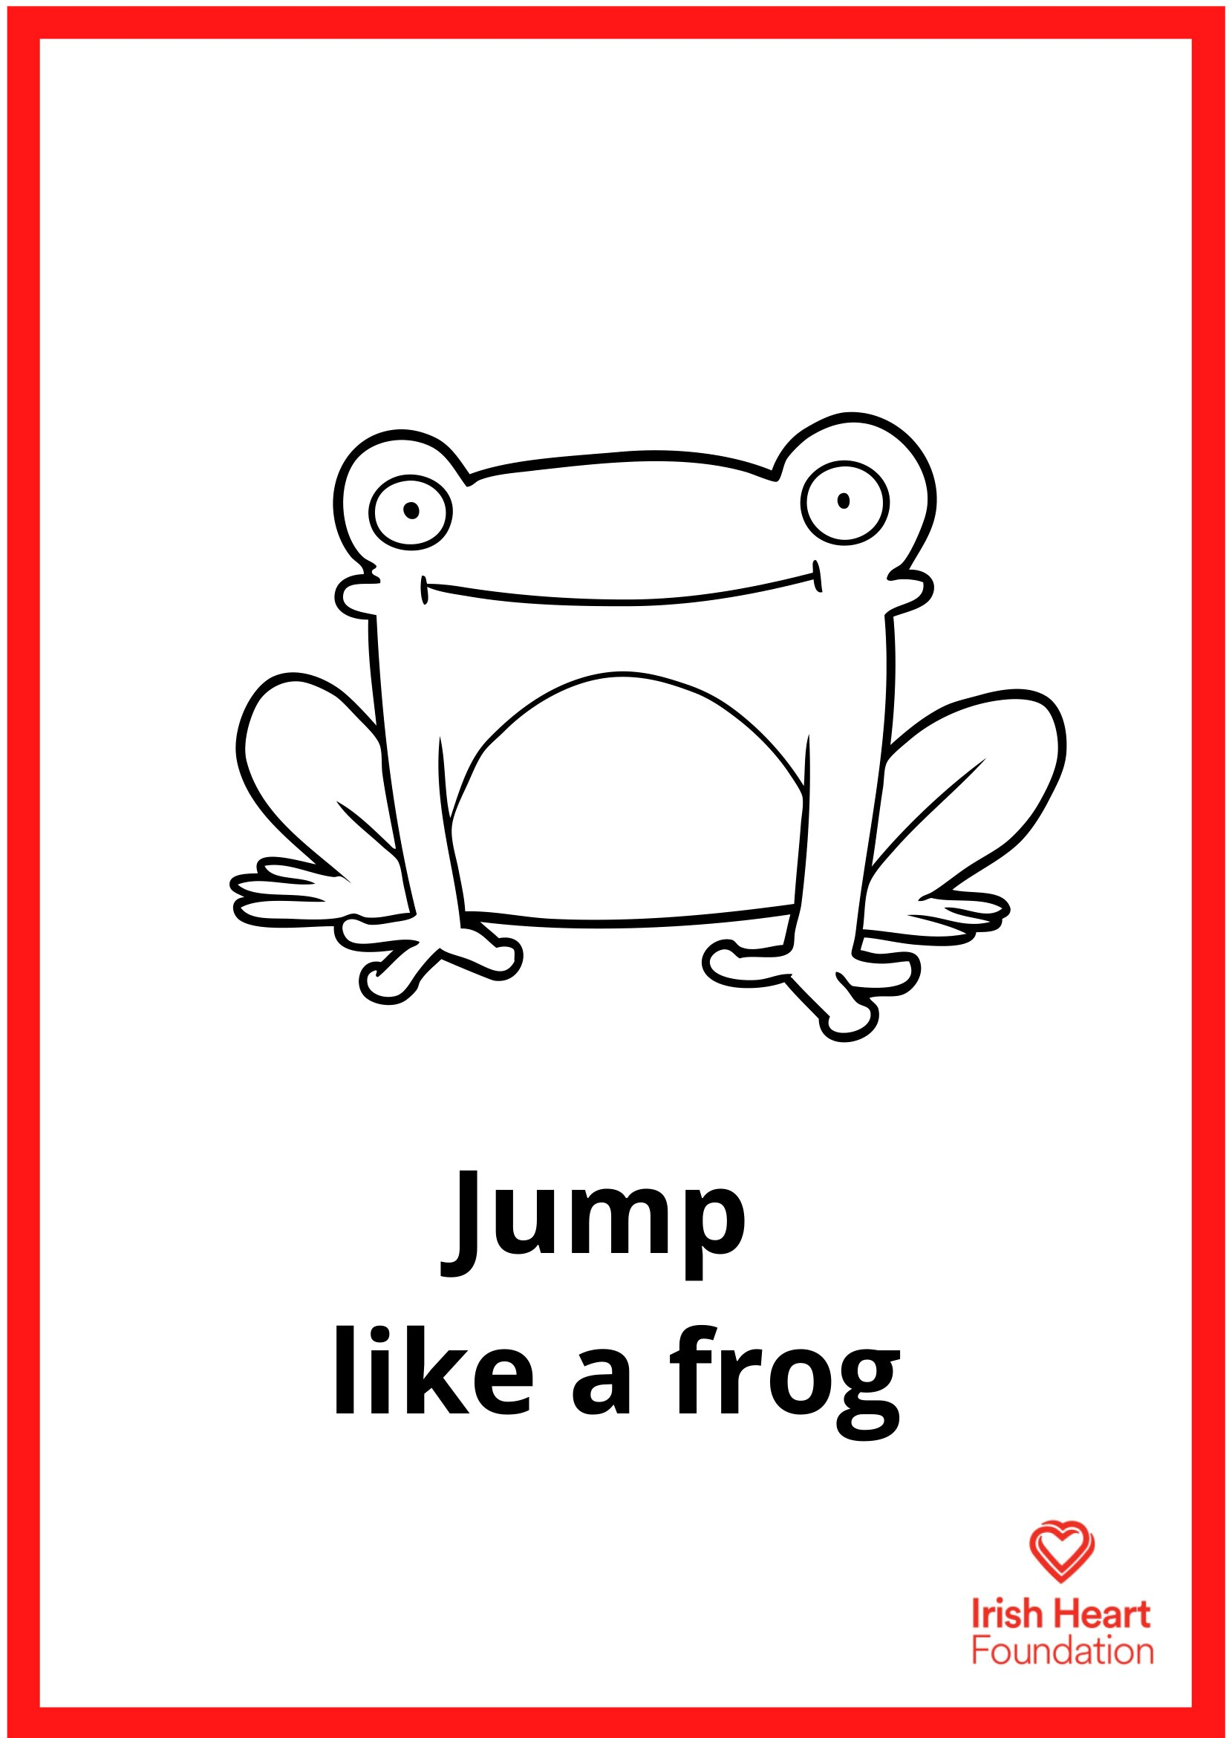
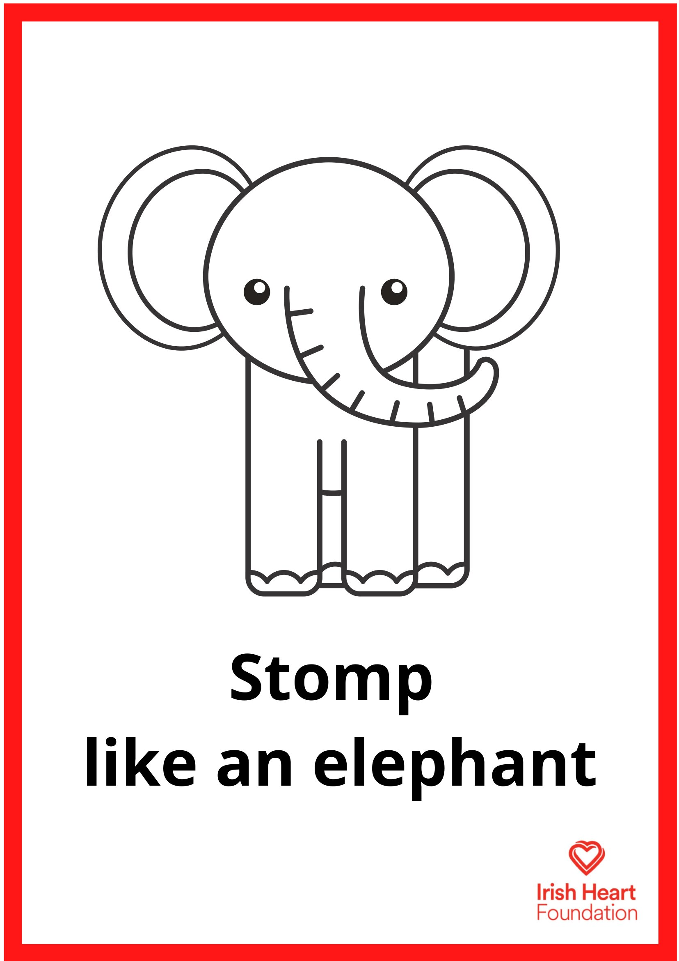
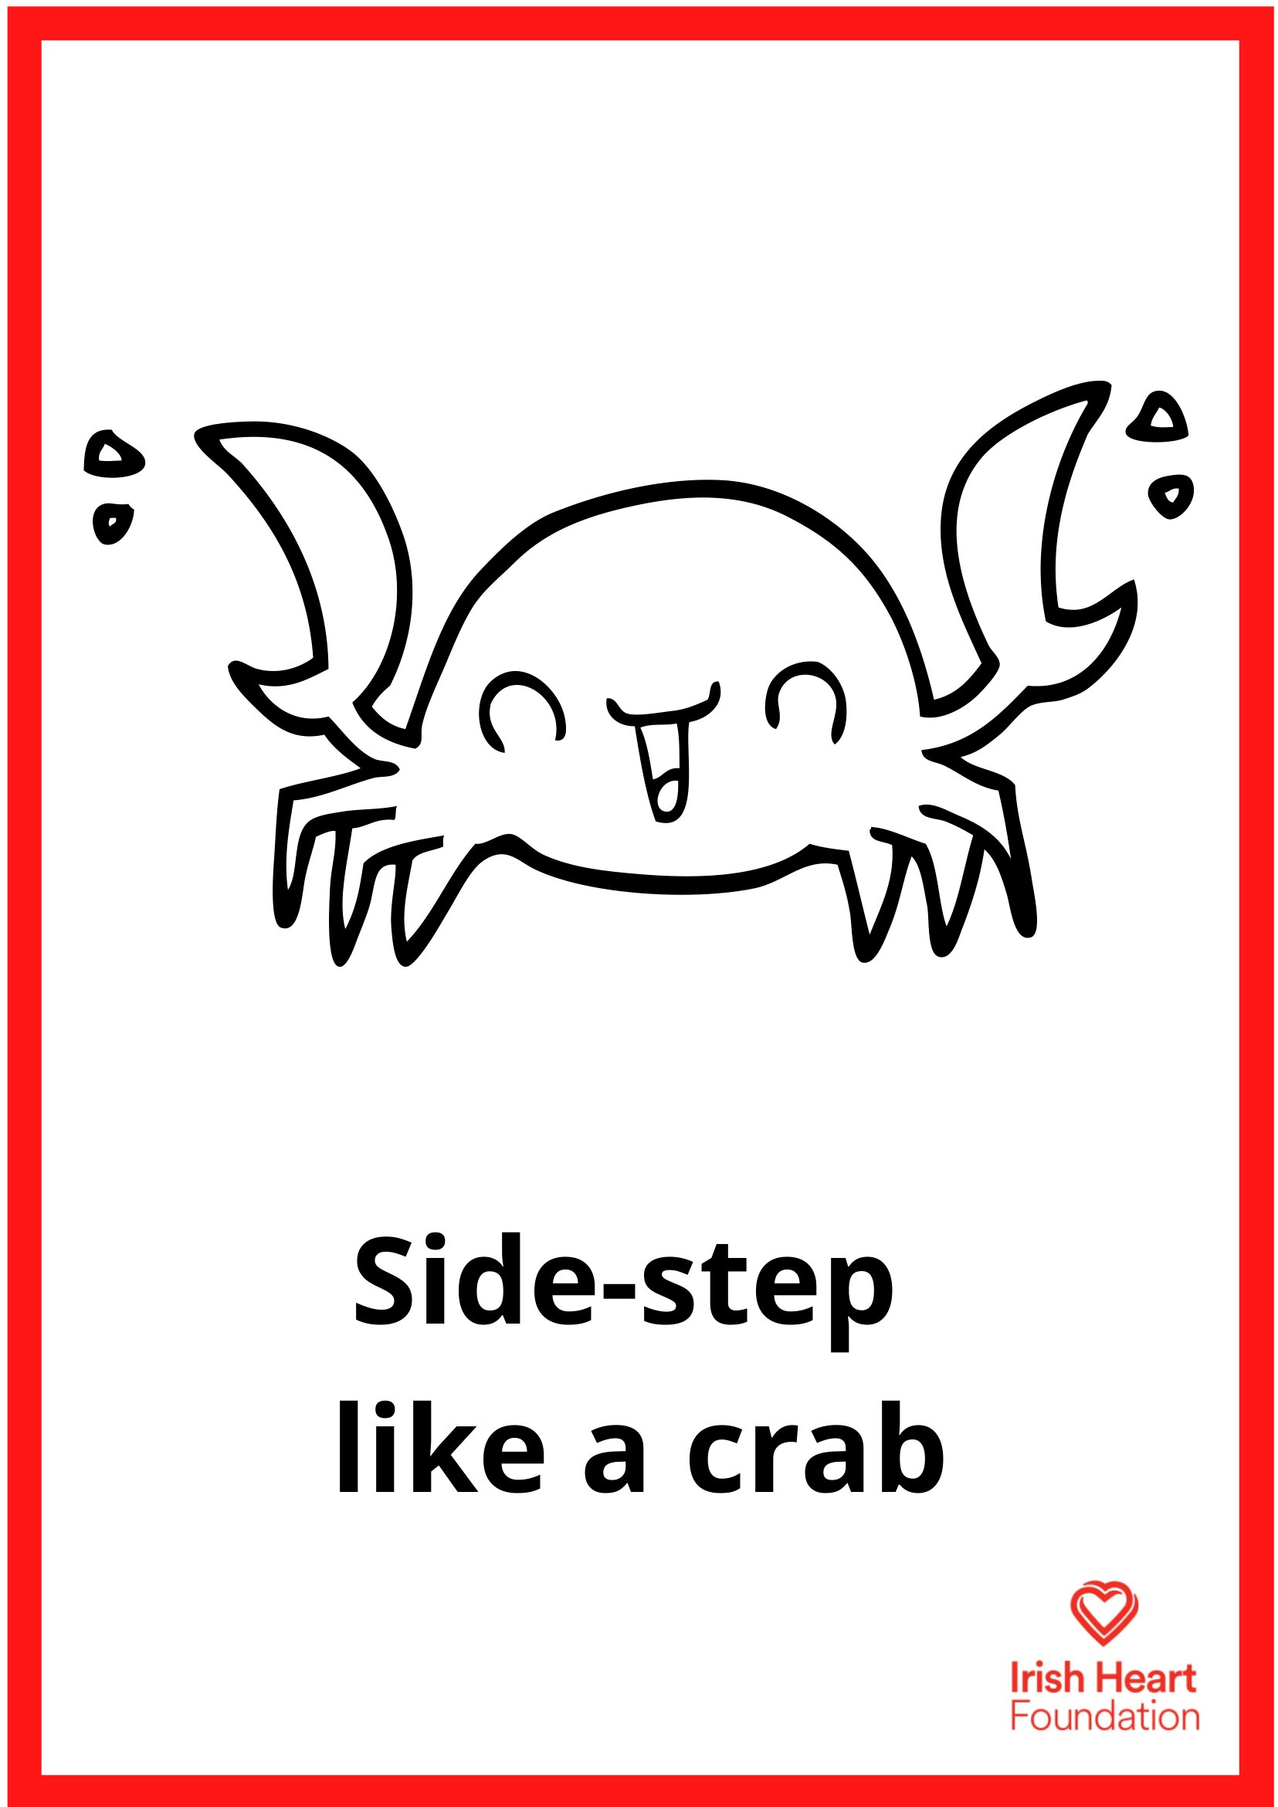
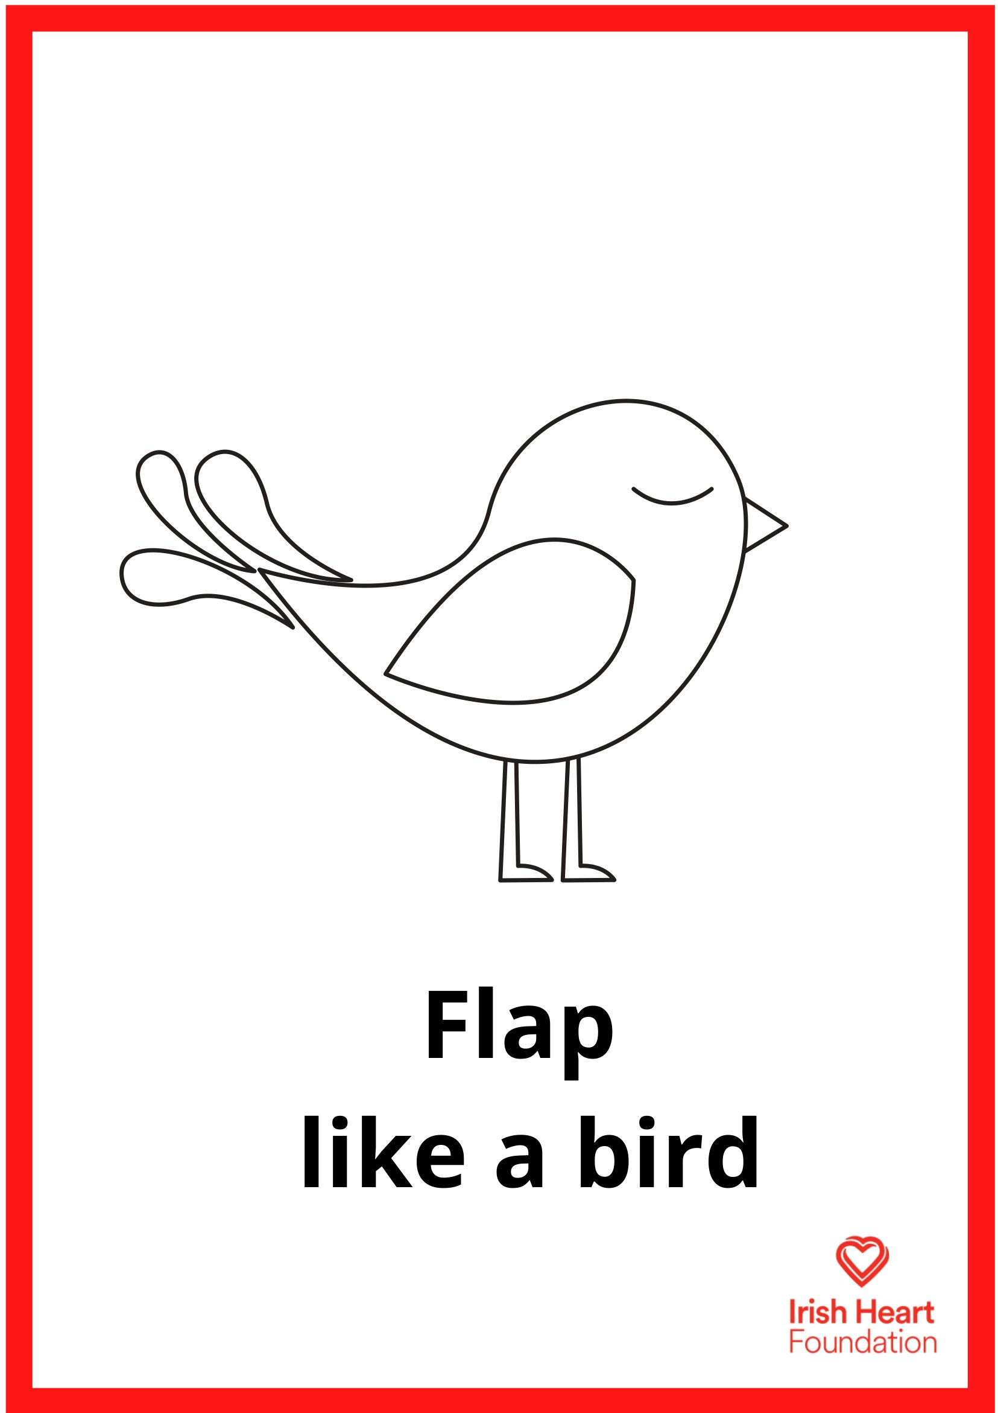
This activity can be done standing at desks with chairs pushed in. Ask pupils to ensure that they have enough space to move their arms and legs.
Music to accompany activities can be found on our Spotify playlists
Animal Moves generator instructions:
Select ‘Start slideshow from beginning’ (or press F5 key). This introduction slide will not be visible when presenting and just the Animal Moves slide will be seen.
Click on the animal image to press play, then click again to stop. (Note: The movements are a looping video so you can start and stop as many times as you like.)
Complete the move of the animal that it stops on.
Press ‘Esc’ button or spacebar to finish and exit.
Printable versions of these cards can be found at https://irishheart.ie/publications/animal-moves/

