Slide 1
Food Source
Curriculum Links SPHE - Strand: Myself Strand Unit: Taking Care of my Body Mathematics - Strand: Early Mathematical Activities Strand Unit: Classifying Learning Outcome: In this lesson pupils will identify foods by their source, recognise and classify the food as either food that comes from a plant or food that comes from an animal.
Teaching Notes Pupils will be familiar with the food groups from the food groups presentation. In advance teachers could revisit the food groups presentation highlighting food that comes from plants and food that comes from animals within each food group.
How to use this slide show Select ‘Start slideshow from beginning’ (or press F5 key). You will see pictures of food. Ask the pupils to categorise the food. When you click on the picture it will sort itself into the correct category. It doesn’t matter which picture you click on first.
*Please note if you click anywhere else on the page it will skip forward to the next slide. If this happens just press back to the slide you missed. You can do this by pressing the up arrow on your keyboard. Click on the white space to move onto the next slide or press the down arrow. Run a test before using it in the classroom so you can get used to the format.
Movement Break
Do you have a garden growing area in the school? It might be a nice movement break to bring pupils to the area to show them where fruit and vegetables grow.

Slide 2
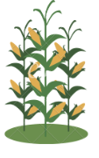
Where does food come from?
All food comes from either a plant or an animal. Can you choose the right source?
Plant
Animal

Slide 3
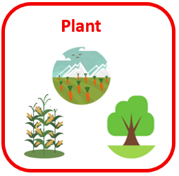
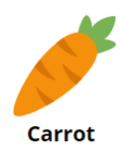
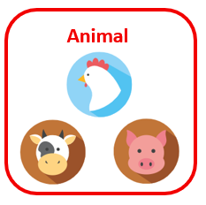
Do these foods come from plants or animals? Sort them into the right box. Click on food to see if you’re right.

Slide 4
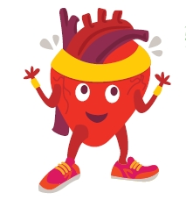
You have sorted all the food into the correct box.
Well Done!

