Slide 1
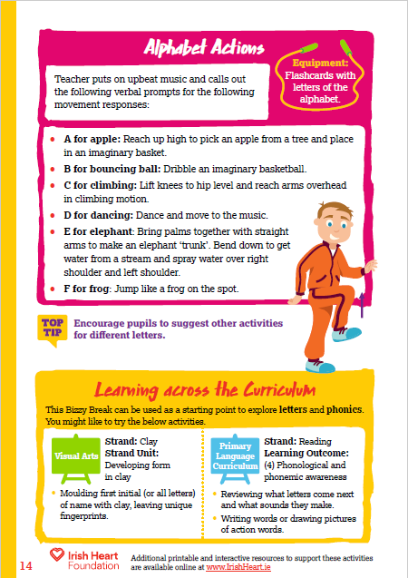
This activity can be done standing at desks with chairs pushed in. Ask pupils to ensure that they have enough space to move their arms and legs.
Music to accompany activities can be found on our Spotify playlists
Alphabet board instructions:
Select ‘Start slideshow from beginning’ (or press F5 key). This introduction slide will not be visible when presenting and just the alphabet board will be seen.
Click on a letter to highlight it and make a word and picture appear.
Complete the movement that corresponds with the letter (find all letter movements here or ask pupils to come up with their own ideas).
Click on the letter again to make the picture disappear.
Download the original activity with teachers notes by clicking here.
Find this and more activities on the full Bizzy Breaks webpage.

Slide 2
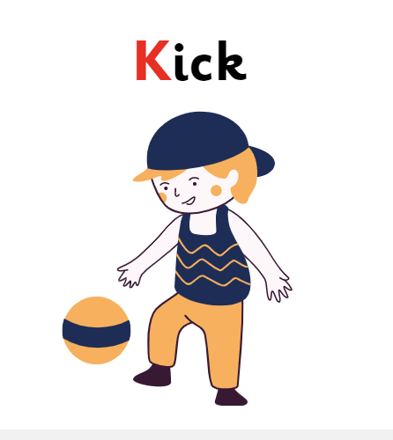
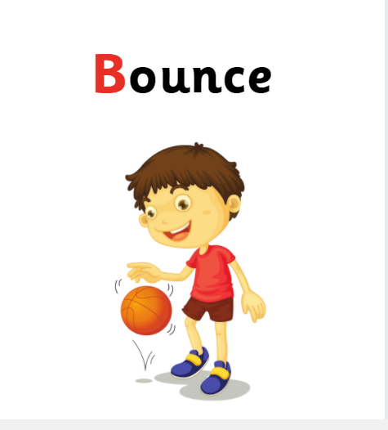
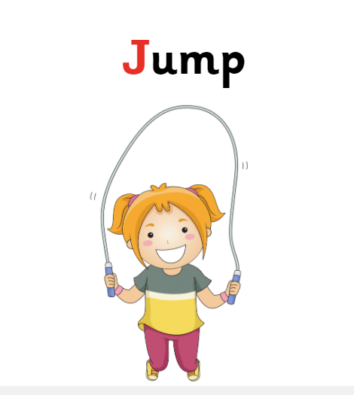
A
B
C
D
E
F
G
H
I
J
K
L
M
N
O
P
Q
R
S
T
Click a letter to highlight it and make an image appear.
Click the letter again to make it disappear.
U
V
W
X
Y
Z

