Slide 1
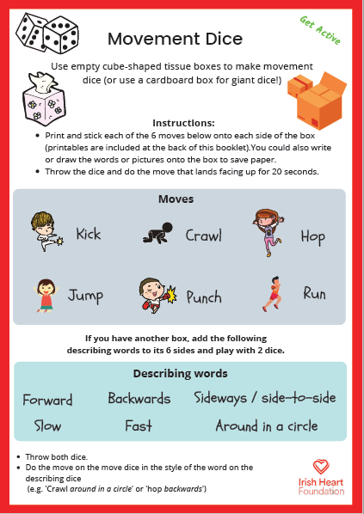
For this activity ensure pupils have enough space to perform the actions. Adjust to space as required and only use the first dice if space is limited.
Movement Dice Instructions:
Select ‘Start slideshow from beginning’ (or press F5 key). This introduction slide will not be visible when presenting.
Each slide has a looping video of a dice. The first video is a dice with six moves: kick, crawl, hop, jump, punch, and run.
Click on the square to press play, then click again to stop. (Note: the dice is a looping video so you can start and stop as many times as you like).
Perform the move for 20 seconds.
Use the right arrow to move to the next slide (use the left arrow if you wish to return to the previous slide).
The second dice video contains six describing words: forward, backwards, sideways/side-to-side, slow, fast and around in a circle.
Click on the square to press play, then click again to stop. (Note: the dice is a looping video so you can start and stop as many times as you like).
Do the move from the move dice in the style of the word on the describing dice. For example ‘hop backwards’ or ‘punch fast’.
Download the original activity for printing by clicking here, or find this and more activities on the Bizzy @ Home Learning Hub.

Slide 2
