Slide 1
Notes:
Teacher Guide on last slide.

Slide 2
Teacher Guide
This slide will not display on presentation mode
The following lesson is designed to get students thinking about the impacts that vaping can have on their health and the environment.
The lesson concludes with a choice of three student activities. They can choose to write a letter to their TD, create an information poster or make and deliver a short presentation.
The first two of these options (TD Letter & Poster) have an associated worksheet which is also provided on the School Resource page.
You will also need an exit slip (post it note) for the conclusion of the lesson.
You can find information in the notes section of each slide to support classroom discussions.
Please feel free to reach out if you have any questions, or to provide feedback on the lesson template and resources, by emailing golooney@irishheart.ie.

Slide 3
To understand the impact that vaping has on the body
To be able to find the right health information online
To recognise the marketing of vapes is targeting young people
To recognise the impact of vaping on the environment
Notes:
Teacher Guide on last slide.

Slide 4
In groups of 3, answer the following questions.
What is a vape?
1.
What is in a vape?
Each group will then share your answer with the class.
What percent of people do you know that use a vape?
2.
Has vaping increased in the last few years? Why?
Notes:
What are e-cigarettes?
An e-cigarette is a device which vaporises and delivers a chemical mixture known as an ‘’e-liquid’’ to the lungs in the form of an aerosol.
How popular are e-cigarettes among young people?
Between 2015 and 2019, the number of 15 to 16-year-olds who had used an e-cigarette at least once (known as ever-use) had risen significantly from 23% to 37.2%. The rate of regular (or current-use) vaping has also increased in this time from 10.1% to 18.1%. However, these figures are from 2019, and with disposable vapes becoming increasingly popular in the last few years, it is likely that these figures have grown considerably.

Slide 5
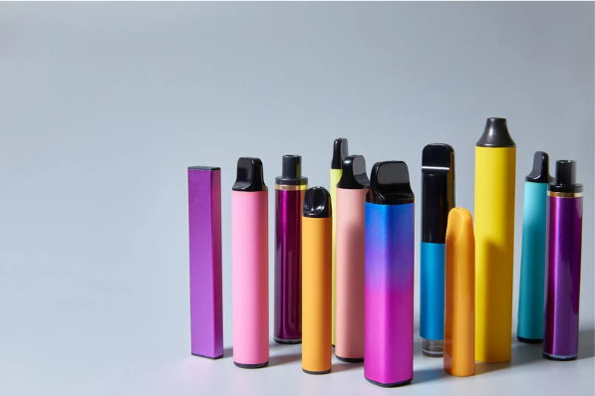
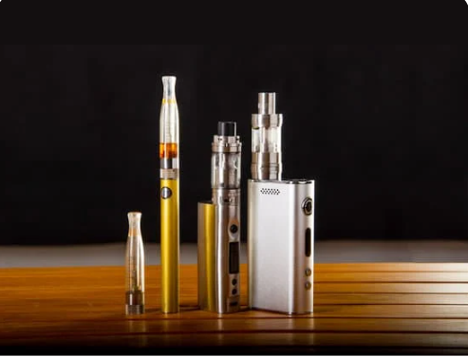
Disposable
Reusable
Already pre-filled with E-liquid
Non-rechargeable
Cannot be refilled
Once the liquid runs out, you throw away the vape
Rechargeable battery
Refillable pods/tanks.
Designed to be reused multiple times.
Not thrown away once the liquid has run out.
Which one do you think is more popular today with young people? Why?

Slide 6
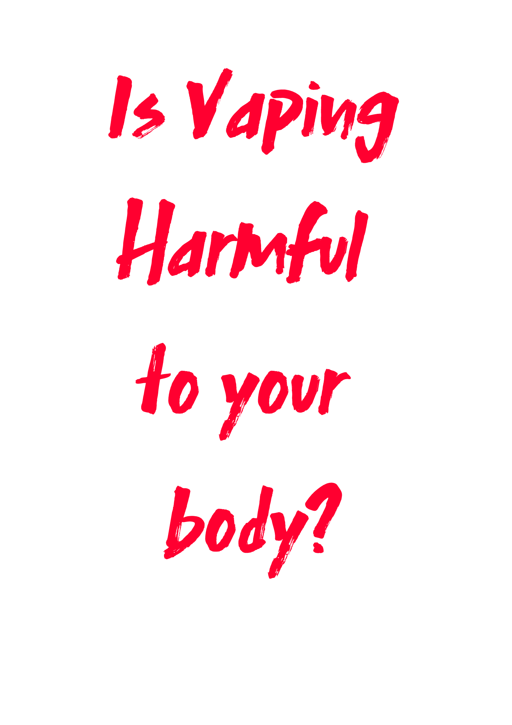
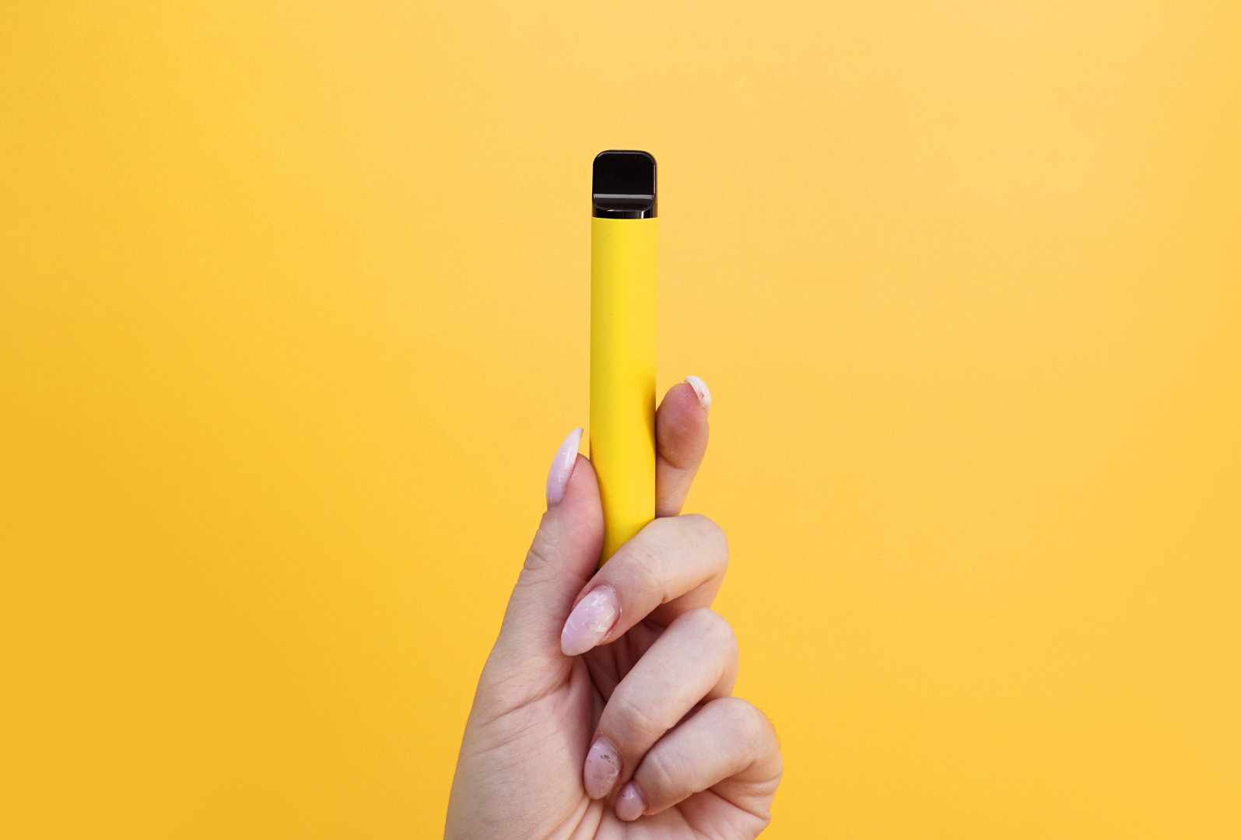
Do you think vaping is harmful for your body?
Explain your answer.
Notes:
Are e-cigarettes harmful to health?
Although e-cigarettes, both disposable and reusable vapes, are safer than smoking normal cigarettes, they are not harm-free and we do not know the long-term health impact. Vaping can cause poisonings, burns, blast injuries, lung injury and asthmatic attacks. More evidence shows that using e-cigarettes can damage the brain, heart, blood vessels and lungs.
Irish research also shows that teenagers who use e-cigarettes are three and five times more likely to start smoking compared to those who never used e-cigarettes. Both e-cigarettes and normal cigarettes contain an ingredient called nicotine, which is very addictive. Nicotine can harm young people’s brain development, which continues into the early to mid-20s.
E-cigarettes harm children and teenagers, and it is the best course of action never to start. They are very addictive and can lead to smoking, which is highly damaging to your health.

Slide 7
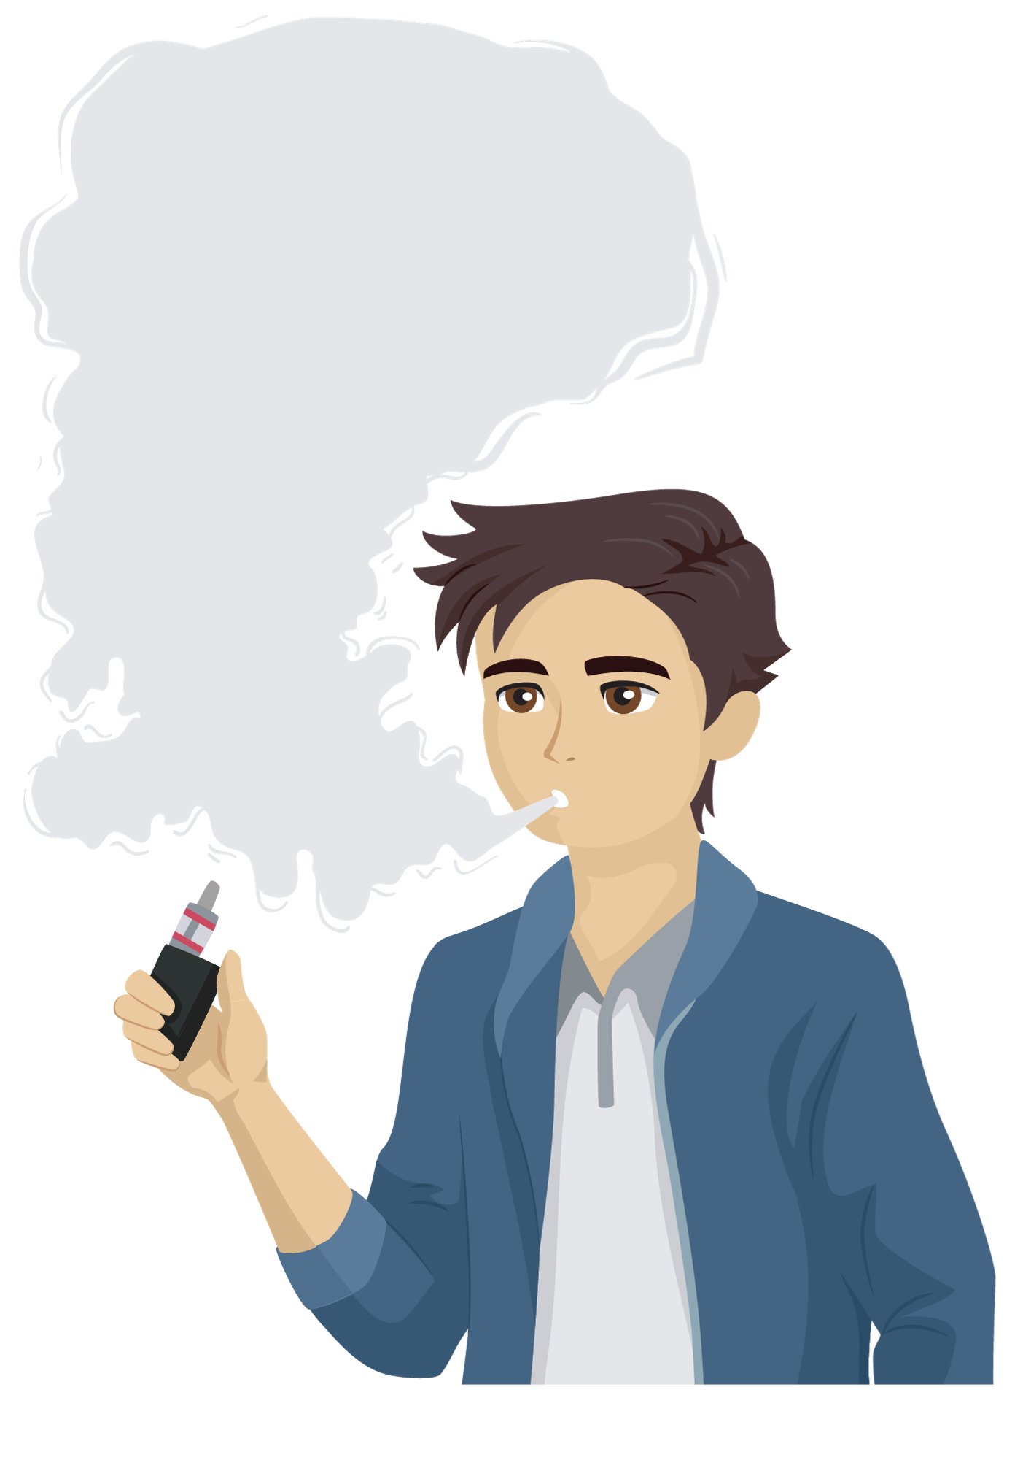
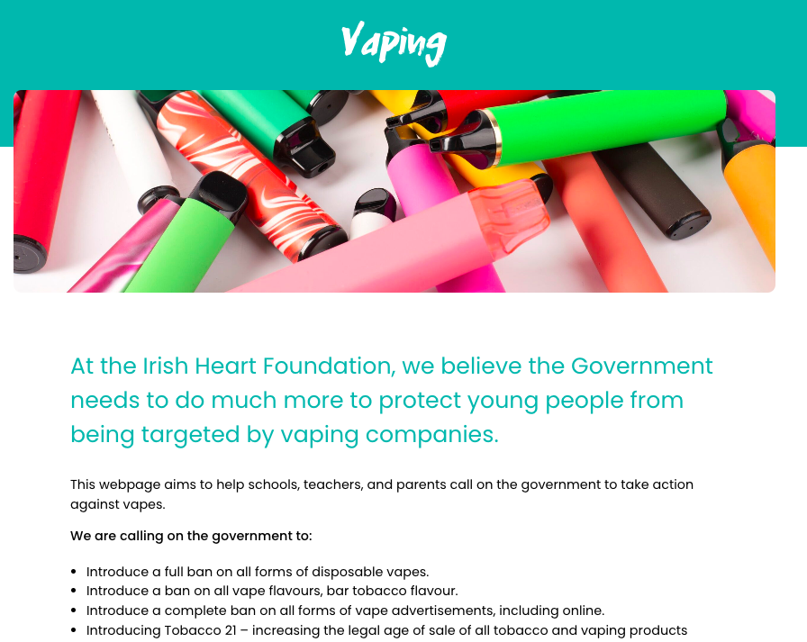
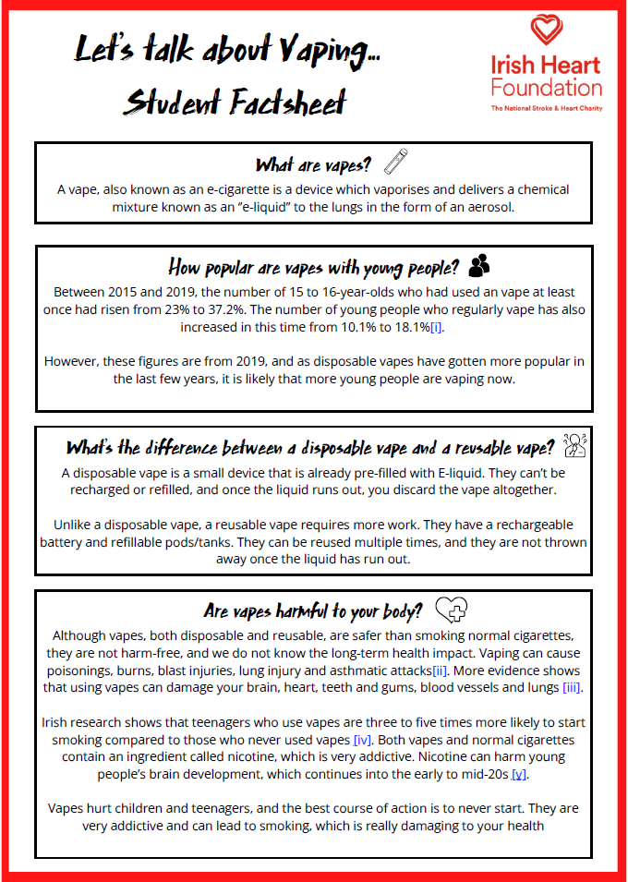
Why shouldn't
young people
vape?
Do your research
On the website
Student Factsheet
Task
In your groups, choose the 3 most important facts you think would convince someone to avoid vaping.
www.irishheart.ie/vaping
Notes:
Are e-cigarettes harmful to health?
Although e-cigarettes, both disposable and reusable vapes, are safer than smoking normal cigarettes, they are not harm-free and we do not know the long-term health impact. Vaping can cause poisonings, burns, blast injuries, lung injury and asthmatic attacks. More evidence shows that using e-cigarettes can damage the brain, heart, blood vessels and lungs.
Irish research also shows that teenagers who use e-cigarettes are three and five times more likely to start smoking compared to those who never used e-cigarettes. Both e-cigarettes and normal cigarettes contain an ingredient called nicotine, which is very addictive. Nicotine can harm young people’s brain development, which continues into the early to mid-20s.
E-cigarettes harm children and teenagers, and it is the best course of action never to start. They are very addictive and can lead to smoking, which is highly damaging to your health.

Slide 8
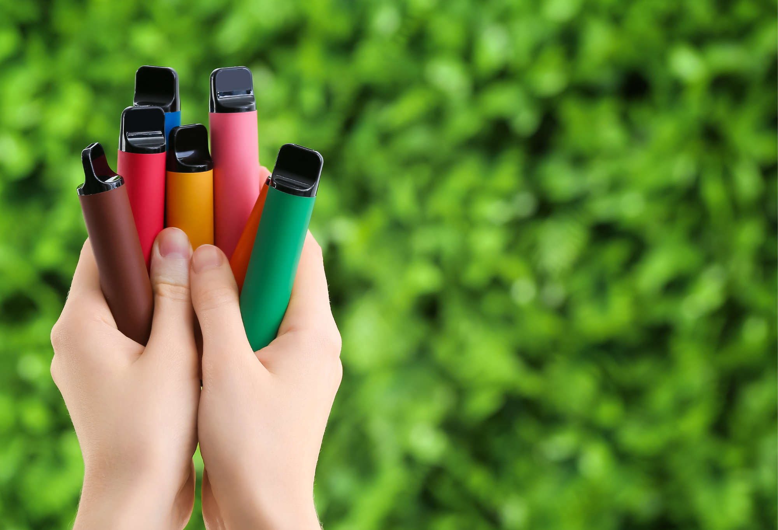
Describe 3 ways that vaping can be bad for the environment.
1 -
2 -
3 -
Notes:
Environmental impact of disposable e-cigarettes
E-cigarette waste has a serious environmental impact as they contain plastic, nicotine salts, heavy metals, lead, mercury, and flammable lithium-ion batteries, which can leach into waterways, soil, and wildlife. Shockingly, in the UK, five million disposable vapes are thrown away each week.
Here in Ireland, an estimated 12.5 million vapes were sold in 2022, and, likely, these single-use devices were simply binned, adding to our already burgeoning plastic waste.
To protect youth health and the planet's health, the Irish Heart Foundation has called for the government to introduce a full ban on all forms of disposable e-cigarettes.

Slide 9
What we know
12.5 million vapes were sold in Ireland in 2022.
They pollute our waterways and hurt wildlife and people.
They are made of plastic, heavy metals, mercury, flammable lithium ion batteries.
They can be damaging to the environment if thrown away.
Notes:
Environmental impact of disposable e-cigarettes
E-cigarette waste has a serious environmental impact as they contain plastic, nicotine salts, heavy metals, lead, mercury, and flammable lithium-ion batteries, which can leach into waterways, soil, and wildlife. Shockingly, in the UK, five million disposable vapes are thrown away each week.
Here in Ireland, an estimated 12.5 million vapes were sold in 2022, and, likely, these single-use devices were simply binned, adding to our already burgeoning plastic waste.
To protect youth health and the planet's health, the Irish Heart Foundation has called for the government to introduce a full ban on all forms of disposable e-cigarettes.
Environment - https://bit.ly/3tM2UQE
A report on the environmental impact of vapes.

Slide 10
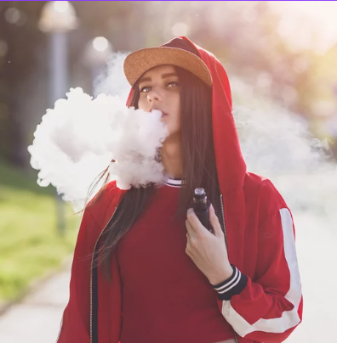
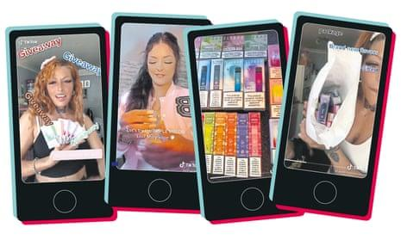
Who are the vape companies trying to sell to?
How do they advertise their vapes to those people?
Do you think they should be allowed do this?
Notes:
How young people are targeted by e-cigarette companies.
E-cigarette companies target young people in a range of cunning, often tricky ways, including:
Slick online advertisements.
Influencers on TikTok, Instagram, and Snapchat.
Bright, colourful stands in shops and newsagents, known as Point-of-sale (POS).
The big tobacco companies often own the biggest and most popular e-cigarette brands available. The same clever marketing used since the 1950s that made cigarettes so famous is now being used to promote vapes among young people. They are using the same playbook.

Slide 11
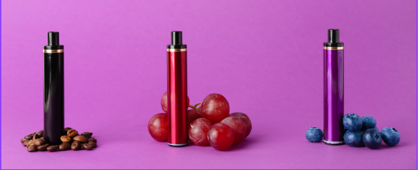
What needs to change?
If you were in charge, what rules would you bring in around vaping?
Explain why.
Notes:
How young people are targeted by e-cigarette companies.
E-cigarette companies target young people in a range of cunning, often tricky ways, including:
Slick online advertisements.
Influencers on TikTok, Instagram, and Snapchat.
Bright, colourful stands in shops and newsagents, known as Point-of-sale (POS).
The big tobacco companies often own the biggest and most popular e-cigarette brands available. The same clever marketing used since the 1950s that made cigarettes so famous is now being used to promote vapes among young people. They are using the same playbook.

Slide 12
Here are three ways that you can help in your school and community. Choose one option and get going.
If you finish, why not try a second!
Make a poster
Present a PowerPoint
Write to your local TD

Slide 13
Make information posters for your school
Option 1:
Make a poster
Find the poster template on the School Resource page
Design a poster to share information about vaping with other students in your school.
Things to include:
An attention catching title
Information on vaping and its effect on the body
Information on vaping and its effect on the environment
How vaping brands are targeting young people
What the students can do to make a change
You can find information on vaping for your poster on www.irishheart.ie/vaping or use the fact sheet provided by your teacher.
Notes:
School Resource page : https://irishheart.ie/schools/post-primary-schools/school-resources/

Slide 14
Educate other classes
Option 2:
Present a PowerPoint
Create a short PowerPoint (3-5 minutes) about vaping that you can present to other classes.
Things to include:
An attention catching title
Information on vaping and its effect on the body
Information on vaping and its effect on the environment
How Vaping brands are targeting young people
What the students can do to make a change
You can find information on vaping for your PowerPoint on www.irishheart.ie/vaping or use the fact sheet provided by your teacher.
Notes:
School Resource page : https://irishheart.ie/schools/post-primary-schools/school-resources/

Slide 15
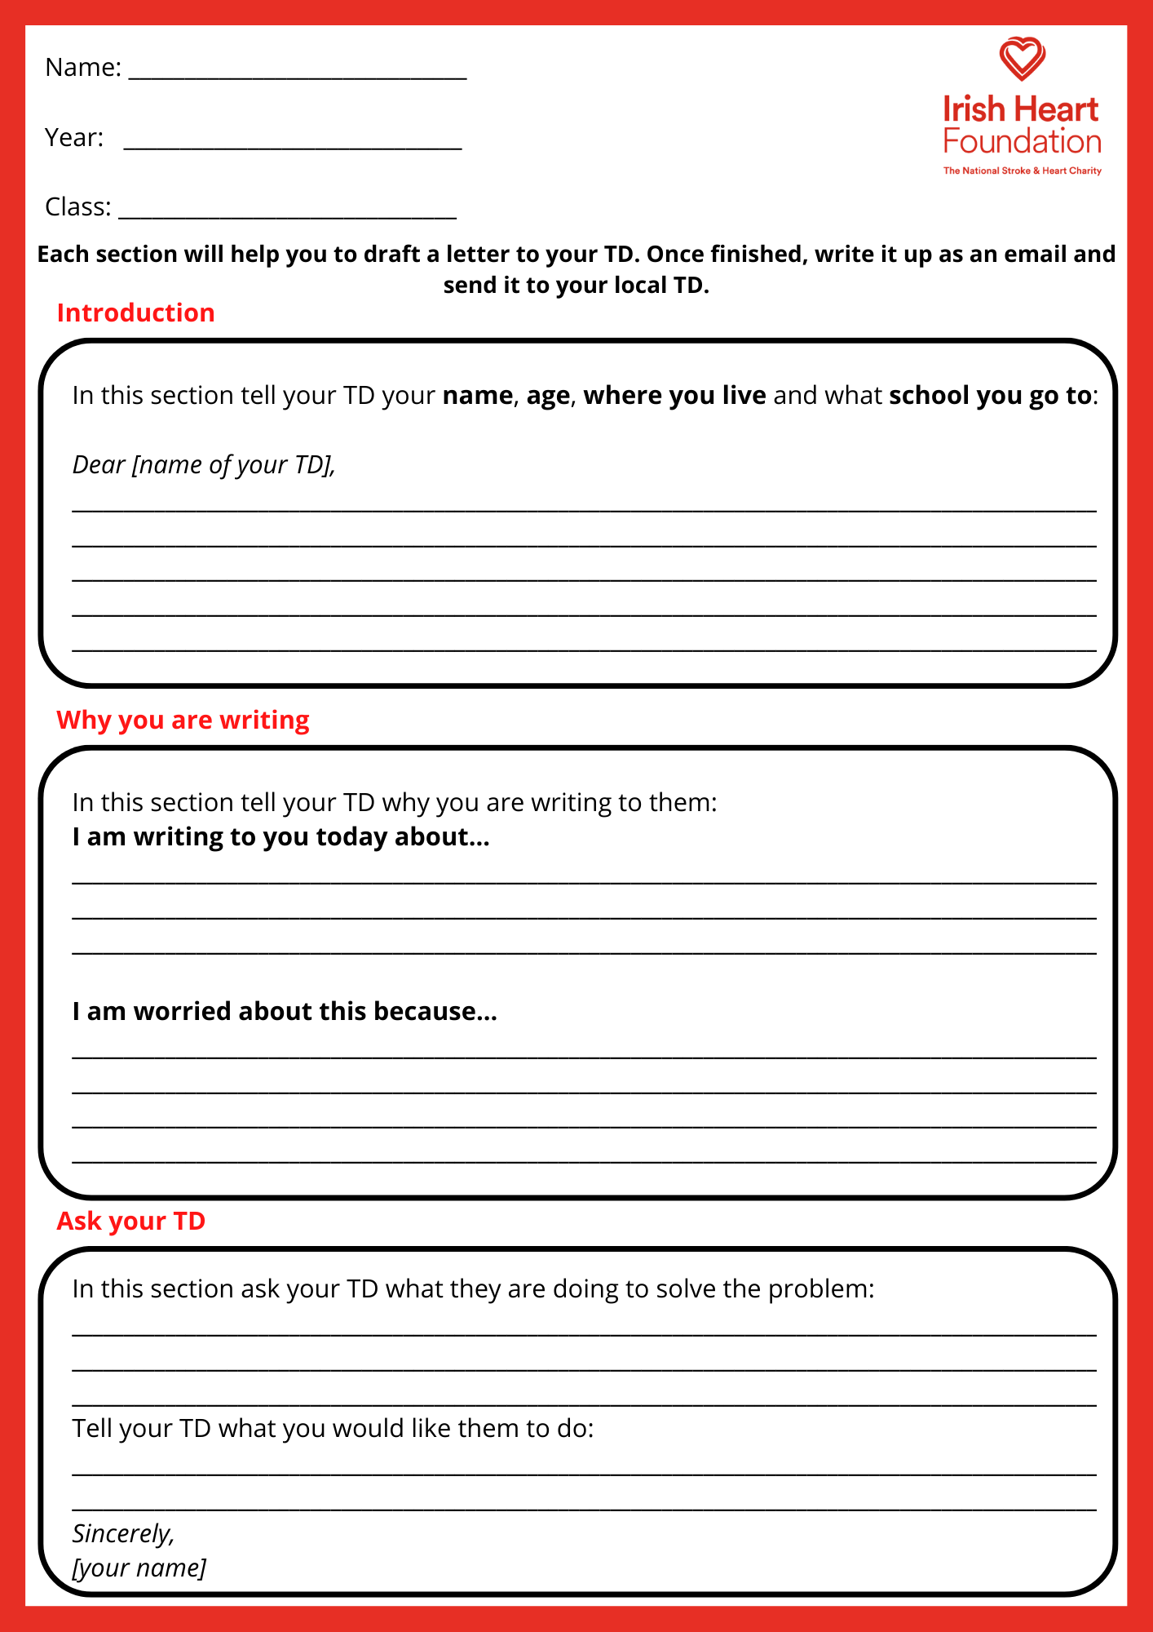
Write to your local TD
Option 3:
Find the TD letter template on the School Resource Page
Write to your local TD
Your voice is powerful and important.
You can use your voice to make change in your community and in the country as a whole. Share your worries about vaping with your local TD or councillor and let them know you want things to change.
You can use the TD letter template worksheet to create your email.
Find your local TD here - https://www.oireachtas.ie/en/members/
Find their email address firstname.surname@oireachtas.ie
Notes:
School Resource page : https://irishheart.ie/schools/post-primary-schools/school-resources/

Slide 16
On a post it note, write the following:
2 things you learned today
1 action you are going to take

