Slide 1
i - Raffle

Slide 2
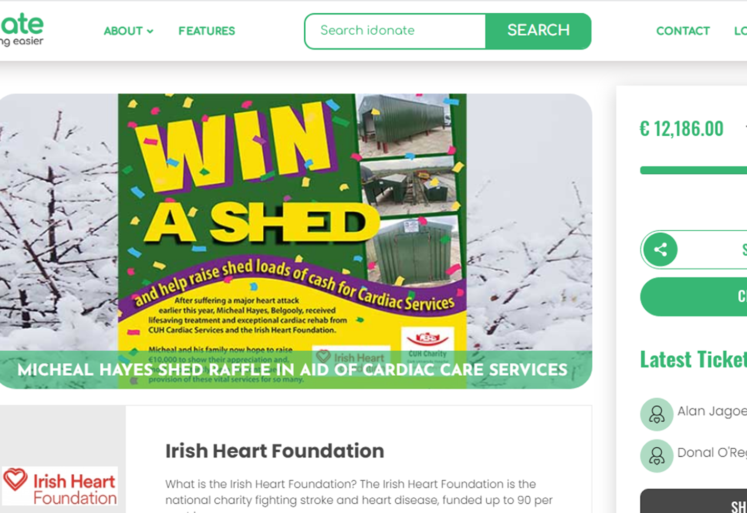
Organise a Raffle
Thinking of organising a raffle? Whether you are planning on organising an in-person event or want to raise funds online we can help set up a raffle for you.
Organising an online raffle takes the hassle out of managing ticket sales while also making it easier for people to support your fundraiser. People will also be able to buy tickets ahead of time and support your event even if they can’t make it on the day.
If you have never organised an online raffle before, have no fear, we are here to help and can answer any question you may have!
Decide on some Prizes for the Raffle;– ask local Businesses to supply them
Set up your raffle on iDonate. By using an online platform, the money will come directly to the Irish Heart Foundation, so you won’t have to worry about cash handling.
Get in touch with our team at hello@irishheart.ie and we will set your raffle page up for you
Get friends and family to share link on WhatsApp groups
Create a poster and include your unique QR Code to help sell more tickets locally (How to)
Remember to let people know who won the prizes afterwards
Read more from the Lotteries and Gaming Act

Slide 3
Information required to setup the raffle:
Name of Raffle.
Target amount.
Closing date / time for sale of tickets.
Date of Draw - if known.
Short Description of raffle.
List of Prizes.
Ticket prices (eg, 1 for €10, 3 for €20, 10 for €50, etc)
Profile Image - Logo / or specific Raffle image. 500 x 500 pixels.
Banner image - plain background image (optional). The Profile image will be centred on this. 1200 x 700 pixels.

