Slide 1

Food Groups Lesson
Curriculum Links
SPHE - Strand: Myself Strand Unit: Taking Care of my Body
Learning Outcome
Pupils will be introduced to the basic food groups as identified through the HSE Food Pyramid. Pupils will become aware and familiar with each group and how many of each food to have each day to keep their heart healthy. Pupils will explore the importance of food for growth, development and energy and why we eat. They will explore food for a balanced diet and their role in a balanced diet.
Teaching Notes
It is important for pupils to understand the three core concepts of what food does for our body. Food is important for healthy minds and healthy bodies. Food is important to help us to grow. Food gives us the energy to play and focus on our work. Here is some background information for teachers. Each of the food groups have an important role to play. Vegetables, salad and fruit contain a lot of different vitamins and minerals. That’s why it is important to eat a rainbow and get 5-8 every day. Foods such as wholemeal cereals and breads, potatoes, pasta and rice are a key energy source. Milk, yoghurt and cheese are really important for our bones. Foods such as meat, poultry, fish, eggs and beans repair our muscles and protect us from illness. Fats, oils and spreads can be a good source of energy and they provide us with essential vitamins. Too much, or the wrong balance of fat can be unhealthy.
It is important to note that what our diet looks like as a whole, getting a balance, is what’s most important not a single food or nutrient.
It is also important to look at our relationship with food as part of daily life. We have included a slide to explore this. Food can be tied to memories. It can be used to celebrate special times and it can remind us of certain people, places and times. We also eat food because we enjoy it, because it tastes good and because we want to feel full and satisfied. These have been split into two core concepts – memories and enjoyment.

Slide 2
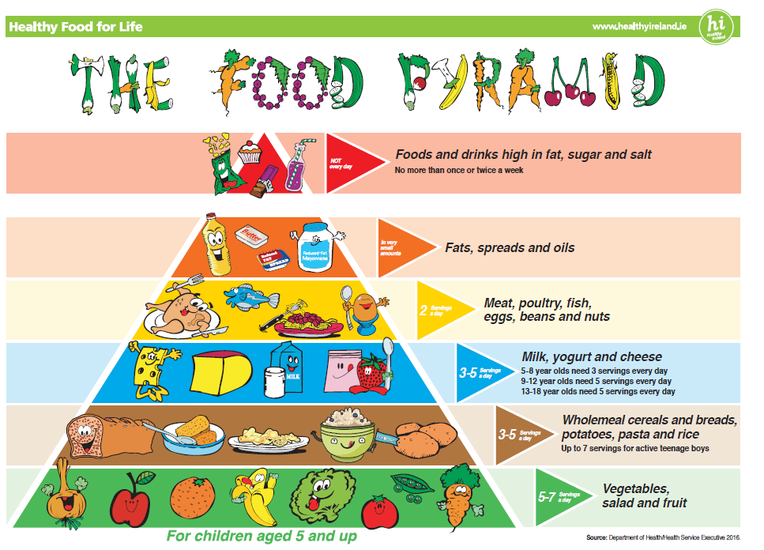
Food Groups Lesson
Food Pyramid
In the lesson we have broken down the food pyramid into the food groups as an introduction for pupils. We have followed the titles from the food pyramid for continuity. If you wish you can show pupils the food pyramid at the end of the lesson or hang it in your classroom for familiarization. We look more closely at the food pyramid for older classes.
Balance
We have included examples of the type of food in each group, how many we should have each day and why we need them.
How we talk about food is important. In line with best practice and to encourage healthy eating habits we recommend moving away from using good/bad when discussing food. We also recommend against using the word treat. Using the word treat can make a food more desirable. We do not want to demonise or elevate any foods through our choice of language.
When discussing food from the top of the food pyramid we recommend using ‘food we can have less often if we wish to.’

Slide 3
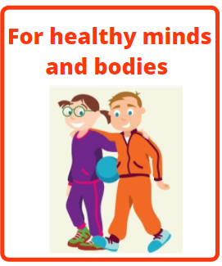
Why we do we need food?

Slide 4
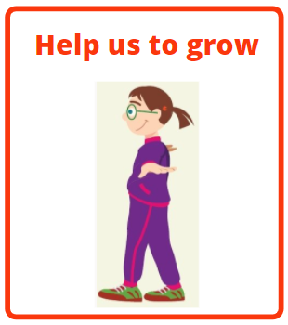
Why we do we need food?

Slide 5

Why we do we need food?

Slide 6
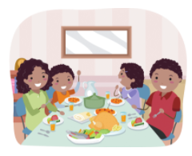
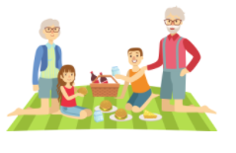
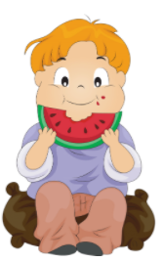
Other reasons we eat
Memories
Making food related memories with friends and family
To remind us of different times, places and people
Enjoyment
Enjoying a special taste
Feeling full and satisfied
To celebrate special times with our families and friends

Slide 7


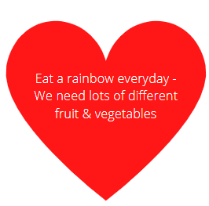






Vegetables,
Salad and Fruit
Eat plenty of fruit and vegetables every day

Slide 8



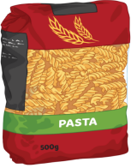




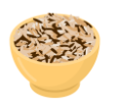
Wholemeal cereals and breads,
potatoes, pasta and rice
Eat at breakfast, lunch and dinner

Slide 9


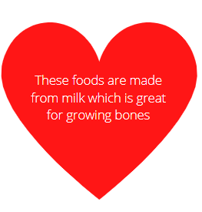



Milk, yoghurt
and cheese
Have three times a day

Slide 10






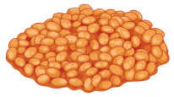
Meat, poultry, fish, eggs
beans and nuts
Eat twice a day

Slide 11
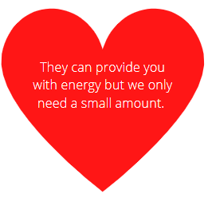


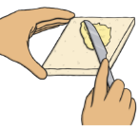
Fats, spreads and oils
Use in small amounts

Slide 12

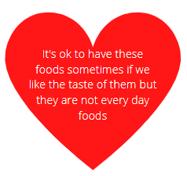







Foods and drinks high in fat,
sugar and salt
Food we can have less often if we wish to

