Slide 1

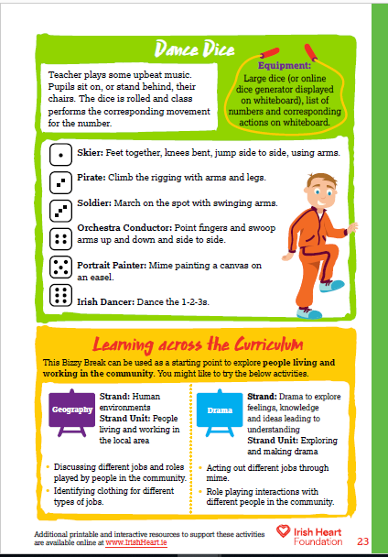

For this activity pupils can sit in their chairs or stand behind them. Play some upbeat music. Music to accompany activities can be found on our Spotify playlists.
Dance Dice instructions:
Select ‘Start slideshow from beginning’ (or press F5 key). This introduction slide will not be visible when presenting.
Click on the dice to press play, then click again to stop. (Note: the dice is a looping video so you can start and stop as many times as you like).
Guide pupils in the movement using the teaching notes.
Use the right arrow to move to the next slide (use the left arrow if you wish to return to the previous slide).
On the second slide is a blank dice. Ask the class to create their own characters and movements for each number.
Click on the dice to press play, then click again to stop on a number. (Note: the dice is a looping video so you can start and stop as many times as you like).
Download the original activity with teachers notes by clicking here, or find this and more activities on the full Bizzy Breaks webpage.

Slide 2


Slide 3


