Slide 1


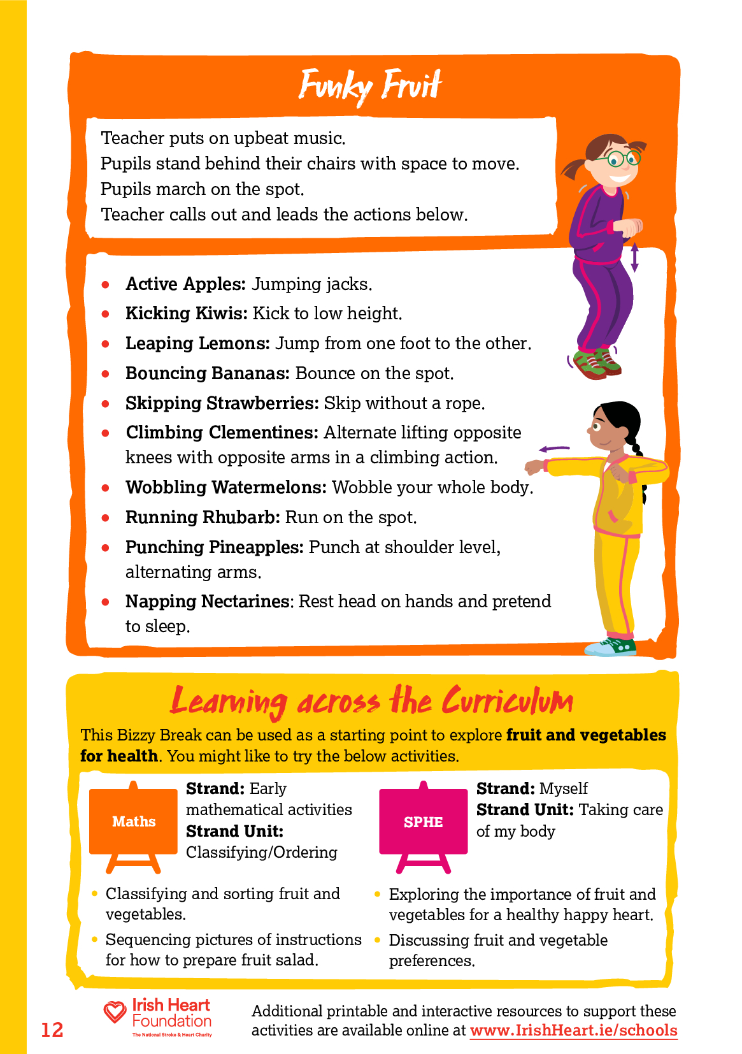
Instructions:
Select ‘Start slideshow from beginning’ (or press F5 key). This introduction slide will not be visible when presenting and just the spinning wheel will be seen.
Click on the ‘SPIN’ button in the centre of the wheel to start spinning.
Click the ‘SPIN’ button again to stop.
Complete the move that the wheel lands on.
Repeat steps 2-4 for the duration of your movement break.
Press ‘Esc’ button or spacebar to finish and exit.
Find Funky Fruit and more activities (including videos) on
the Bizzy Breaks webpage

Slide 2


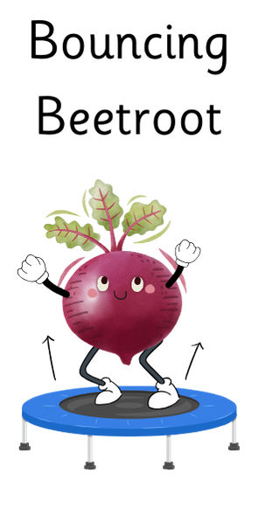



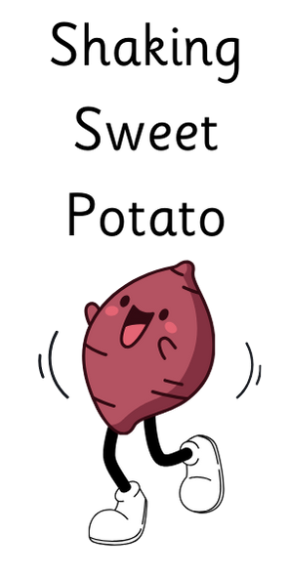



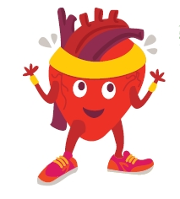
Click ‘SPIN’ to start and stop spinning
SPIN
When the wheel stops, do the move for that vegetable
Irishheart.ie/bizzybreaks

