Slide 1
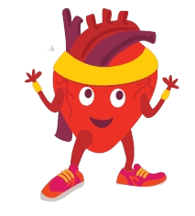


Where is Bizzy?

Slide 2
Where is Bizzy?
Bizzy is on the table

Slide 3
Where is Bizzy?

Slide 4
Where is Bizzy?
Bizzy is beside the table

Slide 5
Where is Bizzy?

Slide 6
Where is Bizzy?
Bizzy is under the table

Slide 7
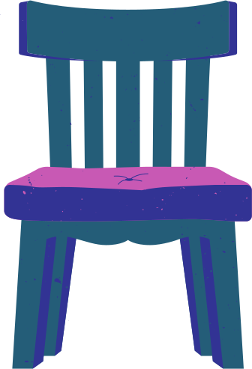
Where is Bizzy?

Slide 8
Where is Bizzy?
Bizzy is at the table

Slide 9


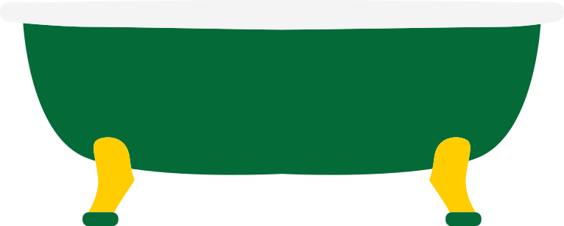
Where is Bizzy?

Slide 10
Where is Bizzy?
Bizzy is in the bath

Slide 11
Where is Bizzy?

Slide 12
Where is Bizzy?
Bizzy is between the bath and the table

Slide 13
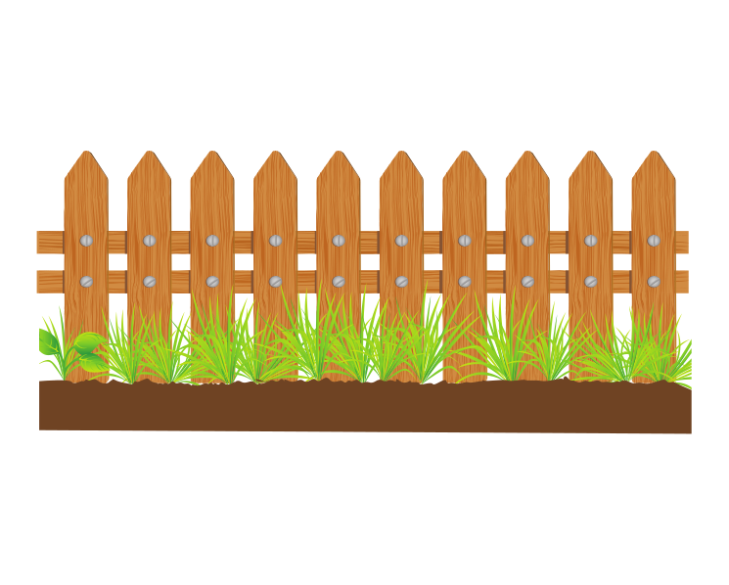
Where is Bizzy?

Slide 14
Where is Bizzy?
Bizzy is in front of the fence

Slide 15
Where is Bizzy?

Slide 16
Where is Bizzy?
Bizzy is behind the fence

Slide 17
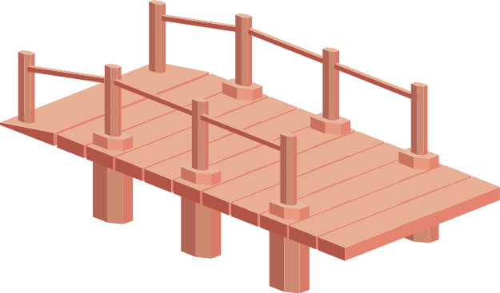
Where is Bizzy going?

Slide 18
Where is Bizzy going?
Bizzy is going across the bridge

Slide 19

Where is Bizzy going?

Slide 20
Where is Bizzy going?
Bizzy is going through the door

Slide 21


Where is Bizzy going?

Slide 22
Where is Bizzy going?
Bizzy is going around the lamppost

Slide 23


Where is Bizzy going?

Slide 24
Where is Bizzy going?
Bizzy is going over the rock

Slide 25
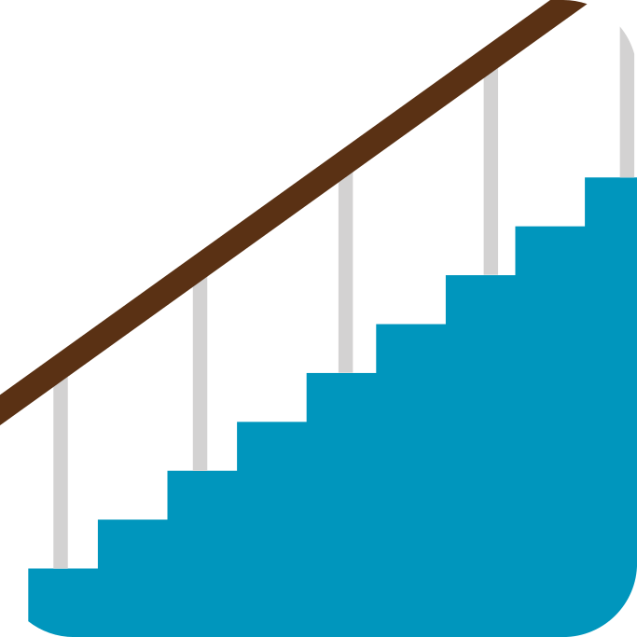
Where is Bizzy going?

Slide 26
Where is Bizzy going?
Bizzy is going up the stairs

Slide 27

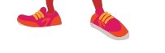
Where is Bizzy going?

Slide 28
Where is Bizzy going?
Bizzy is going down the stairs

