Slide 1

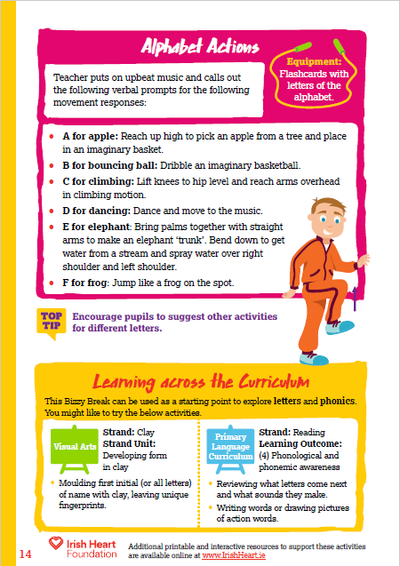

This activity can be done standing at desks with chairs pushed in. Ask pupils to ensure that they have enough space to move their arms and legs.
Music to accompany activities can be found on our Spotify playlists
Alphabet board instructions:
Select ‘Start slideshow from beginning’ (or press F5 key). This introduction slide will not be visible when presenting and just the alphabet board will be seen.
Click on a letter to highlight it and make a movement appear.
Complete the movement that corresponds with the letter.
Click on the letter again to make the picture disappear.
Find this and more activities on the Bizzy Breaks webpage.

Slide 2
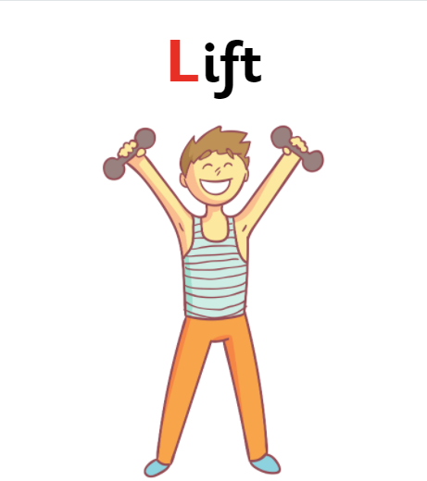
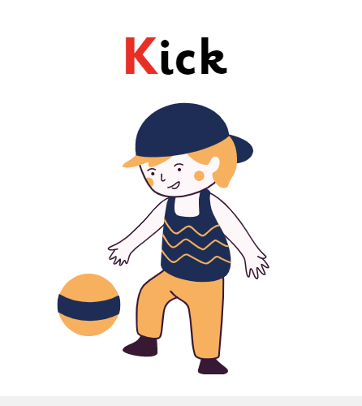
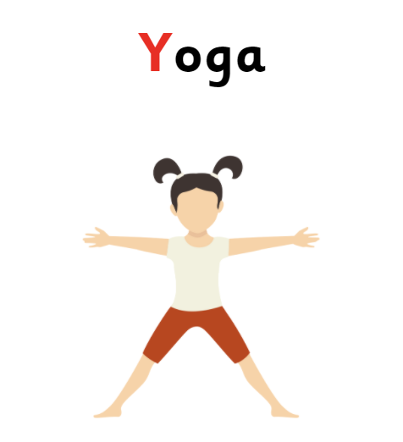
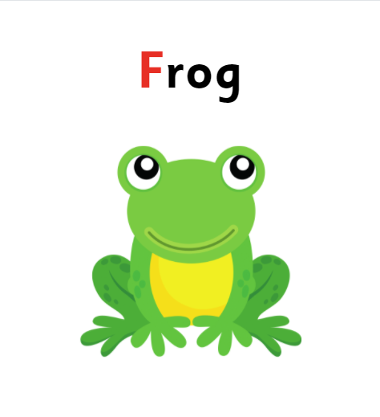
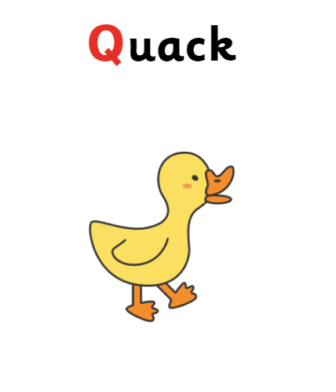
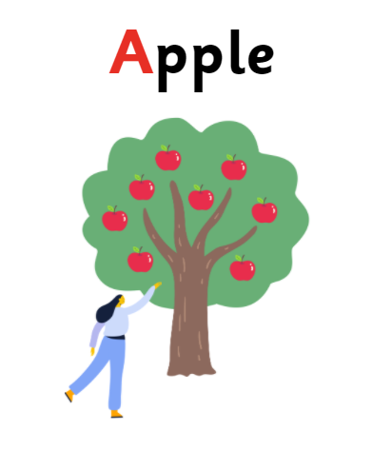


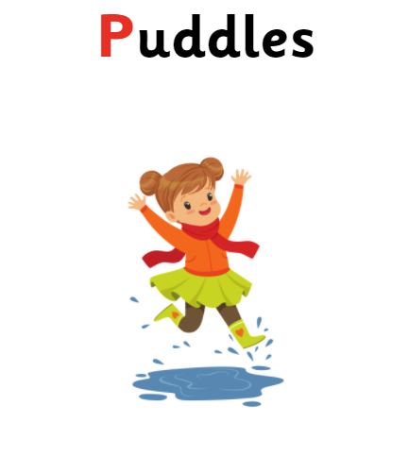
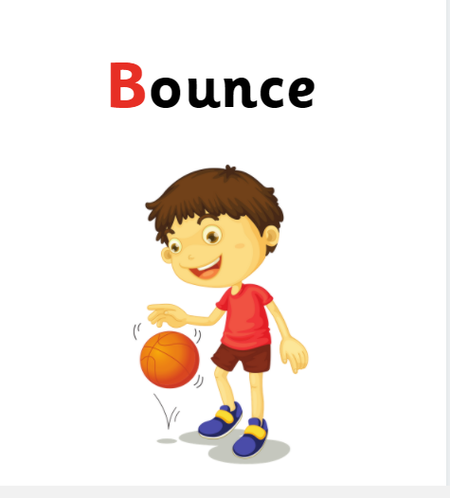
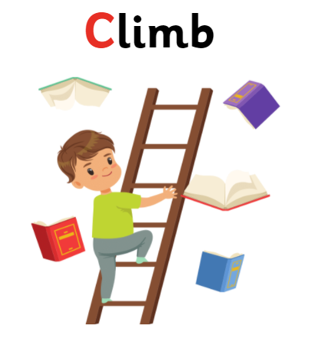


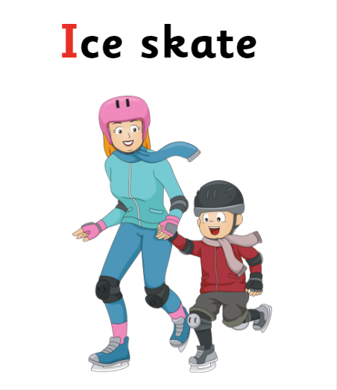

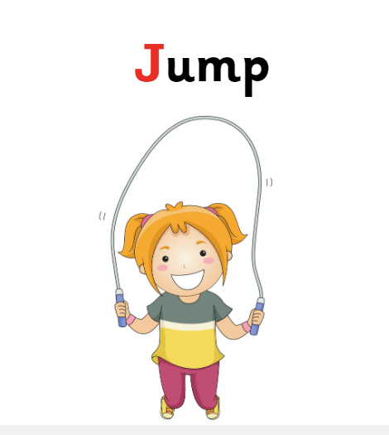
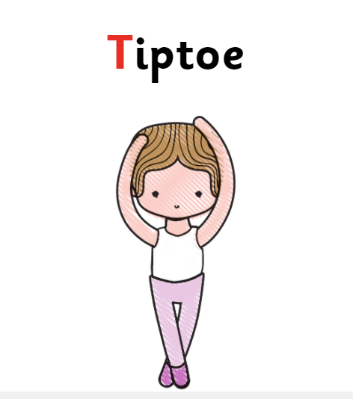
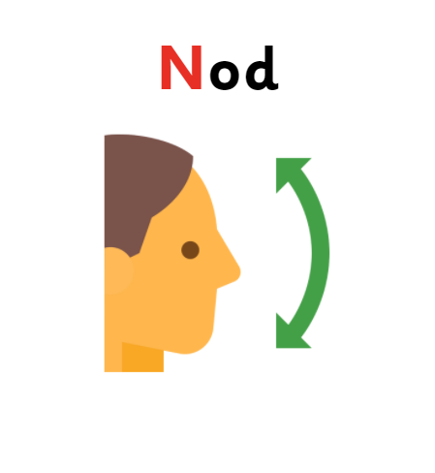

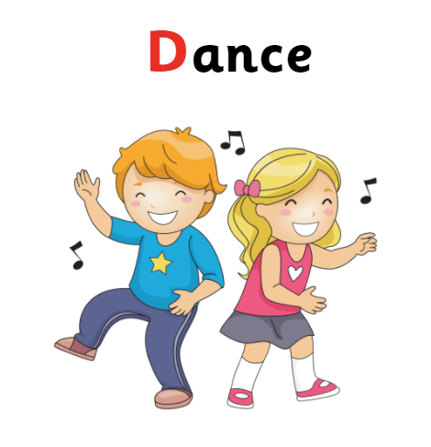
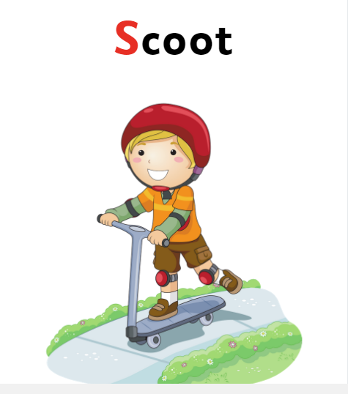
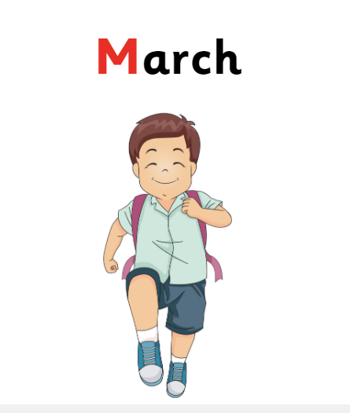
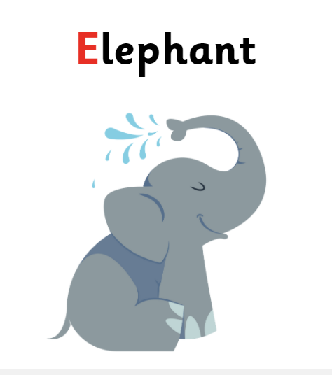


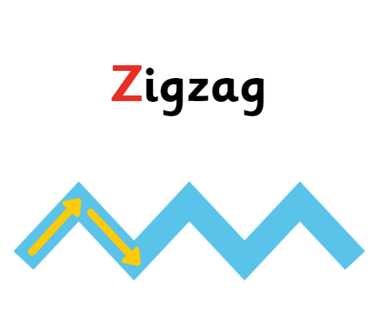

A
B
C
D
E
F
G
Lift imaginary weights up and down
Stretch arms and legs out wide
Step over (or jump into!) imaginary puddles on the floor
Move your arms in an arc over your head like a rainbow
H
I
J
K
L
M
N
Put your arms up. Move them side to side like window wipers
Slide your feet along the ground like skating
Skip with an imaginary rope
Spin your arms like a helicopter
Stand up onto your tiptoes
Dance to the music
Slide one foot on the floor like moving on a scooter
March on the spot
Put your arms together and swing them like an elephant’s trunk
Wriggle your arms and legs like an octopus
O
P
Q
R
S
T
Click on a letter for a movement to do.
Click the letter again to make it disappear.
Take a step diagonally
Pretend to hold sticks in your hand and hit keys on a xylophone
Waddle like a duck
Kick your legs (keeping your feet low)
Jump like a frog
U
V
W
X
Y
Z
Move your arms up and down like opening and closing an umbrella
Move your arms like swinging through vines in a jungle
Slowly nod your head up and down
Lift knees and reach arms up like you’re climbing a ladder
Reach arms up high like you’re picking apples from a tree
Gallop like a horse
Dribble an imaginary basketball
Find more at irishheart.ie/bizzybreaks

