Slide 1



Instructions:
Select ‘Start slideshow from beginning’ (or press F5 key). This introduction slide will not be visible when presenting.
Click on the image in the middle to start the randomiser.
Click the image in the middle again to stop.
Do the animal move that appears for 10 seconds (or
Repeat steps 2-4 for the duration of your movement break.
Press ‘Esc’ button or spacebar to finish and exit.
Find more classroom movement break activities (including videos) on the Bizzy Breaks webpage

Slide 2

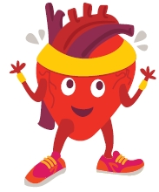
Click on the picture in the centre to start
(Click again to stop)
Move like the animal you stop on
Irishheart.ie/bizzybreaks

