Slide 1



Instructions:
Select ‘Start slideshow from beginning’ (or press F5 key). This introduction slide will not be visible when presenting.
The slides will rotate until you press the ‘S’ key on your keyboard (Press ‘S’ to pause and ‘S’ to resume)
Complete the move for 10 seconds (or as long as you choose)
Press ‘S’ to resume.
Press ‘Esc’ button to exit the slideshow.
Find this and more activities on the Bizzy Breaks webpage
Notes:
Press S to pause. Press S again to resume.
Press ESC to exit the presentation.

Slide 2

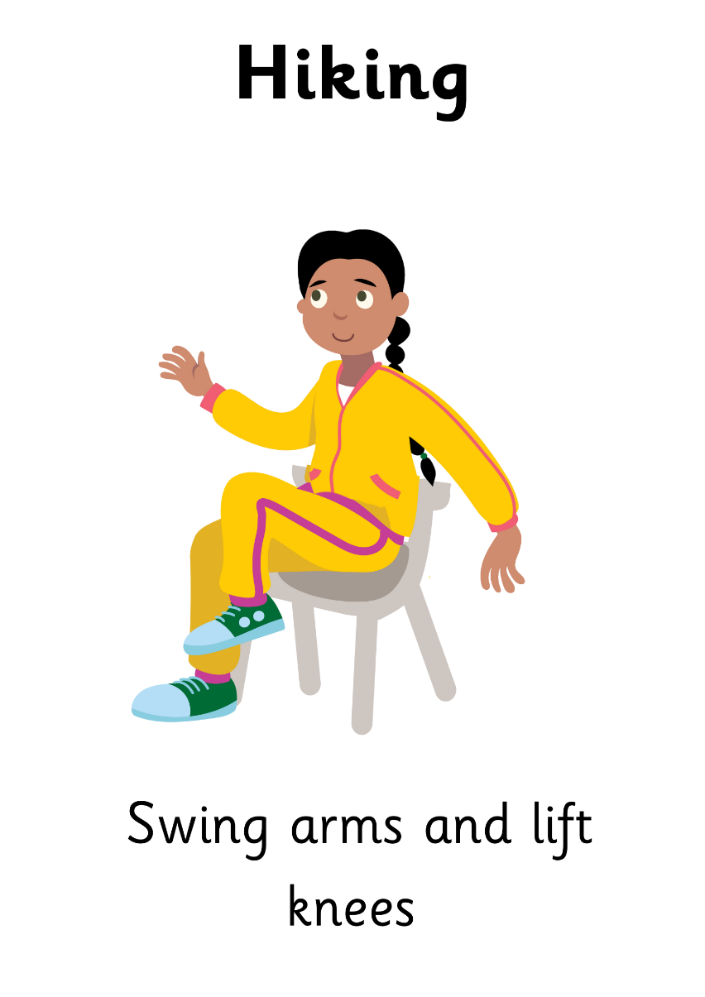


Press ‘s’ key to start and stop
Find more at Irishheart.ie/bizzybreaks
Notes:
Press S to pause. Press S again to resume.
Press ESC to exit the presentation.

Slide 3

Press ‘s’ key to start and stop
Find more at Irishheart.ie/bizzybreaks
Notes:
Press S to pause. Press S again to resume.
Press ESC to exit the presentation.

Slide 4
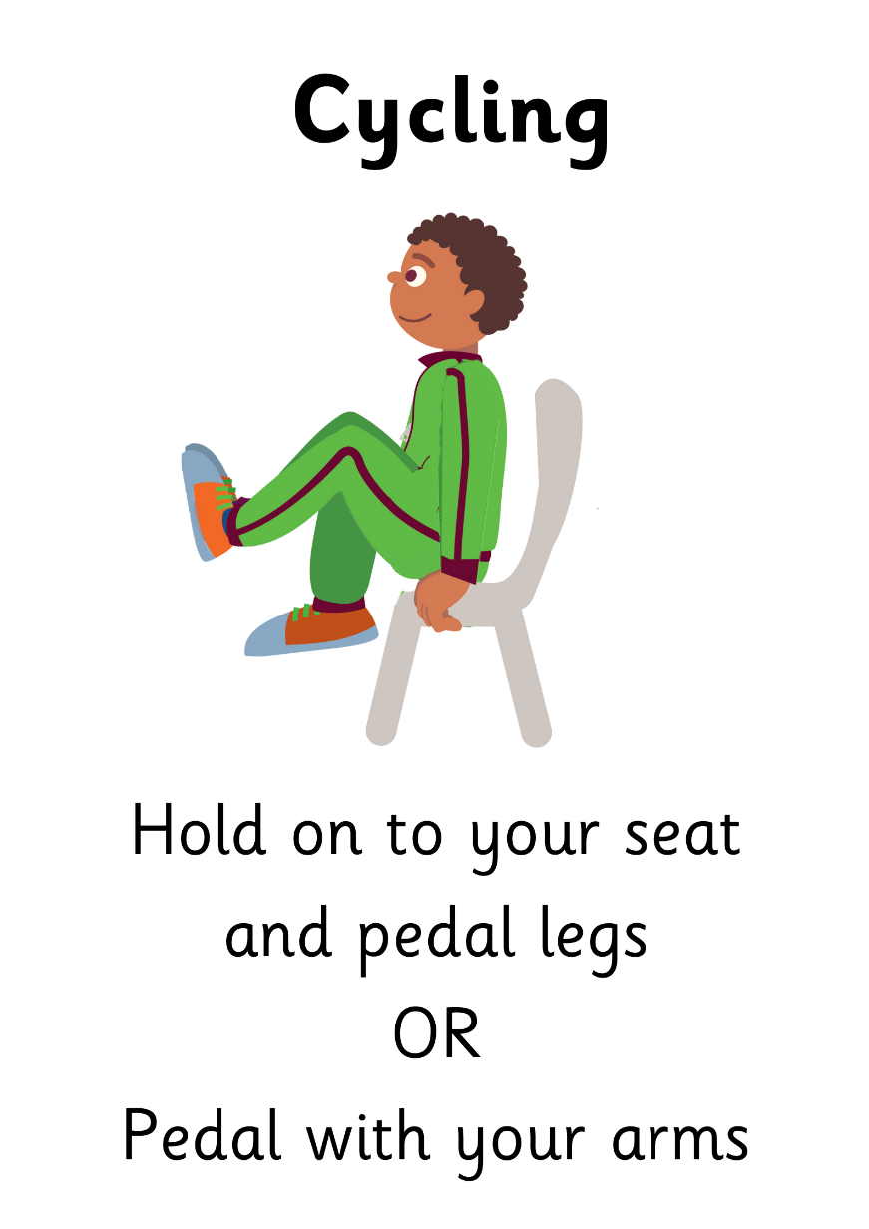
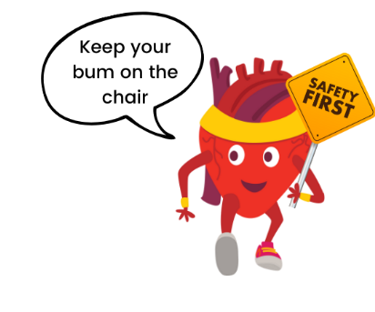
Press ‘s’ key to start and stop
Find more at Irishheart.ie/bizzybreaks
Notes:
Press S to pause. Press S again to resume.
Press ESC to exit the presentation.

Slide 5

Press ‘s’ key to start and stop
Find more at Irishheart.ie/bizzybreaks
Notes:
Press S to pause. Press S again to resume.
Press ESC to exit the presentation.

Slide 6

Press ‘s’ key to start and stop
Find more at Irishheart.ie/bizzybreaks
Notes:
Press S to pause. Press S again to resume.
Press ESC to exit the presentation.

Slide 7

Press ‘s’ key to start and stop
Find more at Irishheart.ie/bizzybreaks
Notes:
Press S to pause. Press S again to resume.
Press ESC to exit the presentation.

Slide 8
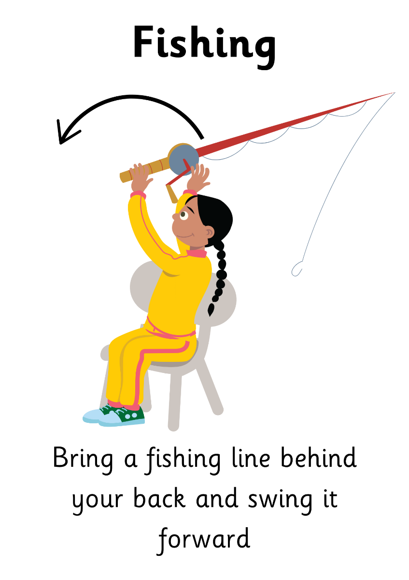
Press ‘s’ key to start and stop
Find more at Irishheart.ie/bizzybreaks
Notes:
Press S to pause. Press S again to resume.
Press ESC to exit the presentation.

Slide 9

Press ‘s’ key to start and stop
Find more at Irishheart.ie/bizzybreaks
Notes:
Press S to pause. Press S again to resume.
Press ESC to exit the presentation.

