Slide 1


Instructions:
Select ‘Start slideshow from beginning’ (or press F5 key). This introduction slide will not be visible when presenting.
Click on the dice to start rolling.
Click dice again to stop.
Complete the move for 10 seconds.
Repeat steps 2-4 for the duration of your movement break.
Press ‘Esc’ button or spacebar to finish and exit.
Find more activities (including videos) on the Bizzy Breaks webpage

Slide 2

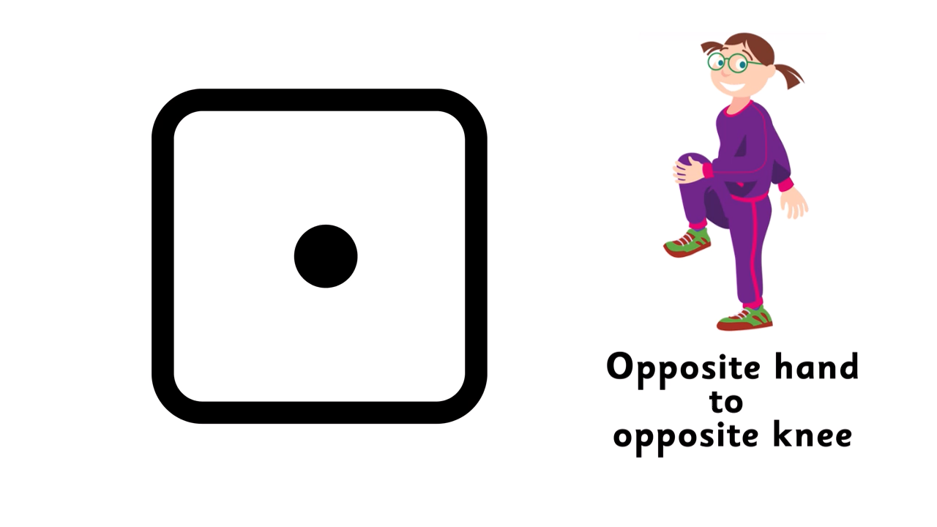
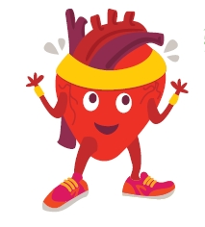
Roll the dice and do the move
Click the dice to start rolling
(Click again to stop rolling)
Irishheart.ie/bizzybreaks

