Slide 1

Note:
The slides are currently arranged alphabetically.
For your movement break, copy and paste to create more slides, then arrange them to give a variety of different movements.
You can keep it to just a few slides or lots of them, depending on how long you would like your movement break to be.
You can also right click on any slide and choose ‘Save as picture’ to save as an image to use as flashcards, or upload to a spinner wheel (e.g.https://pickerwheel.com/tools/random-image-generator/)

Slide 2
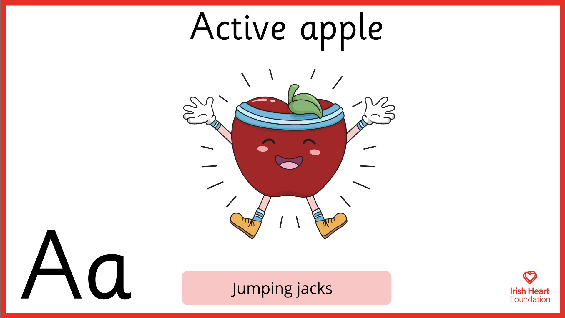

Slide 3
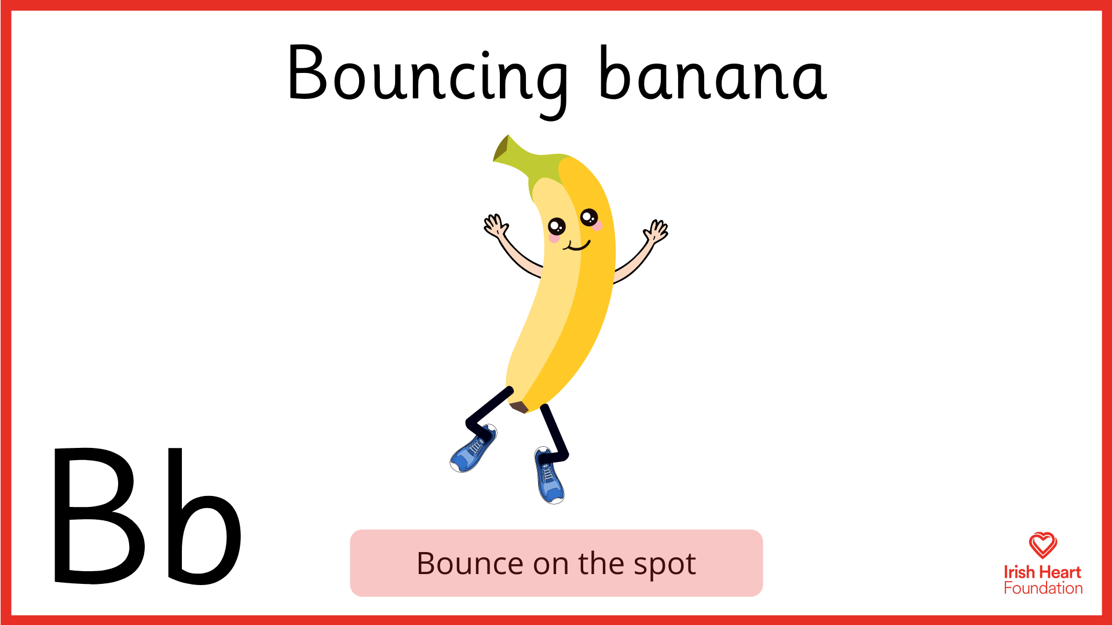

Slide 4
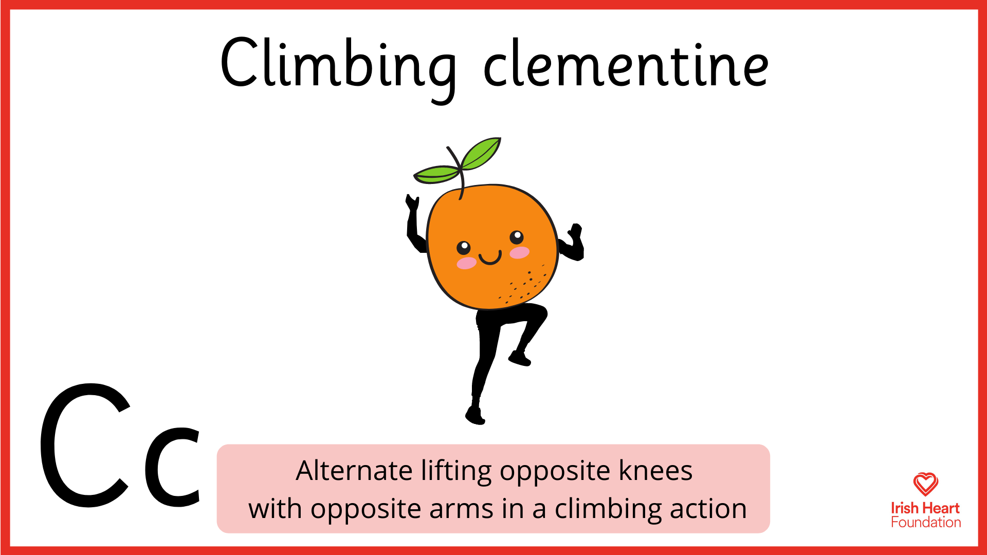

Slide 5
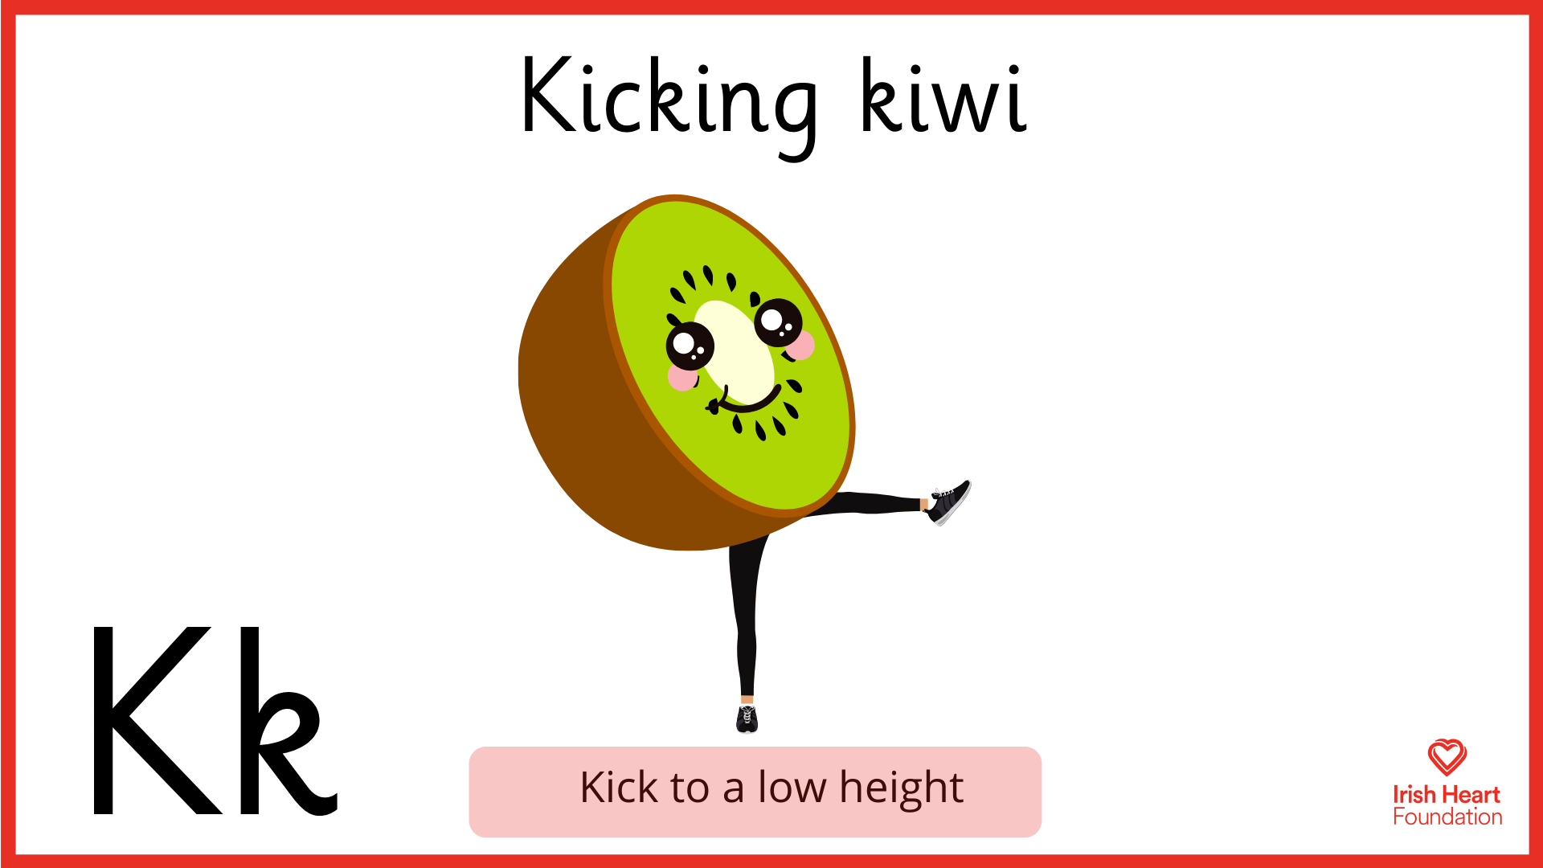

Slide 6
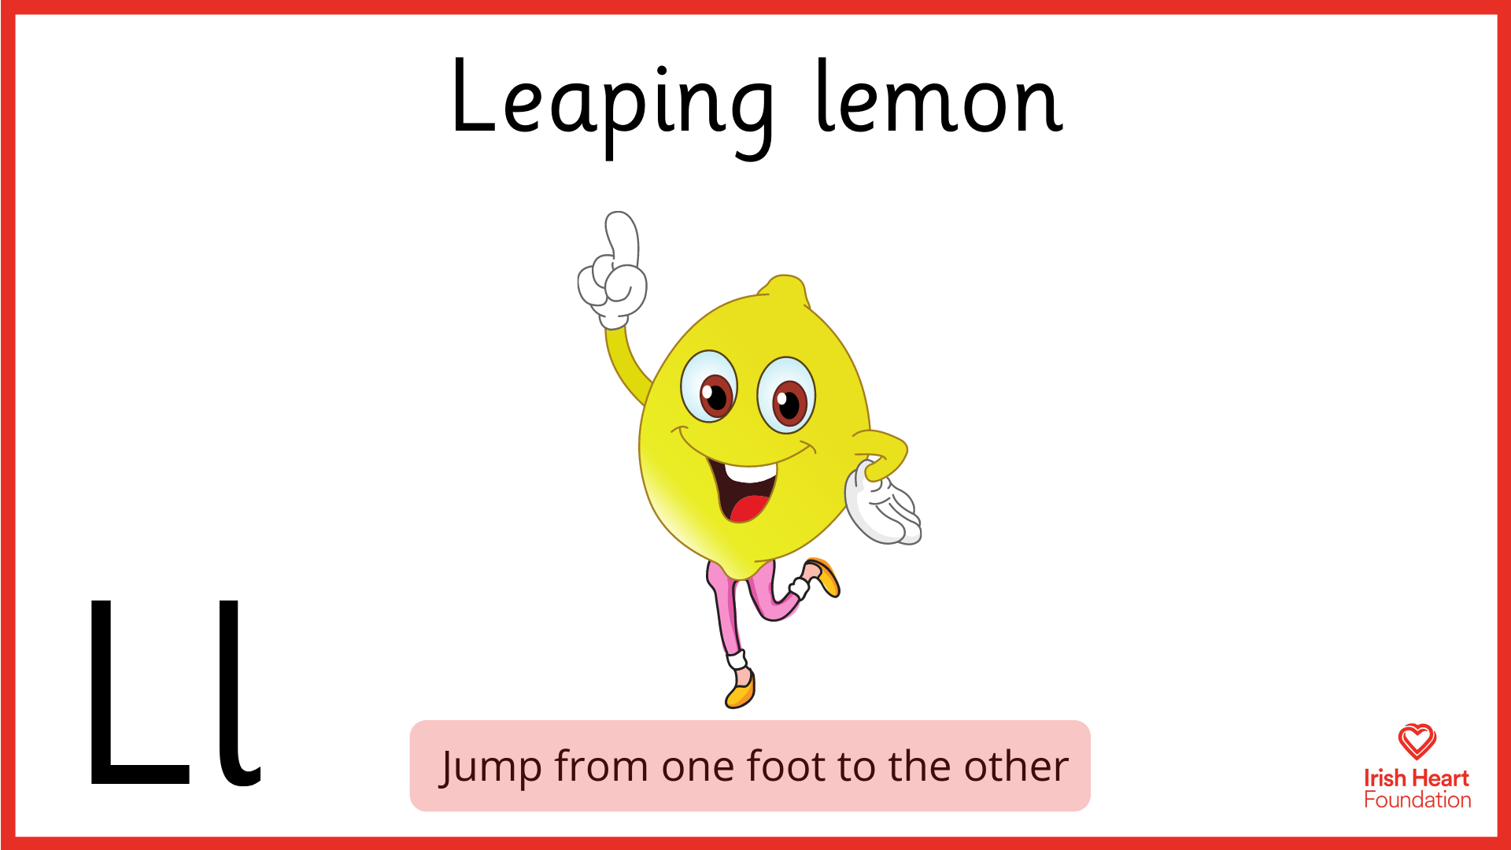

Slide 7
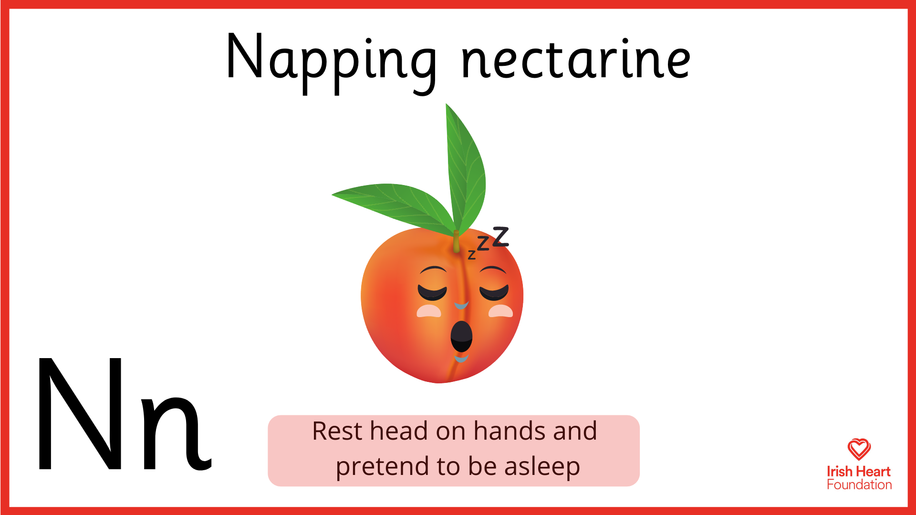

Slide 8
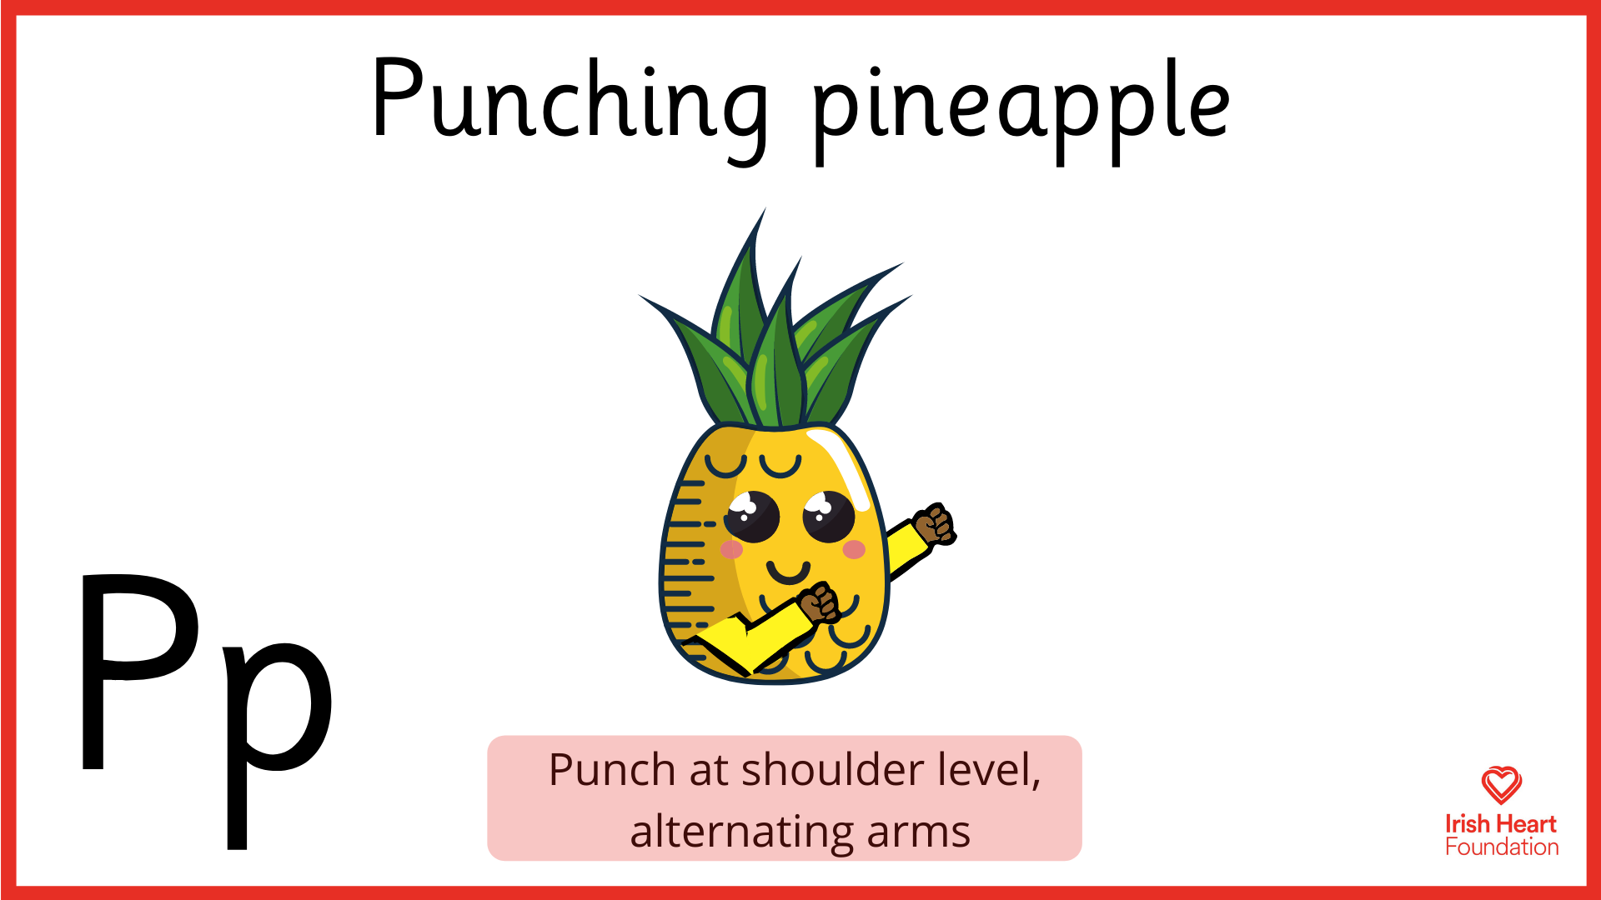

Slide 9
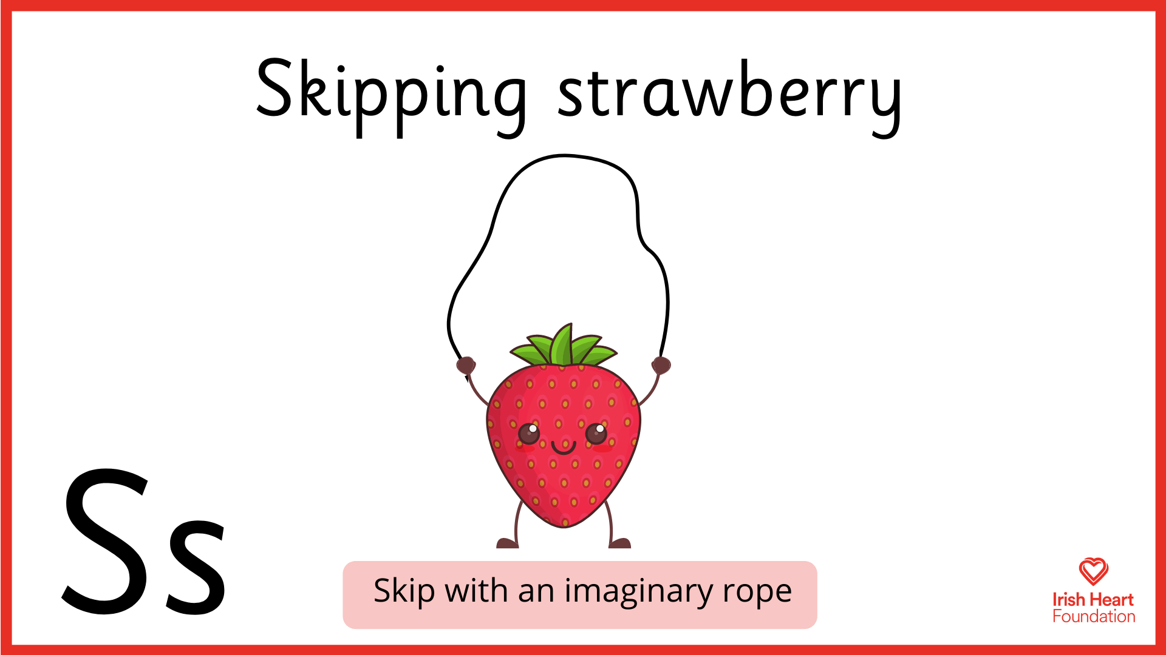

Slide 10
