Slide 1

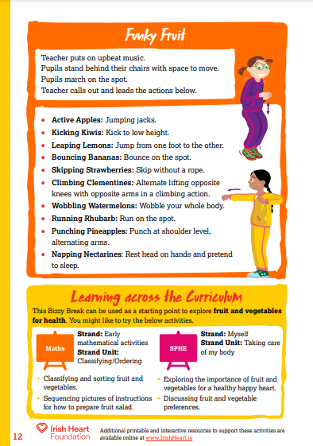

This activity can be done standing at desks with chairs pushed in. Ask pupils to ensure that they have enough space to move their arms and legs.
Music to accompany activities can be found on our Spotify playlists.
Spinning Wheel instructions:
Select ‘Start slideshow from beginning’ (or press F5 key). This introduction slide will not be visible when presenting and just the spinning wheel will be seen.
Click on the ‘SPIN’ button in the centre of the wheel to start spinning.
Click the ‘SPIN’ button again to stop.
Complete the move that the wheel lands on.
Repeat steps 2-4 for the duration of your movement break.
Press ‘Esc’ button or spacebar to finish and exit.
Find this and more activities on the full Bizzy Breaks webpage.

Slide 2





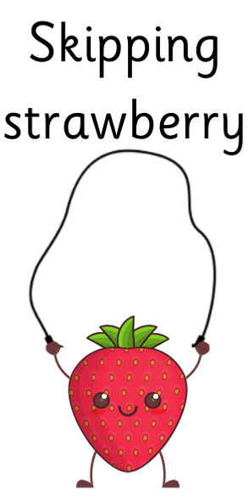
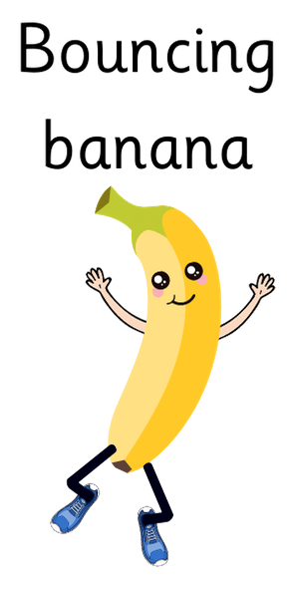


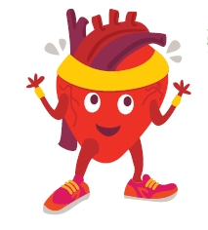
SPIN
Click the ‘SPIN’ button in the centre to start and stop the spinning wheel.
Find more at Irishheart.ie/bizzybreaks

