Slide 1


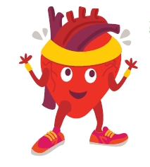


Movement Dice
Find more at Irishheart.ie/bizzybreaks

