Slide 1




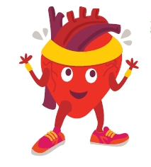
Click on present (or F5) to start slideshow.
Click on the picture in the red border to start.
Click picture again to stop, then do the animal move landed on.
Find more at Irishheart.ie/bizzybreaks

