Slide 1

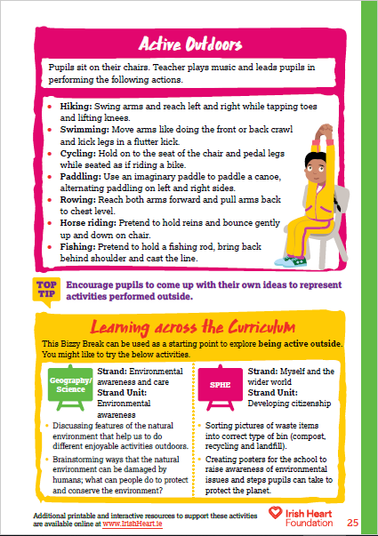

For this activity pupils sit at their chairs. Music to accompany activities can be found on our Spotify playlists. ​
Active Outdoors Instructions:
Select ‘Start slideshow from beginning’ (or press F5 key). This introduction slide will not be visible when presenting.
The slides will rotate until you press the S key.
Teacher guides pupils in the movement using the teaching notes.
Pupils will remain seated for the full activity.
Press S to pause and S to resume.
Resume the slide show and pick another activity.
Press ‘ESC’ button to exit the slideshow.
Download the original activity with teachers notes by clicking here, or find this and more activities on the full Bizzy Breaks webpage.
Notes:
Press S to pause. Press S again to resume.
Press ESC to exit the presentation.

Slide 2

Notes:
Press S to pause. Press S again to resume.
Press ESC to exit the presentation.

Slide 3

Notes:
Press S to pause. Press S again to resume.
Press ESC to exit the presentation.

Slide 4

Notes:
Press S to pause. Press S again to resume.
Press ESC to exit the presentation.

Slide 5

Notes:
Press S to pause. Press S again to resume.
Press ESC to exit the presentation.

Slide 6

Notes:
Press S to pause. Press S again to resume.
Press ESC to exit the presentation.

Slide 7

Notes:
Press S to pause. Press S again to resume.
Press ESC to exit the presentation.

Slide 8
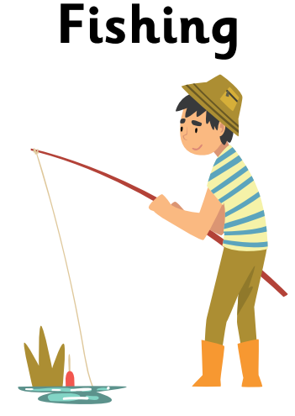
Notes:
Press S to pause. Press S again to resume.
Press ESC to exit the presentation.

Slide 9

Notes:
Press S to pause. Press S again to resume.
Press ESC to exit the presentation.

