Slide 1

Curriculum Links
SPHE - Strand: Myself Strand Unit: Taking Care of my Body
Mathematics - Strand: Data Strand Unit: Recognising and Interpreting Data
Overview
In this activity you’ll find a wide range of classification and sorting for fruit & vegetables. We’ve provided a number of slides which are differentiated in level depending on the ability of your class. This activity is designed with logical reasoning in mind in a fun and game like fashion all while gaining a deeper recognition of fruit & vegetables.
Learning Outcome Pupils will recognise fruit and vegetables . Pupils will classify and interpret fruit and vegetables with various variables.
Teaching Notes
All of these fruit and vegetables are listed on the Flashcards. Use these Flashcards in advance of the lesson to familiarize pupils with the fruit and vegetables and their classification.
The difficulty will advance throughout the slide show.
Slides 1-6 – These slides have a mix of fruit and vegetable. Ask pupils to classify if the flashcard is a fruit or vegetable.
Slides 7-10 – These slides have a mix of fruit and vegetables of the same colour. Pupils will be asked to pick out either all fruit or all vegetable of that colour.
Slides 11-14 – These slides have a mix of fruit and vegetables of different colours. Pupils will be asked to pick out a certain colour of fruit or vegetable. For example green vegetables or red fruit.
Fruit & Vegetable Classification

Slide 2
How to use this slide show
1. Select ‘Start slideshow from beginning’ (or press F5 key).
You will see a series of fruit and vegetables. Your pupils will be familiar with these from the flashcards. Ask the pupils which category the flashcard goes into. When you click on the picture it will sort itself into the correct category.
*Please note if you click anywhere else on the page it will skip forward to the next slide. If this happens just press back to the slide you missed. You can do this by pressing the up arrow on your keyboard.
2. Click on any flashcard and it will sort into the correct category. It doesn’t matter which flashcard you click on first.
If you click on an incorrect answer the flashcard will not move. For example if the classification is green fruit and you click lettuce the flashcard will not move. You can signal to the class that this is an incorrect classification and prompt for another answer.
3. Click on the white space to move onto the next slide or press the down arrow.
4. Test it out yourself before you try it with the class to get used to the format.
Fruit & Vegetable Classification

Slide 3
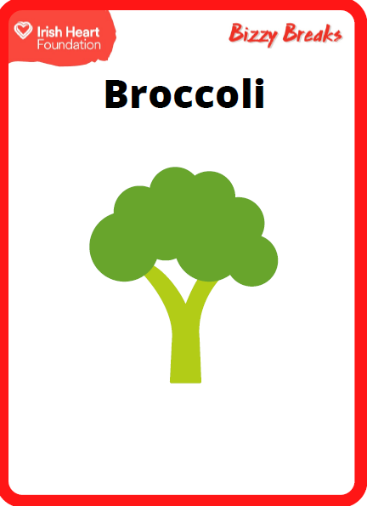
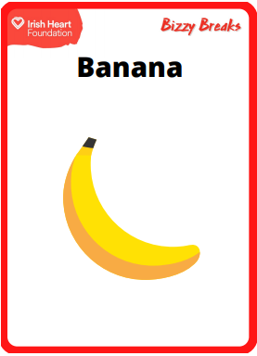
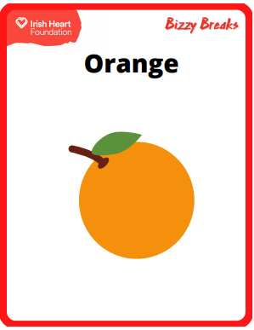
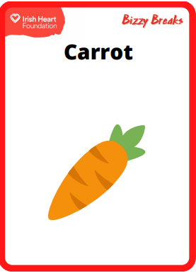
Are these foods fruit or vegetables? Sort them into the right box. Click on food to see if you’re right.
Fruit
Vegetable

Slide 4
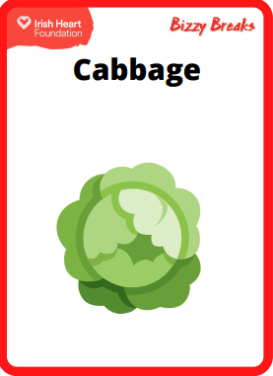
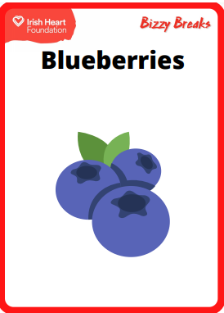
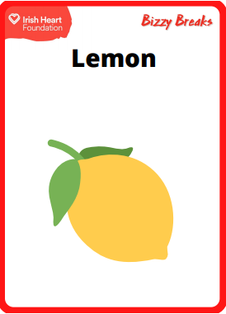
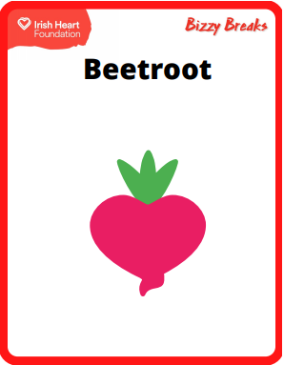
Are these foods fruit or vegetables? Sort them into the right box. Click on food to see if you’re right.
Fruit
Vegetable

Slide 5
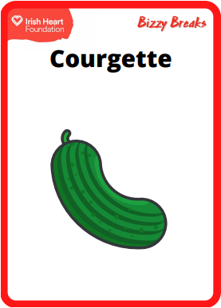
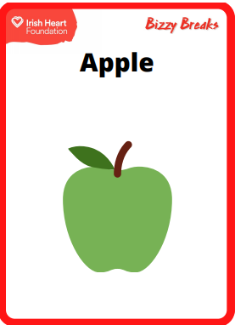

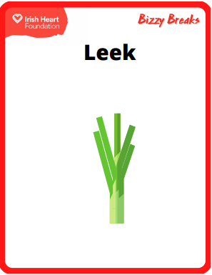
Are these foods fruit or vegetables? Sort them into the right box. Click on food to see if you’re right.
Fruit
Vegetable

Slide 6

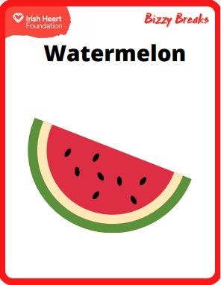
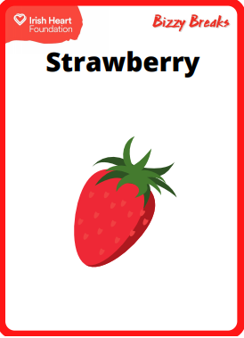
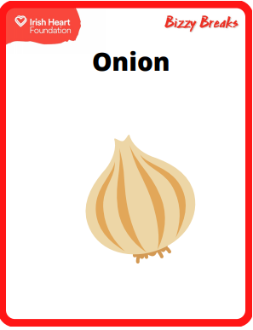
Are these foods fruit or vegetables? Sort them into the right box. Click on food to see if you’re right.
Fruit
Vegetable

Slide 7
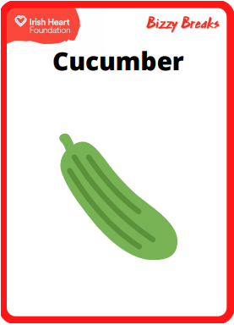

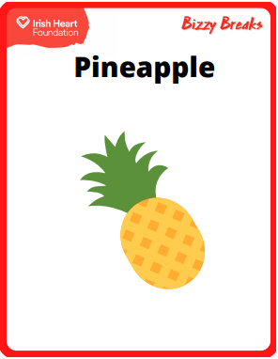
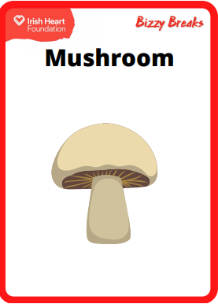
Are these foods fruit or vegetables? Sort them into the right box. Click on food to see if you’re right.
Fruit
Vegetable

Slide 8
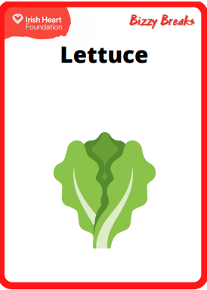
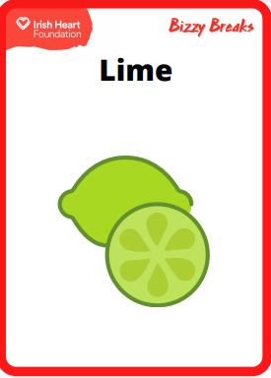
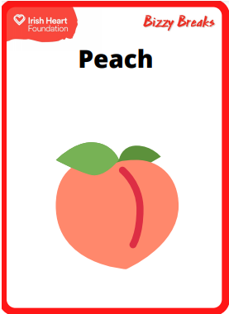
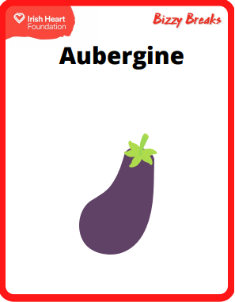
Are these foods fruit or vegetables? Sort them into the right box. Click on food to see if you’re right.
Fruit
Vegetable

Slide 9
Can you find the green fruit? Sort them into the right box. Click on food to see if you’re right.
Green
Fruit =

Slide 10
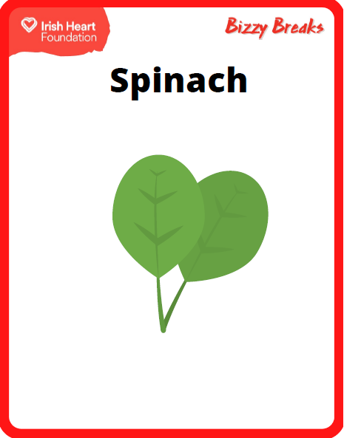
Can you find the green vegetables? Sort them into the right box. Click on food to see if you’re right.
Green
Vegetable =

Slide 11
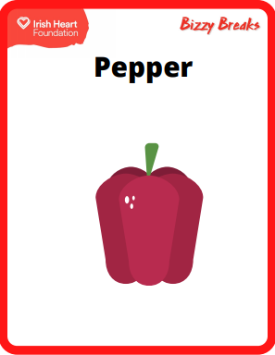
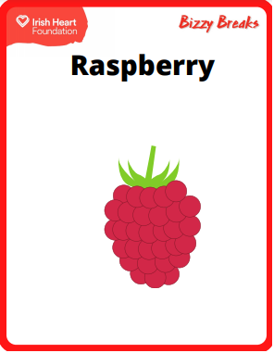
Can you find the red fruit? Sort them into the right box. Click on food to see if you’re right.
Red
Fruit =

Slide 12
Can you find the yellow fruit? Sort them into the right box. Click on food to see if you’re right.
Yellow
Fruit =

Slide 13
Can you find the green fruit? Sort them into the right box. Click on food to see if you’re right.
Green
Fruit =

Slide 14
Can you find the yellow fruit? Sort them into the right box. Click on food to see if you’re right.
Yellow
Fruit =

Slide 15
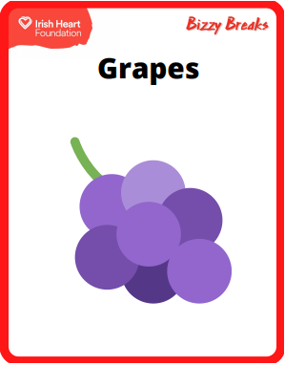

Can you find the green vegetables? Sort them into the right box. Click on food to see if you’re right.
Green
Vegetable =

Slide 16
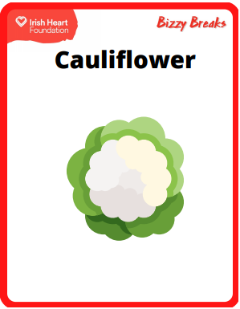
Can you find the red fruit? Sort them into the right box. Click on food to see if you’re right.
Red
Fruit =

Slide 17

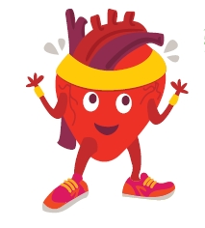
Congratulations! You have reached the end of the slideshow. We hope you have learned loads of new fruit and vegetables.

