Slide 1
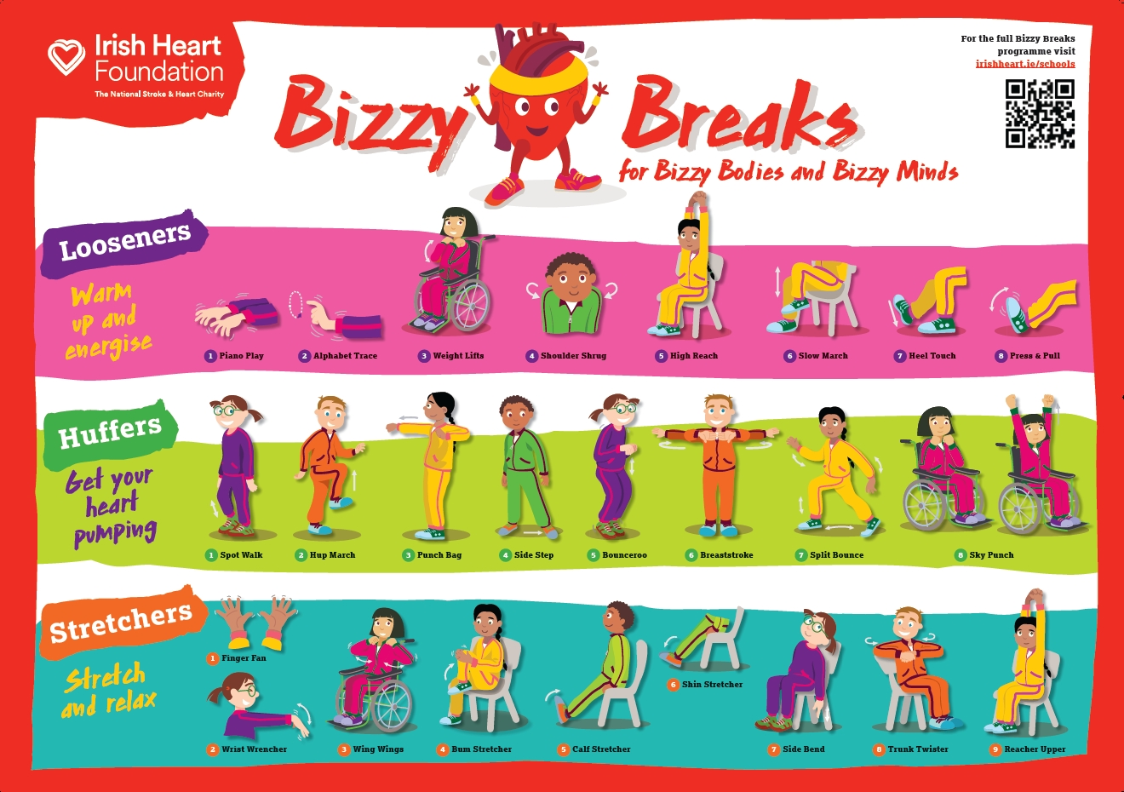
This presentation will guide you through the Bizzy Breaks poster.
All movements are included with illustrations, descriptions and timings.
This interactive presentation allows you to choose how many times to repeat each section.
Music
Choose your own music for each section
(our Spotify playlists below have some suggestions)
Looseners playlist
You can also find full follow-along videos with music on the Bizzy Breaks poster page (full poster) and on the videos page (individual videos for Looseners, Huffers and Stretchers).
Huffers playlist
Stretchers playlist

Slide 2

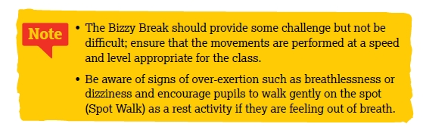
How to use this presentation guide:
Select ‘Start slideshow from beginning’ (or press F5 key). The first slide will be a navigation slide which displays each section you can move to. The first two slides will not appear in the slide show.
Click on the top image and invite pupils to do the Space Check and Seat Check to ensure safety and comfort. Press the right arrow button and you will be returned to the navigation slide.
Put on music for the relevant section (Looseners, Huffers or Stretchers) and click on the corresponding image to start the movements for that section. Do not click through each slide during the slideshow as a countdown timer for each movement is included and the next slide will appear automatically.
Each time you finish a section, you will be returned to the navigation pane; you can choose to repeat the section again, or move onto the next one, by clicking on the relevant picture.

Slide 3
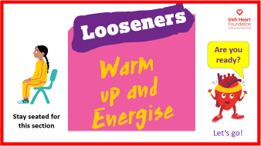
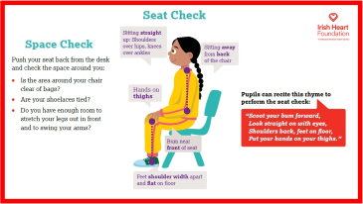
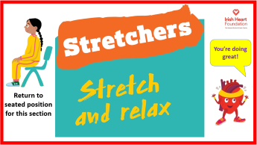

Click on an image below to go to that section
Link to Spotify playlist for Looseners: tiny.cc/BizzyBreaks1
Link to Spotify playlist for Huffers:
tiny.cc/BizzyBreaks2
Link to Spotify playlist for Stretchers:
tiny.cc/BizzyBreaks3

Slide 4
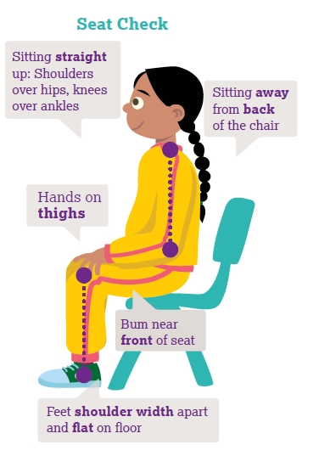
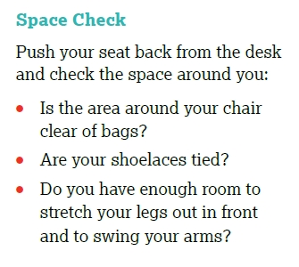
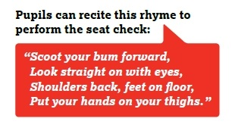

Slide 5
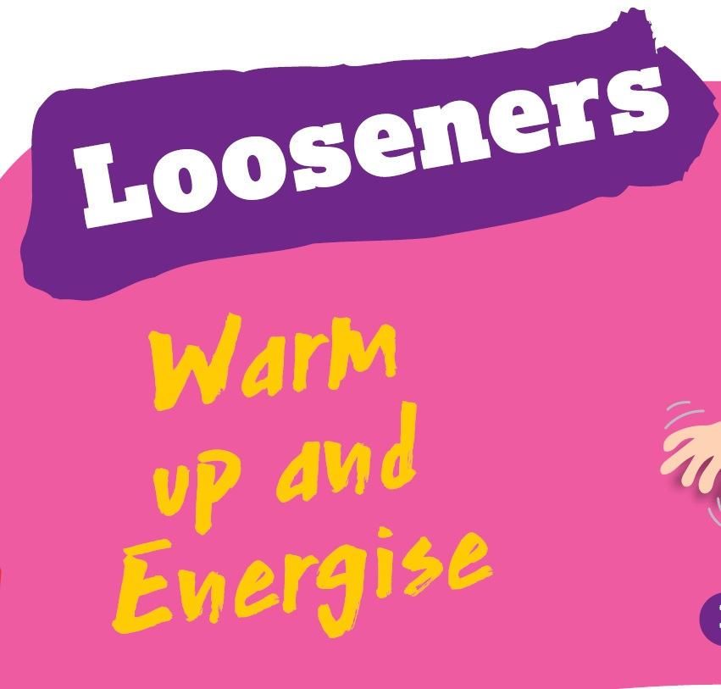
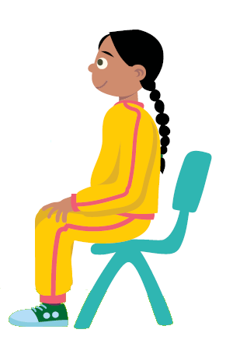
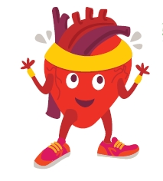
Are you ready?
Stay seated for this section
Let’s go!

Slide 6
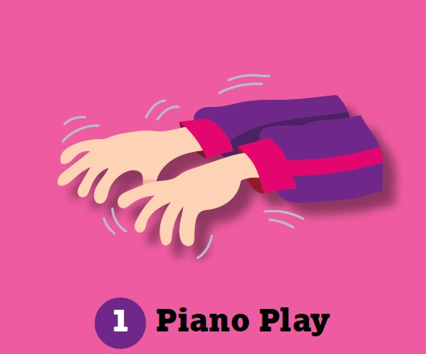
• Hold arms out in front and spread fingers.
• Wiggle fingers and thumbs.
• Make long careful movements.
Repeat for 8…
1
2
3
4
5
6
7
8

Slide 7
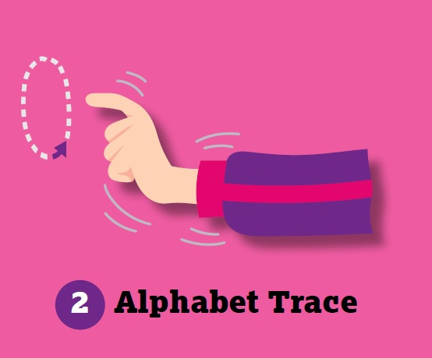
• Keep arms out in front.
• Point index fingers (like you are conducting an orchestra).
• Circle the wrists to make the letter ‘O’.
• Make circles in both directions.
Repeat for 8…
1
2
3
4
5
6
7
8

Slide 8
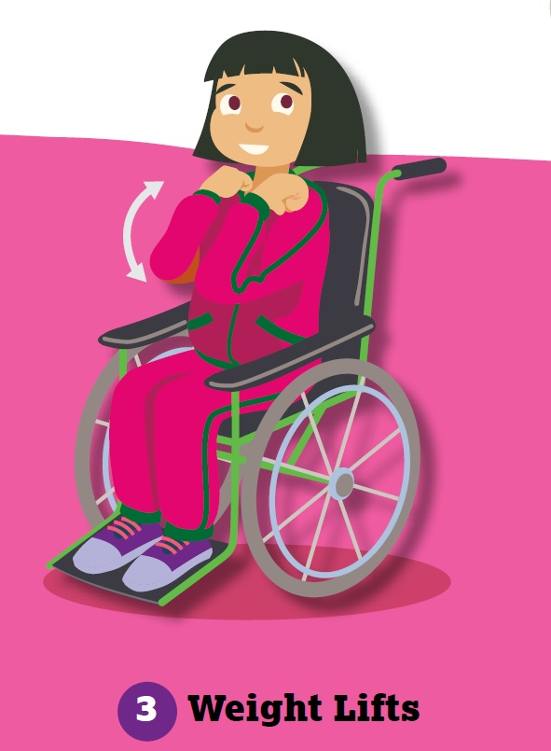
• Start with hands on lap.
• Make fists with palms facing up.
• Pretend to move imaginary weights up to shoulders and back down again.
Repeat for 8…
1
2
3
4
5
6
7
8

Slide 9
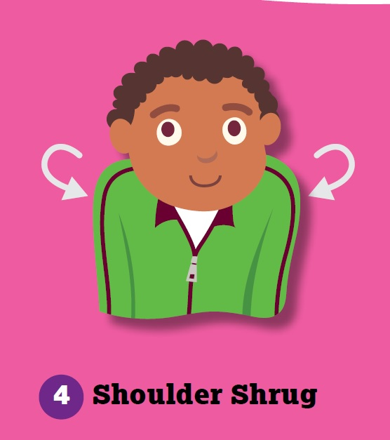
• Allow arms to hang loose.
• Rotate shoulders upwards and forwards.
Repeat for 8…
1
• Now rotate shoulders the opposite direction (upwards and backwards).
2
3
4
5
6
7
8
1
2
3
4
5
6
7
8

Slide 10
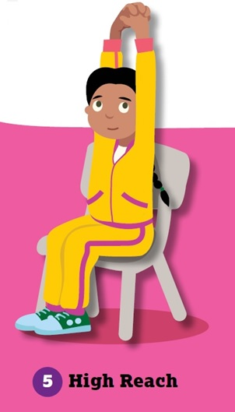
Reach arms up high.
Interlock fingers with palms facing down.
Lean gently to left (lean from waist keeping hips and bum in place).
Lean back to centre (reaching up high).
Lean to the right.
Continue, returning to the centre each time.
Repeat for 8…
1
2
3
4
5
6
7
8

Slide 11
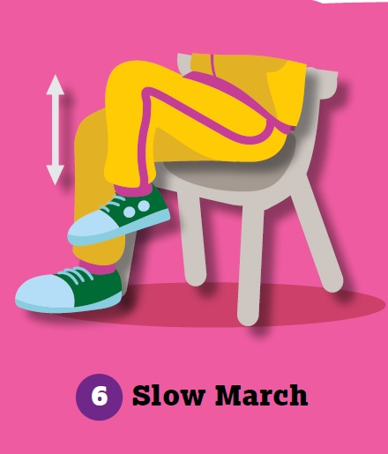
• March on the spot slowly while sitting in the chair.
• Lift knees high.
Repeat for 8…
1
2
3
4
5
6
7
8

Slide 12
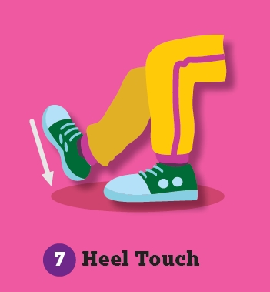
Start with both feet flat on the ground.
Keeping one foot flat on floor, step heel of other foot forward to touch the ground with toes facing up.
Keep a slight bend at the knee.
Return to starting position and repeat with opposite heel.
Continue alternating heels.
Repeat for 8…
1
2
3
4
5
6
7
8

Slide 13
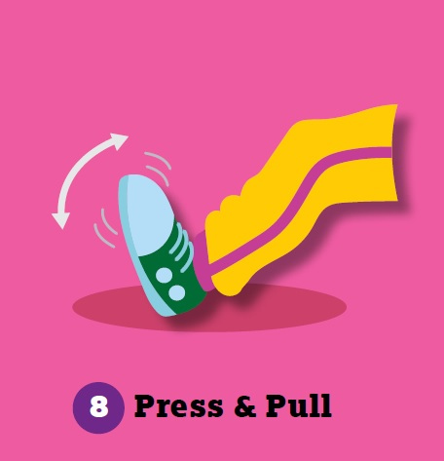
• Place both heels on the floor.
• Pull toes upwards to point at face, hold for a beat, then point toes
forward.
Repeat for 8…
1
2
3
4
5
6
7
8

Slide 14

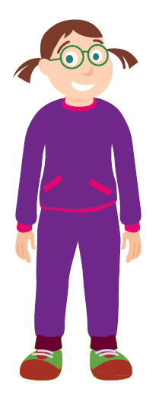
Let’s go!
Stand up for this section

Slide 15
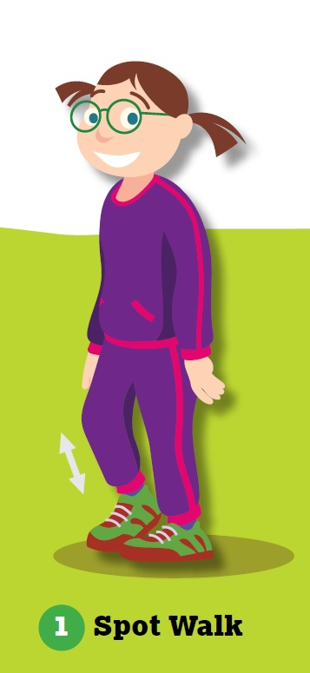
Take small steps on the spot.
Use this action as a transition between movements or as a rest activity if over-exerted.
Repeat for 8…
1
2
3
4
5
6
7
8

Slide 16
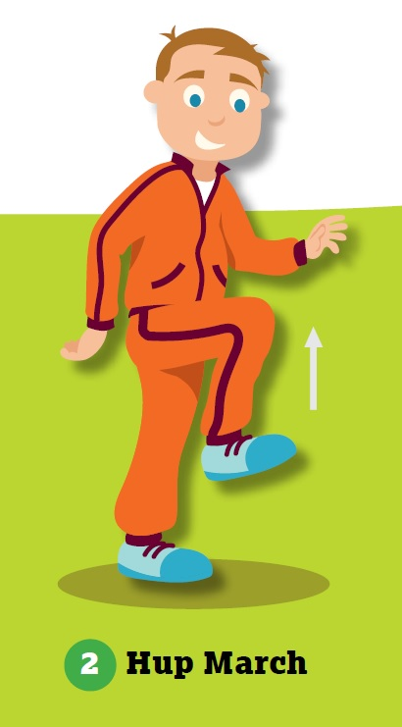
March on the spot – bringing the knees up high and swinging arms.
(Optional)
More Action: Bring knees higher and pump arms.
Repeat for 8…
1
2
3
4
5
6
7
8

Slide 17
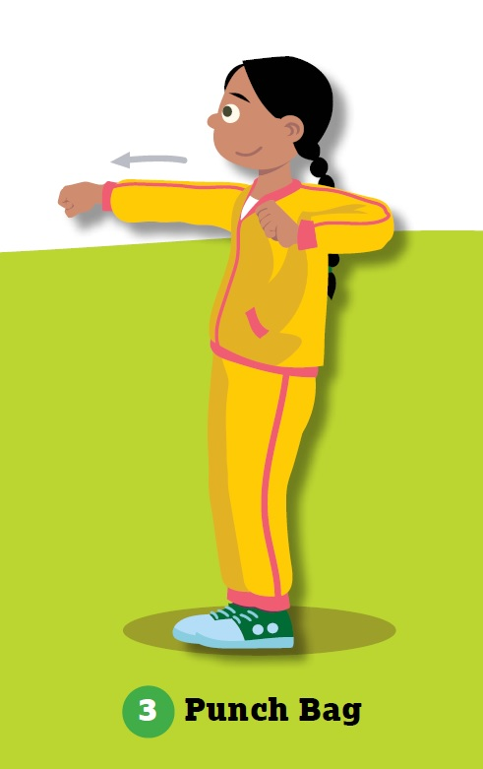
Pretend you are punching an imaginary punching bag.
Do not straighten the arm fully when punching.
(Optional)
More Action: If space allows, add some foot shuffling side to side or backwards and forwards.
Repeat for 8…
1
2
3
4
5
6
7
8

Slide 18
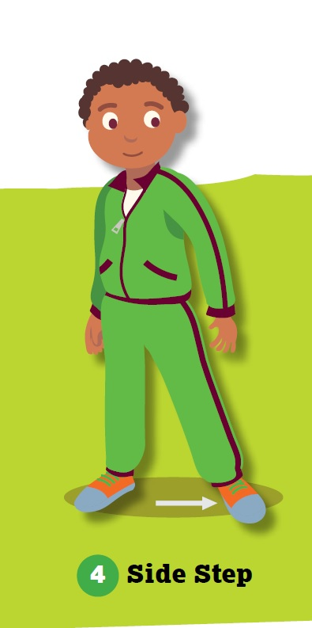
Take a wide step to the side.
Slide the other foot over to bring the two feet together.
Repeat, stepping to the opposite side.
(optional)
More Action: Bend elbows with palms facing forward in front of shoulders, make circles with hands to the left or right in the direction of the step.
Repeat for 8…
1
2
3
4
5
6
7
8

Slide 19
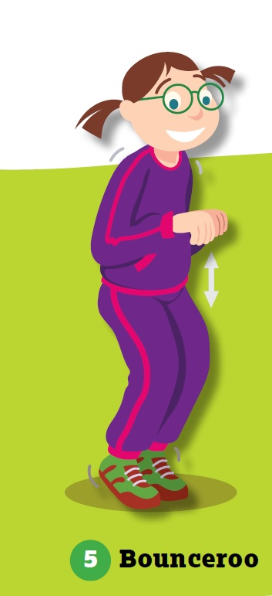
Bounce with both feet.
Land each time on the balls of the feet with knees slightly bent.
(optional)
More Action:
Push arms forward and out with each bounce.
Repeat for 8…
1
2
3
4
5
6
7
8

Slide 20
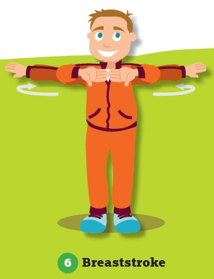
Hold arms at chest level.
Mimic swimming action of breaststroke (bring hands together at chest, push hands forward, spread arms wide and bring arms back to chest).
(optional)
More Action: Stand with feet hip-distance apart and squat slightly with each stroke.
Repeat for 8…
1
2
3
4
5
6
7
8

Slide 21
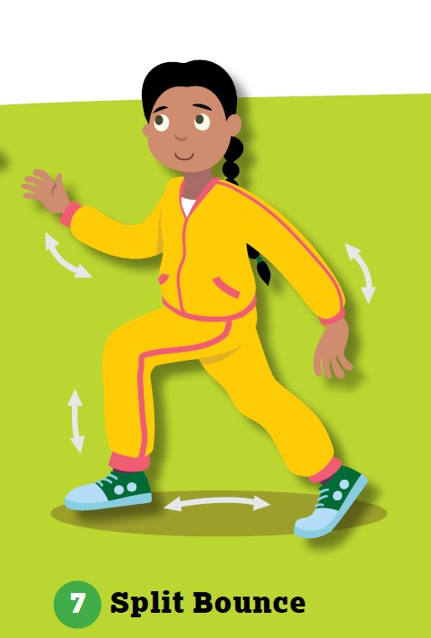
Stand with one foot behind, one foot in front.
Bounce, switching legs with each jump.
(optional)
More Action: Move arms in opposition to legs with each bounce.
Repeat for 8…
1
2
3
4
5
6
7
8

Slide 22
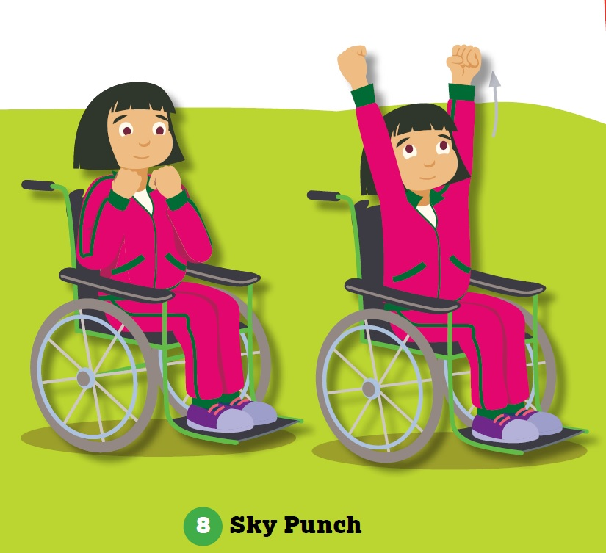
Make two fists with hands at shoulder level.
Punch both arms upwards (keeping a slight bend in the arm).
Return to shoulder level.
(optional)
More Action: Kick leg out in front, alternating legs
Repeat for 8…
1
2
3
4
5
6
7
8

Slide 23


You’re doing great!
Return to seated position for this section

Slide 24
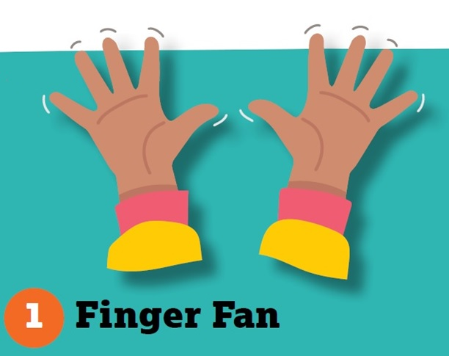
Spread fingers and thumbs to stretch out hands.
Hold for 6…
1
2
3
4
5
6

Slide 25
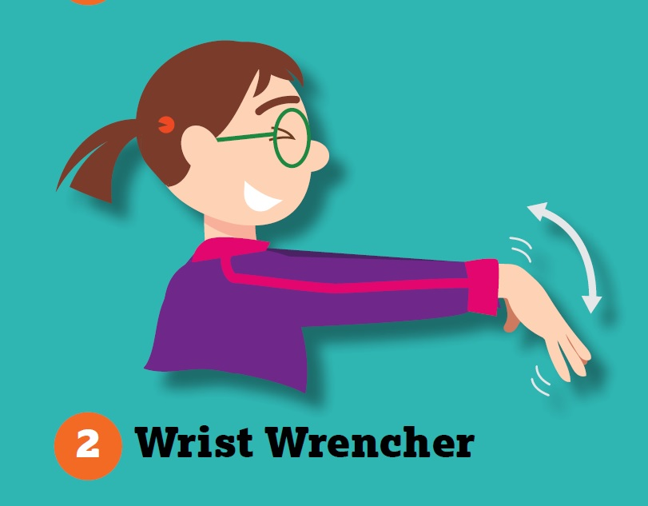
Hold arms straight out in front with palms facing down:
• Slowly bend wrists so that fingers are pointing down
Hold for 6…
1
2
3
4
5
6
• Slowly bend the opposite way so that fingers point up.
Hold for 6…
1
2
3
4
5
6

Slide 26
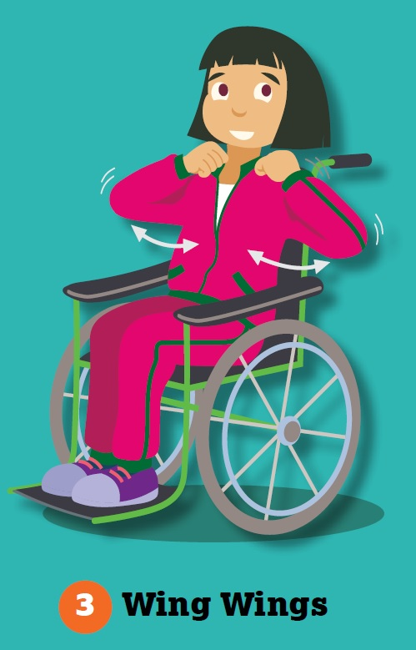
Place hands on shoulders with elbows bent:
Stretch elbows outwards like wings
Hold for 6…
1
2
3
4
5
6
Move elbows close together, feeling a stretch in the shoulders and upper back
Hold for 6…
1
2
3
4
5
6

Slide 27
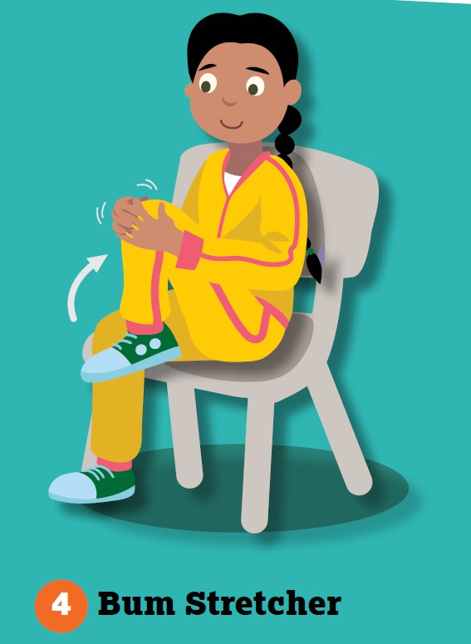
Raise one knee and wrap arm around it.
Pull knee gently towards chest.
Hold for 6…
1
2
3
4
5
6
Repeat for other leg.
Hold for 6…
1
2
3
4
5
6

Slide 28
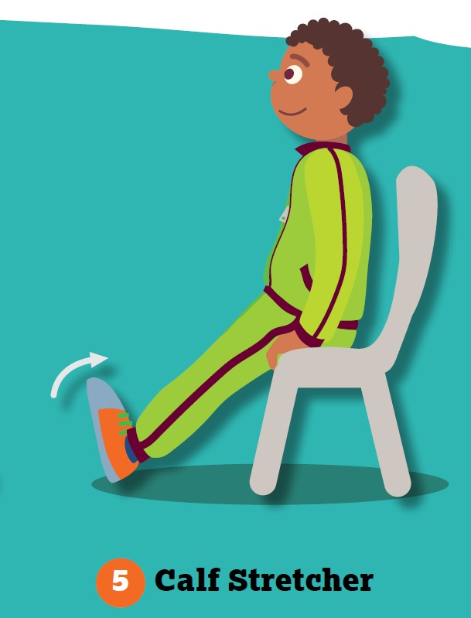
• Move both heels forward until legs are almost straight.
• With heels on floor, point toes back towards face to feel stretch along back of lower leg.
Hold for 6…
1
2
3
4
5
6
(Remain in position for next movement)

Slide 29
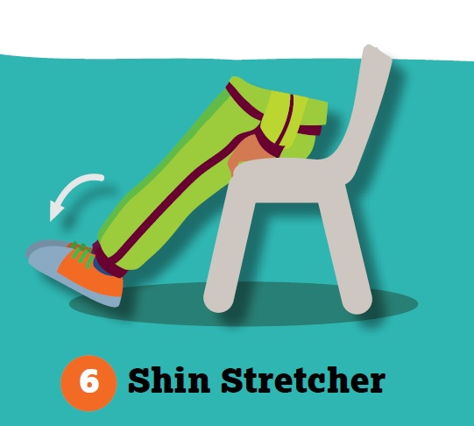
• Sitting with legs straight and heels on floor from Calf Stretcher
• Push toes forward, feeling the stretch along the front of lower leg.
Hold for 6…
1
2
3
4
5
6

Slide 30
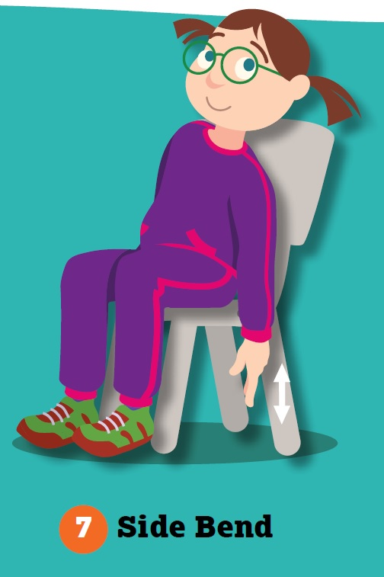
Keeping arms relaxed by side, lean from the waist to the left side.
Let the ear fall to the shoulder to stretch the neck.
Hold for 6…
1
2
3
4
5
6
Return to centre and repeat on the opposite side.
Hold for 6…
1
2
3
4
5
6

Slide 31
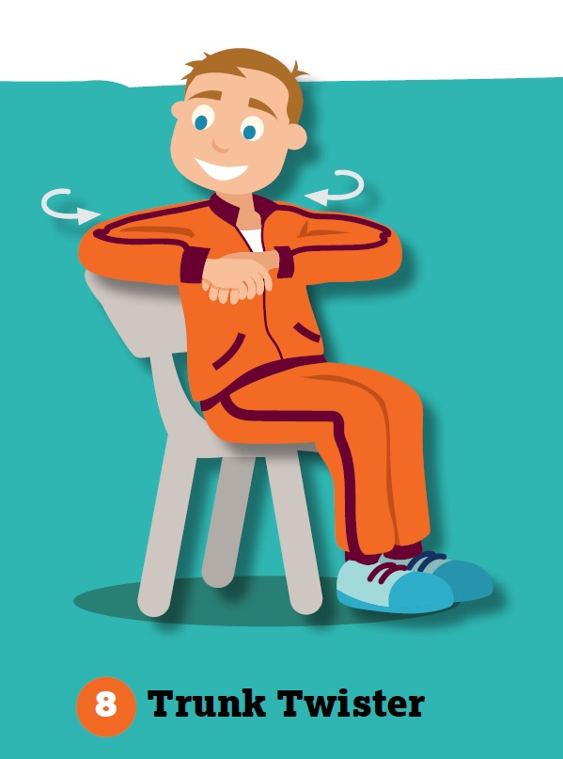
Clasp hands together and raise arms to shoulder level.
Slowly twist to right and look over the shoulder.
Hold for 6…
1
2
3
4
5
6
Repeat on opposite side.
Hold for 6…
1
2
3
4
5
6

Slide 32
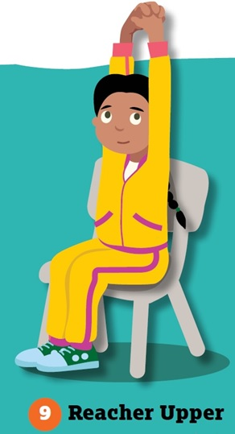
With fingers clasped, raise both arms above the head.
Stretch arms up towards the ceiling.
Hold for 6…
1
2
3
4
5
6

Slide 33
You have completed this Bizzy Break
Well done!
You did it!

